Slide 1

VSG CHRISTMAS
QUIZ!

Slide 2
Round 1
CHRISTMAS
PAST

Slide 3
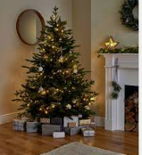
What year did Prince Albert first bring a Christmas tree to Britain?
1834
1848
1863

Slide 4
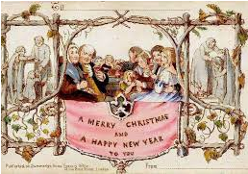
Henry Cole introduced the idea of Christmas cards in 1843. But how much did it cost to send a Christmas card that year?
1d
2d
6d

Slide 5
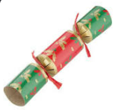
Tom Smith invented the Christmas cracker in 1846. But what kind of shop did he own?
Chemist shop
Sweet shop
Toy shop

Slide 6
Wonder Balls were very popular at Christmas in Victorian Britain, but what were they?
An everlasting gobstopper with many different layers of flavours.
A decadent party with lots of lights, festive food and performers to wow guests.
A present made from a ball of yarn with small gifts hidden inside.

Slide 7
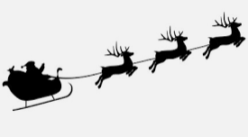
Santa Claus and Father Christmas are modern versions of St Nicholas. What colour suit does St Nicholas wear?
Red
Green
White

Slide 8
Round 1
CHRISTMAS
PAST
ANSWERS

Slide 9
What year did Prince Albert first bring a Christmas tree to Britain?
1834
1848
1863

Slide 10
Henry Cole introduced the idea of Christmas cards in 1843. But how much did it cost to send a Christmas card that year?
1d
2d
6d

Slide 11
Tom Smith invented the Christmas cracker in 1846. But what kind of shop did he own?
Chemist shop
Sweet shop
Toy shop

Slide 12
Wonder Balls were very popular at Christmas in Victorian Britain, but what were they?
An everlasting gobstopper with many different layers of flavours.
A decadent party with lots of lights, festive food and performers to wow guests.
A present made from a ball of yarn with small gifts hidden inside.

Slide 13
Santa Claus and Father Christmas are modern versions of St Nicholas. What colour suit does St Nicholas wear?
Red
Green
White

Slide 14

Round 2
CHRISTMAS PRESENT

Slide 15
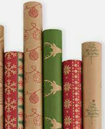
The amount of card from packaging and greeting cards used in the UK at Christmas would stretch between London and Lapland and back again, how many times?
50
100
150

Slide 16
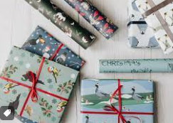
Consumers in the UK use 227,000 miles of wrapping paper each year – enough to wrap which island?
Guernsey (62km)
Isle of Man (572km)
Isle of Skye (1656km)

Slide 17
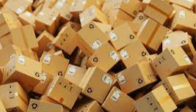
On their busiest day in the run-up to Christmas, which company receives 47 orders per second?
Ebay
Marks & Spencer
Amazon

Slide 18
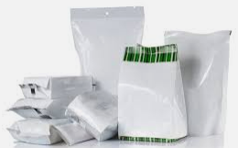
UK residents send around 114,000 tonnes of plastic packaging to landfills instead of being recycled each Christmas.
This is equivalent to 650,000 what?
Turkeys
Reindeer
Polar Bears

Slide 19
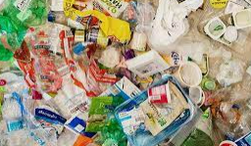
The average person in the UK handles how many types of packaging every single day?
10
25
50

Slide 20
Round 2
CHRISTMAS PRESENT
ANSWERS

Slide 21
The amount of card from packaging and greeting cards used in the UK at Christmas would stretch between London and Lapland and back again, how many times?
50
100
150

Slide 22
Consumers in the UK use 227,000 miles of wrapping paper each year – enough to wrap which island?
Guernsey (62km)
Isle of Man (572km)
Isle of Skye (1656km)

Slide 23
On their busiest day in the run-up to Christmas, which company receives 47 orders per second?
Ebay
Marks & Spencer
Amazon

Slide 24
UK residents send around 114,000 tonnes of plastic packaging to landfills instead of being recycled each Christmas.
This is equivalent to 650,000 what?
Turkeys
Reindeer
Polar Bears

Slide 25
The average person in the UK handles how many types of packaging every single day?
10
25
50

Slide 26
Round 3
CHRISTMAS FUTURE

Slide 27
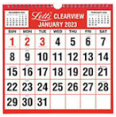
Which day of the week will Christmas fall on in 2024?
Monday
Tuesday
Wednesday

Slide 28
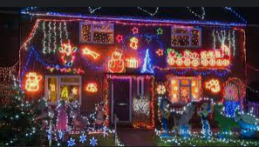
How many strings of Christmas lights would you need on the outside of your house to make it visible from space?
1536
2683
5947

Slide 29

How much less will people in the UK spend on presents in 2022 (per person)?
£33
£66
£99

Slide 30
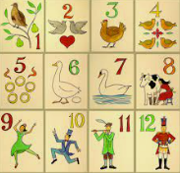
In Medieval times, during the 12 days of Christmas people predicted the future for the coming year.
What did they use?
The stars
The weather
The length of the grass

Slide 31
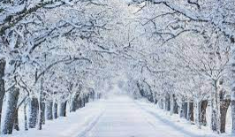
How many times has the UK had a proper ‘White Christmas’ (40% UK coverage of snow) since 1960?
4
8
12

Slide 32
Round 3
CHRISTMAS FUTURE
ANSWERS

Slide 33
Which day of the week will Christmas fall on in 2024?
Monday
Tuesday
Wednesday

Slide 34
How many strings of Christmas lights would you need on the outside of your house to make it visible from space?
1536
2683
5947

Slide 35
How much less will people in the UK spend on presents in 2022 (per person)?
£33
£66
£99

Slide 36
In Medieval times, during the 12 days of Christmas people predicted the future for the coming year.
What did they use?
The stars
The weather
The length of the grass

Slide 37
How many times has the UK had a proper ‘White Christmas’ (40% UK coverage of snow) since 1960?
4 1981, 1995, 2009, 2010
8
12

Slide 38
Round 4
CHRISTMAS
CURIOSITIES

Slide 39
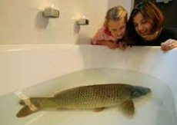
In which European country is it traditional keep a live carp in the bath ready for eating on Christmas day?
Poland
Spain
France

Slide 40
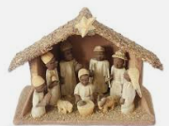
In Spain it is traditional to include a ‘caganer’ in the nativity scene, but what is this figure doing?
Dancing naked
Doing a poo
Picking his nose

Slide 41
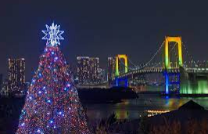
Which fast-food restaurant has become the traditional Christmas dinner venue in Japan?
KFC
McDonalds
Nandos

Slide 42
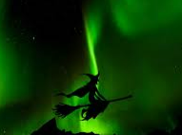
What do Norwegians hide in their house on Christmas Eve to scare away witches and evil spirits?
Garlic
Silver coins
Broomsticks

Slide 43
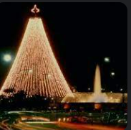
In the Venezuelan capital city Caracas, how do people travel to church on Christmas Day?
On horseback
On rollerskates
On a tandem bicycle

Slide 44
Round 4
CHRISTMAS CURIOSITIES
ANSWERS

Slide 45
In which European country is it traditional keep a live carp in the bath ready for eating on Christmas day?
Poland
Spain
France

Slide 46
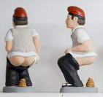
In Spain it is traditional to include a ‘caganer’ in the nativity scene, but what is this figure doing?
Dancing naked
Doing a poo
Picking his nose

Slide 47
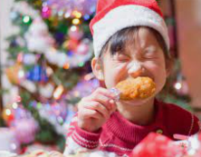
Which fast-food restaurant has become the traditional Christmas dinner venue in Japan?
KFC
McDonalds
Nandos

Slide 48
What do Norwegians hide in their house on Christmas Eve to scare away witches and evil spirits?
Garlic
Silver coins
Broomsticks

Slide 49
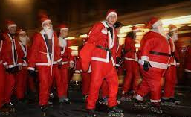
In the Venezuelan capital city Caracas, how do people travel to church on Christmas Day?
On horseback
On rollerskates
On a tandem bicycle

Slide 50
Round 5
CHRISTMAS
MUSIC

Slide 51
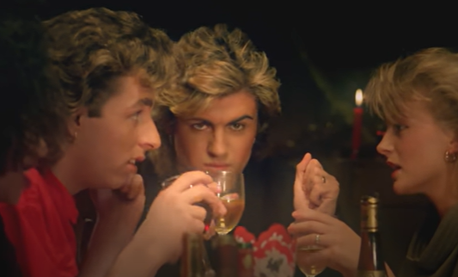

Slide 52
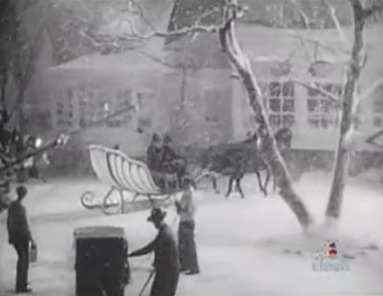

Slide 53
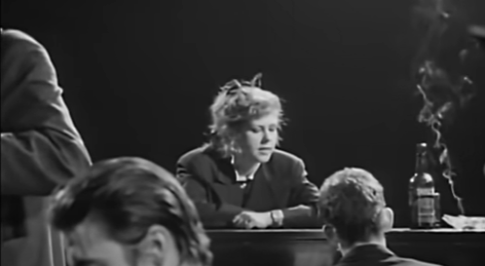

Slide 54
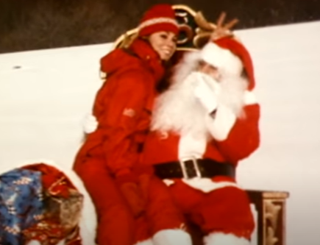

Slide 55
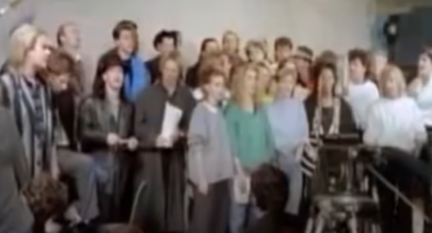

Slide 56
Round 5
CHRISTMAS MUSIC ANSWERS

Slide 57
Wham! Last Christmas

Slide 58
Bing Crosby, White Christmas

Slide 59
The Pogues & Kirsty McColl, Fairytale of New York

Slide 60
Mariah Carey, All I Want For Christmas Is You

Slide 61
Band Aid, Do They Know It’s Christmas?

Slide 62
Scores out of 25?

