Slide 1


Spatial politics of participation: the changing role of public spaces in arts institutions
Stefania Donini, PhD candidate
Guildhall School of Music and Drama
Barbican – Guildhall studentship
Visitor Studies Group conference
Co-Creating the Future: Participation and the Role of Visitor Studies
5 – 6 March 2020, Museum of London
Aernout Mik, ‘Communitas’ (2010) Photographie : Florian Braun

Slide 2
We live in the ’age of participation’
New technologies, web 2.0 and social media
Variety of participatory and socially-engaged arts practices
Cultural policy and the ‘participation agenda’ (and myth)
Increasing demands on cultural institutions to justify their existence and public value
Experience economy and the rise of the prosumer
Engaging and participatory museums and arts institutions

Slide 3
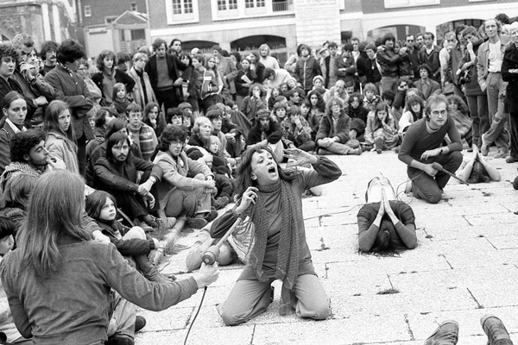
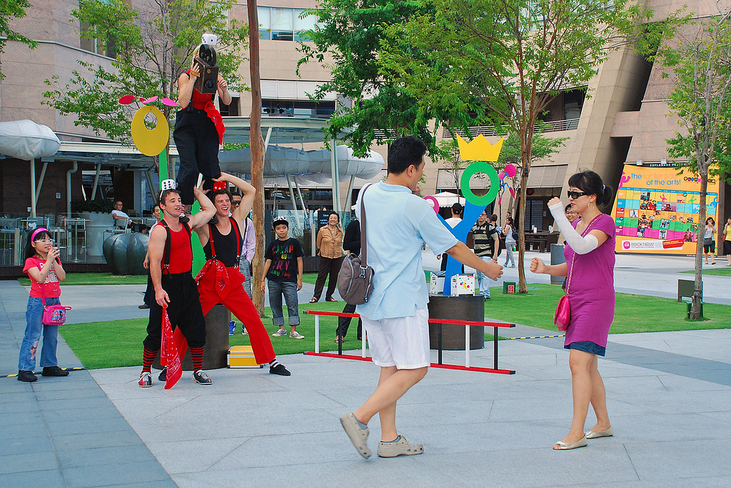
From radical beginnings to mainstream...
1960, The Living Theatre in Amiens (France)
Performance by the Dislocate (Australia) at the Esplanade Waterfront. Canopy. Singapore, 2009
Photo: Choo Yut Shing (CC)

Slide 4
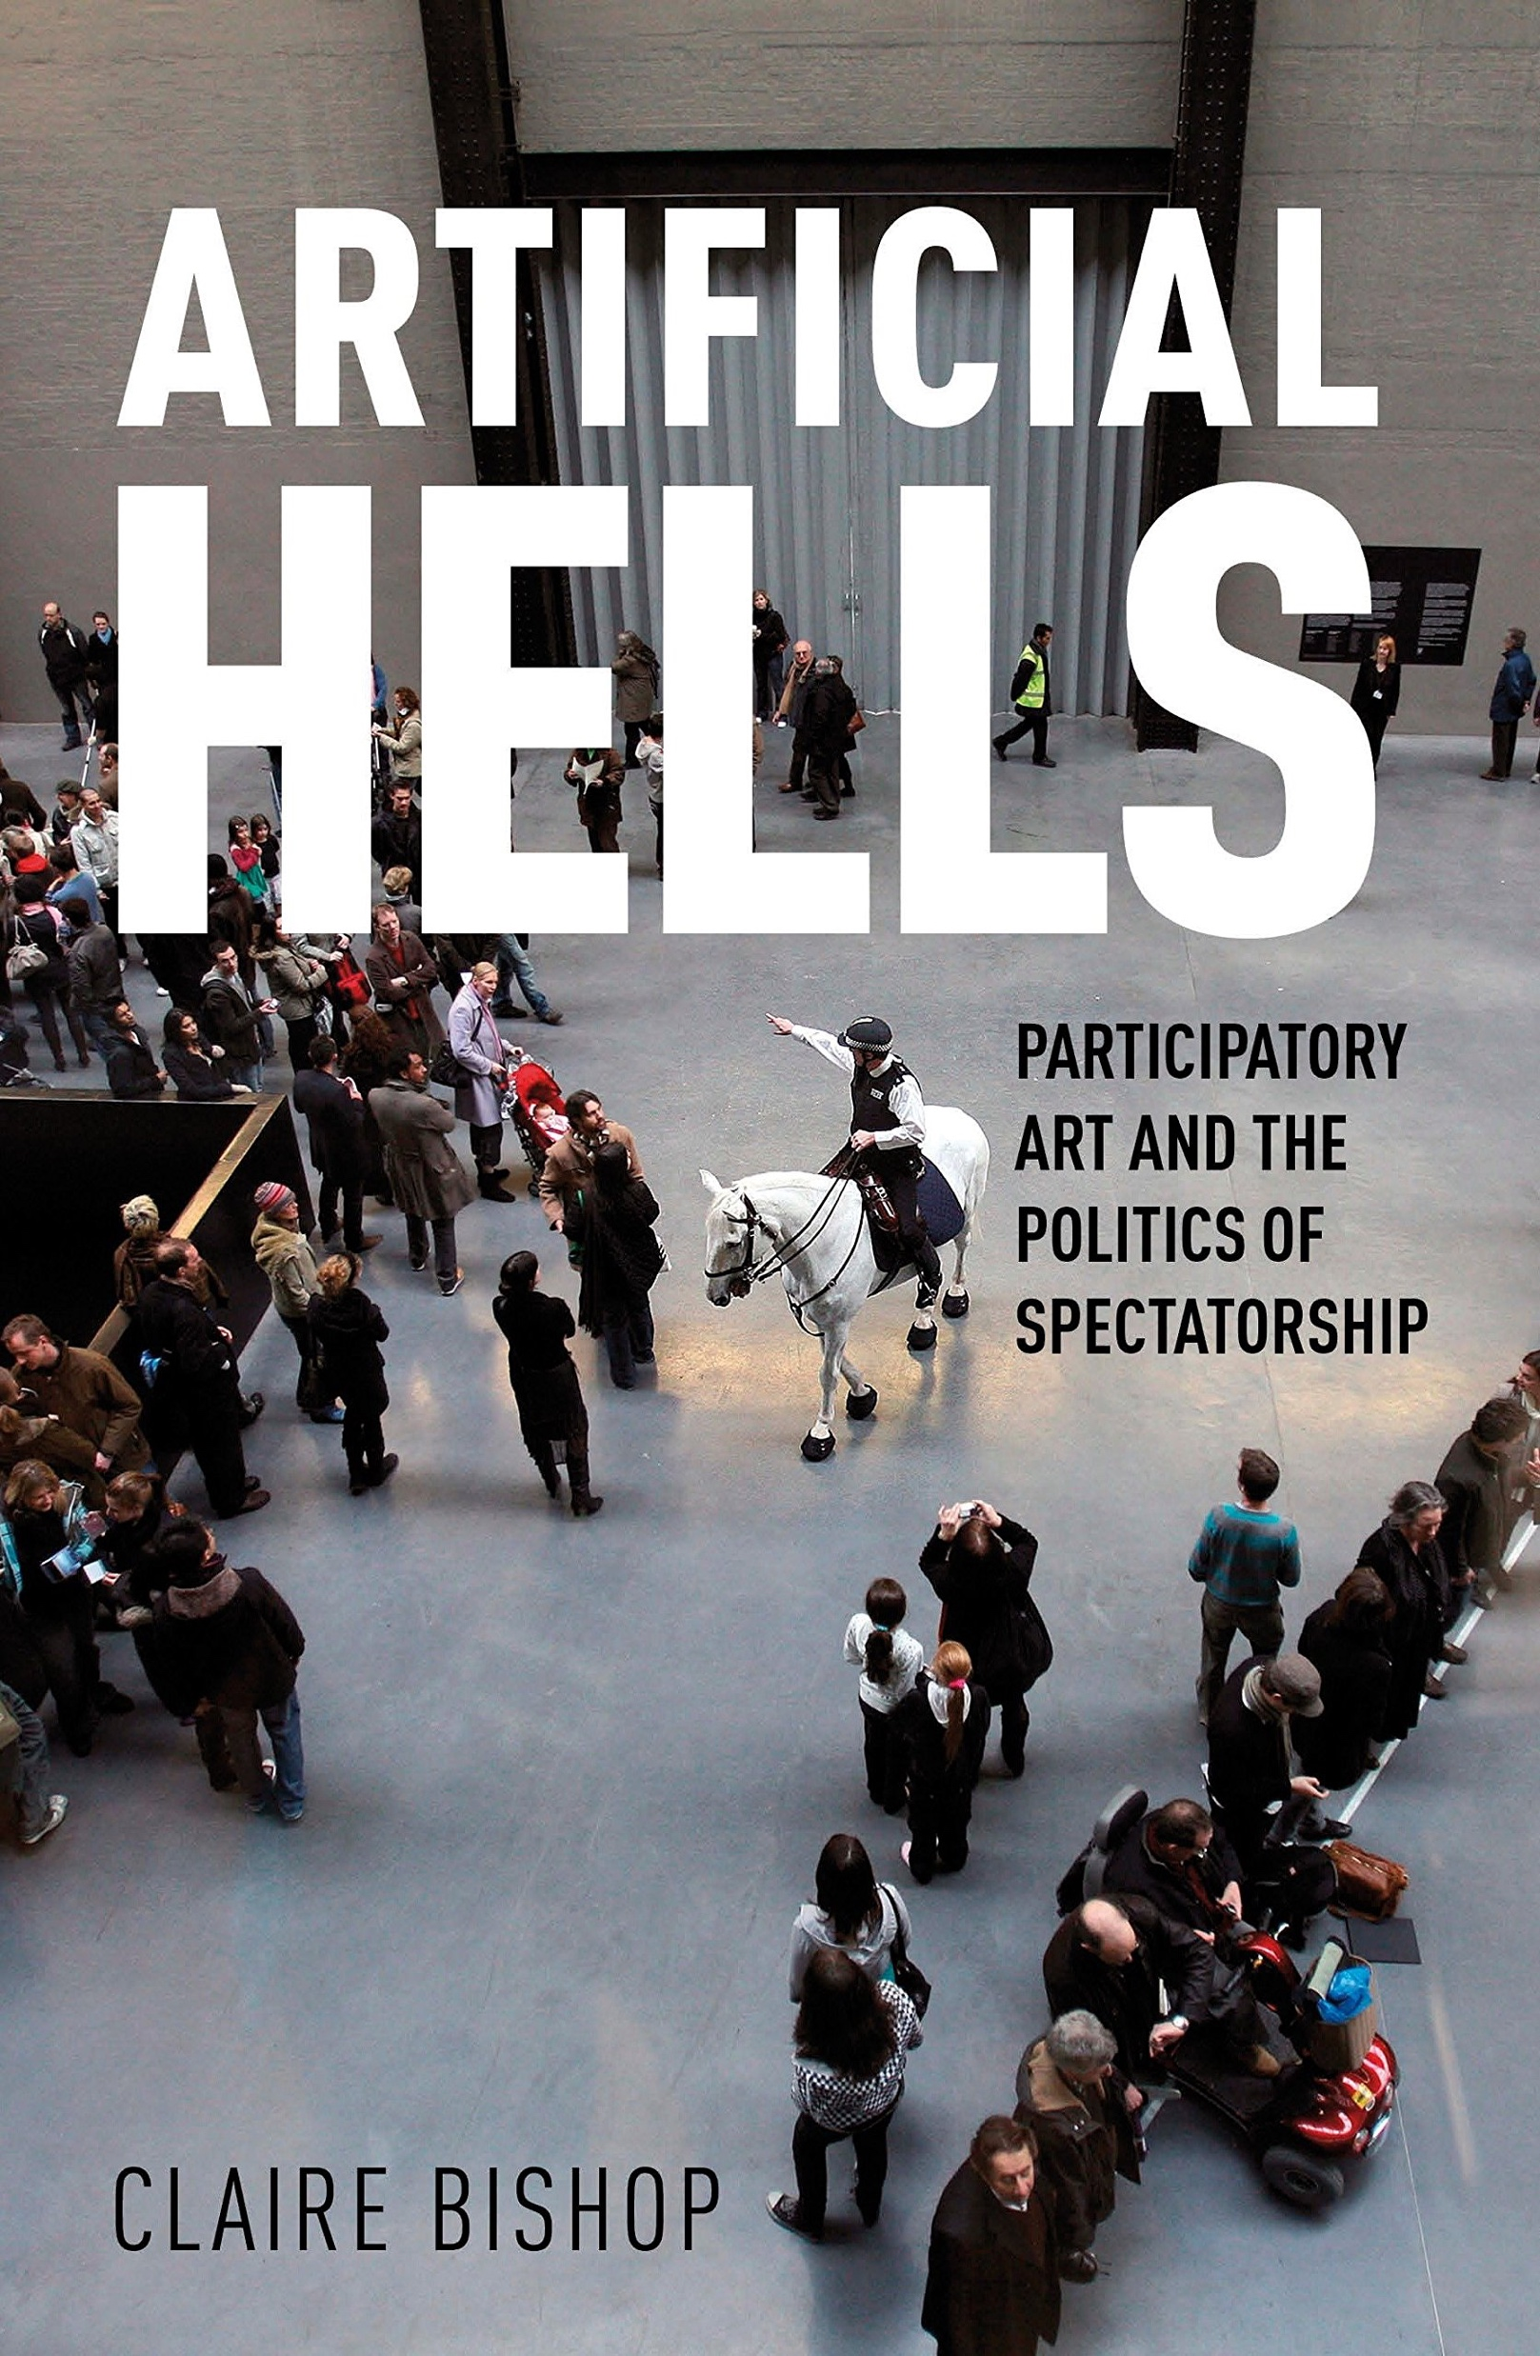
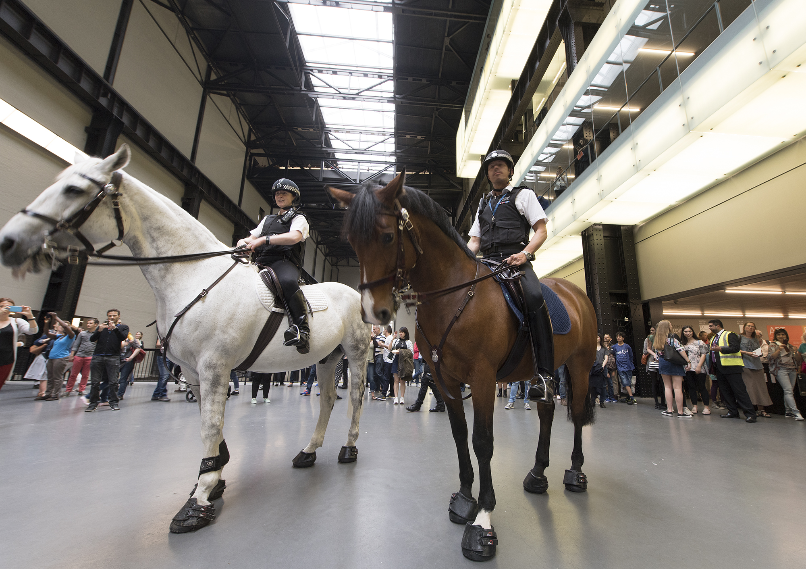
...but still potentially subversive?
'Tania Bruguera - Tatlin's Whisper #5, at Tate Modern 2016. (c) Tate

Slide 5
How do we define participation?
Slippery term, with multiple uses
Individual or social value of participation
The risk of active – passive binary
Role of art in public spaces and socially-engaged practices
Increase in outreach and public programming in museums and arts institutions

Slide 6
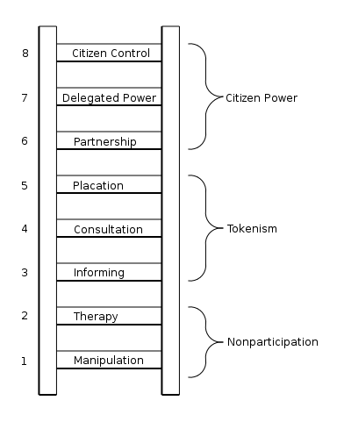
The problem of ‘measuring participation’
‘Getting in on the act: how to create opportunity for active participation’ –
Jennifer L. Novak-Leonard, Alan Brown, 2013
A Ladder of Citizen Participation - Sherry R. Arnstein, 1969

Slide 7
Understanding Everyday Participation
(Miles and Gibson, 2016)
Rich variety of cultural participation outside the orbit of state-supported cultural activities (only 8% of the UK population – a small, affluent minority - take part in funded cultural activities)
Prioritising quantitative methods based on the sample survey involves the reduces the cultural field to a partial and specific set of measurable indicators of participation
Proposal to shift the focus to the demand side of culture, reversing the deficit model underlying official cultural policy and starting from what people themselves value about their own everyday participation practices
Importance of understanding everyday forms of participation situated in specific places, with their own histories of values and governance

Slide 8
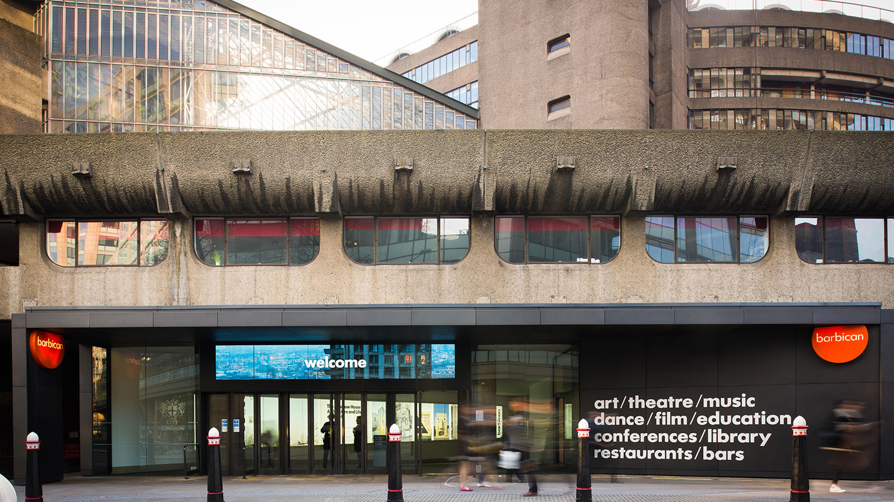
Silk Street Entrance, Photo: Max Colson (The Art Fund)

Slide 9
Research setting: the Barbican Centre
3 years Barbican-Guildhall studentship ‘Understanding Audiences’
Large urban arts centre with multiple venues and different art forms (music, dance and theatre, visual arts, cinema), founded and funded by the City of London Corporation (and ACE)
Grade II listed (Brutalist) building designed and built between 1960s and 70s (opened in 1982)
Availability of foyers and publicly-accessible area, used by both attenders and non-attenders of the core programmes

Slide 10
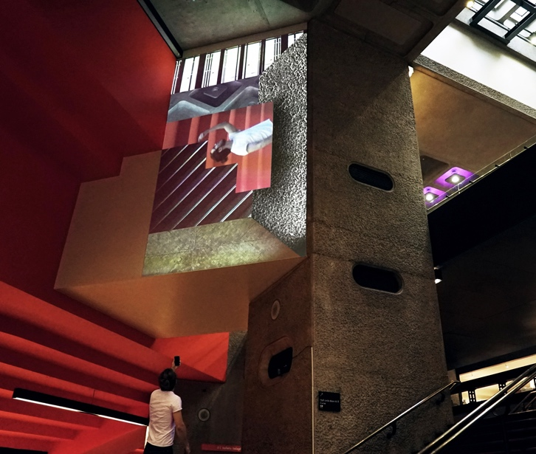
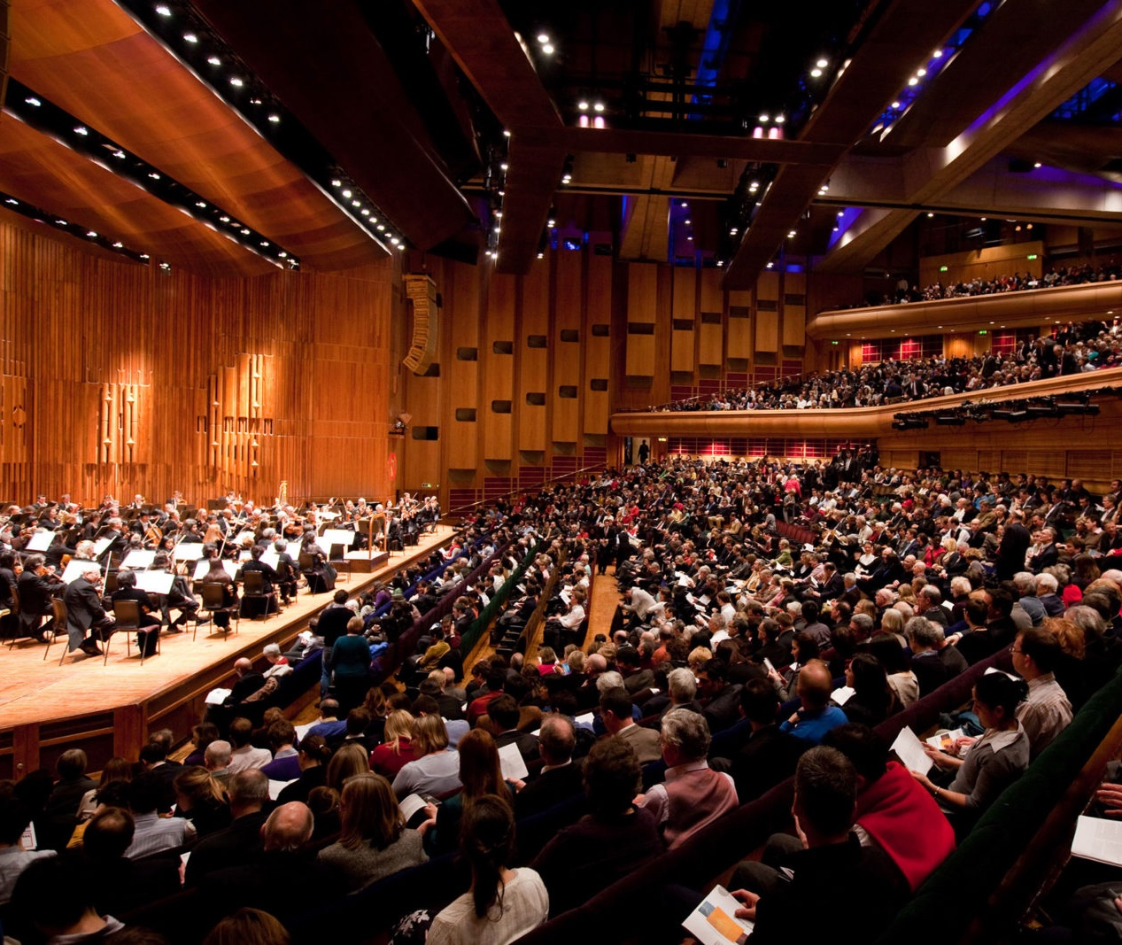
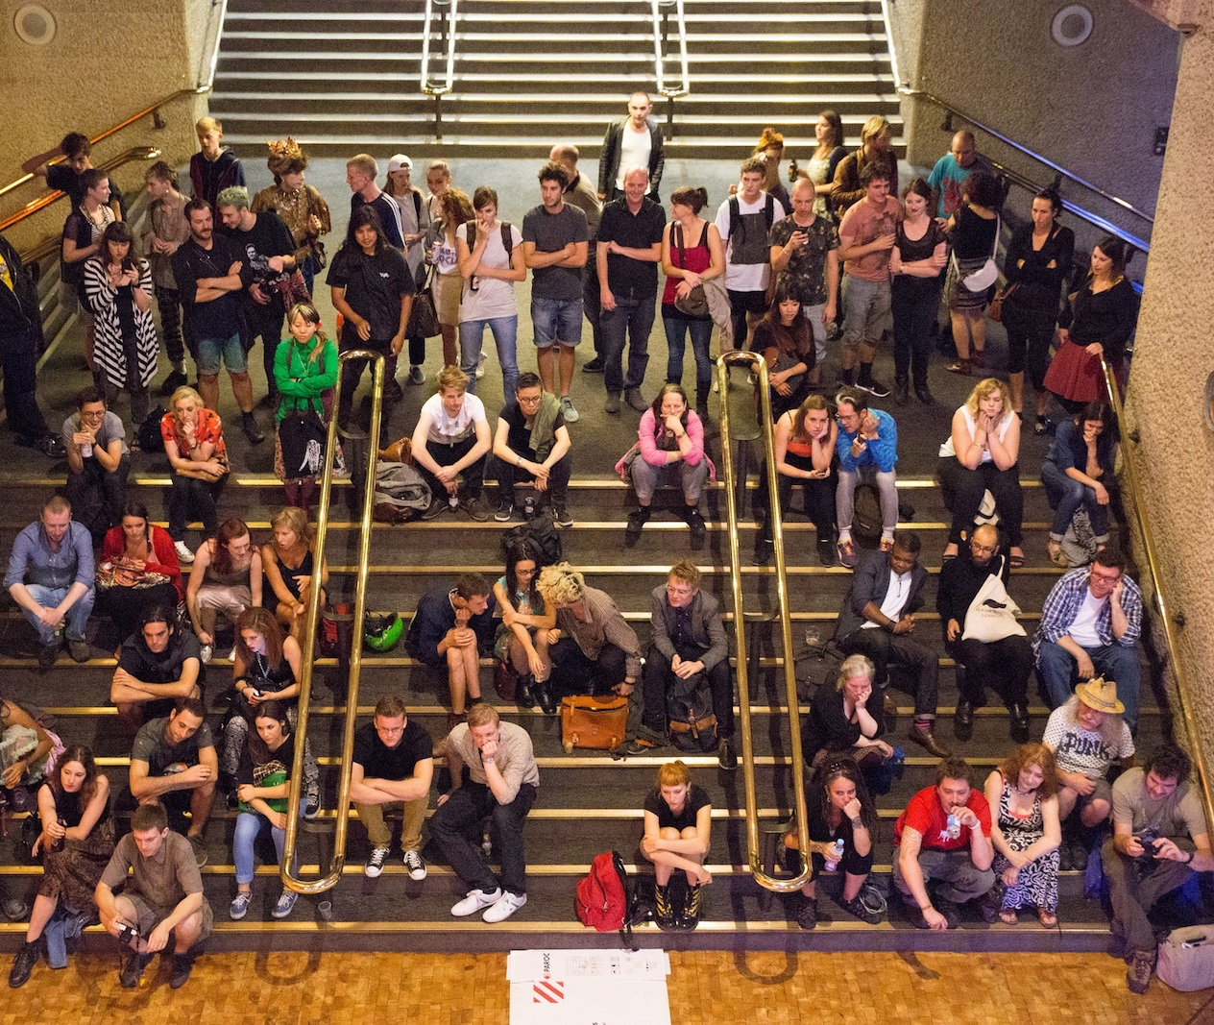
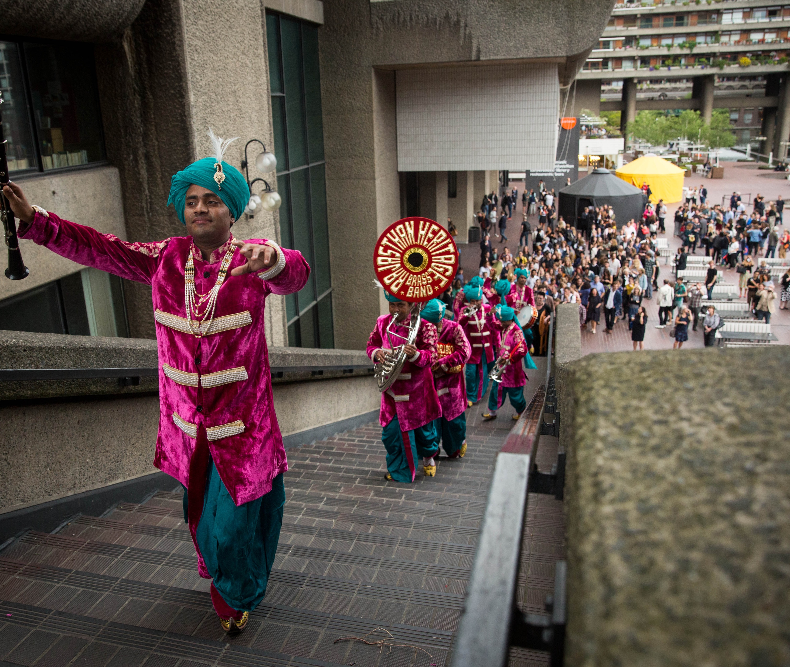
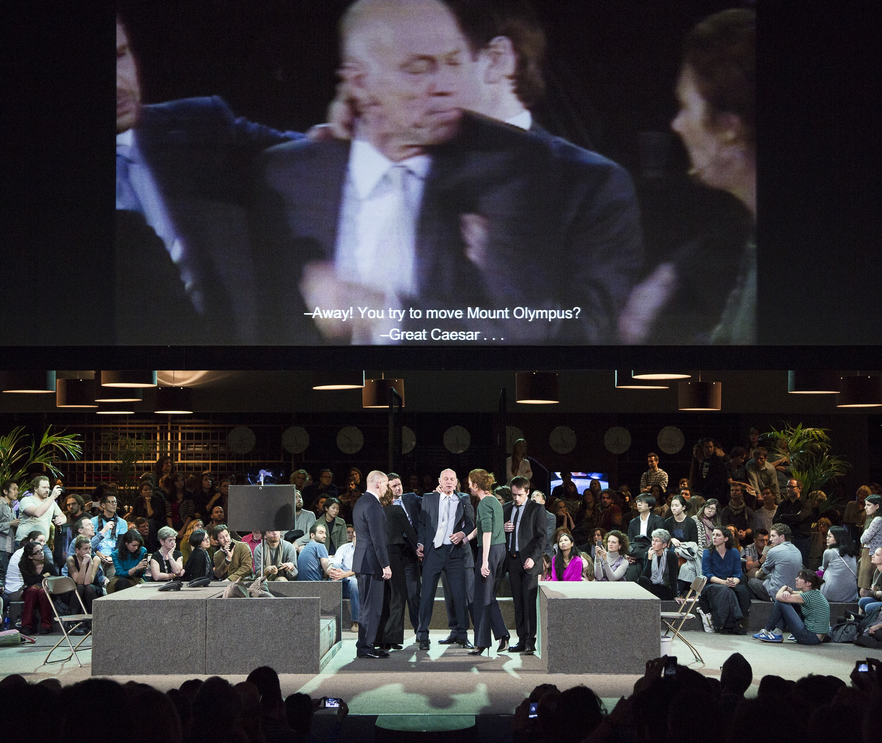
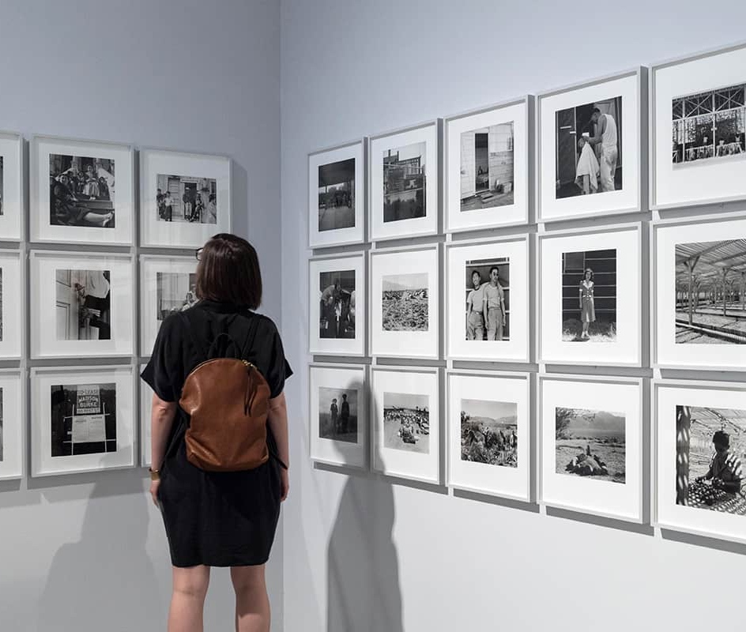
Alex Mead and Jack Wates: Find Yourself, Barbican Foyers, 2017
Barbican Concert Hall
Barbican Foyers
Rajasthan Heritage Brass Band, Station to Station, Barbican Centre (June 2015)
Ivo Van Hove, Roman Tragedies, BC, 2017
Ivo Van Hove, Roman Tragedies, BC, 2017
Barbican Art Gallery

Slide 11
How do arts institutions think about audiences and participation, through institutional policies, spatial strategies and public programming?
How are these policies, strategies and programmes mediated ‘on the ground’ by front of house staff and audience members?

Slide 12
Qualitative data collection
Two semi-structured interview studies with Barbican staff:
1. FOH staff members (12 interviews) on Foyers and venue/audience management
2. Managers across departments (18 interviews) from Marketing to Arts Programming, Creative Learning, Buildings & Operations on audience strategies and policies
Archival research on Annual Reports (2002 – 2018) and strategic documents
Ethnographic site-observations and researcher’s journal

Slide 13
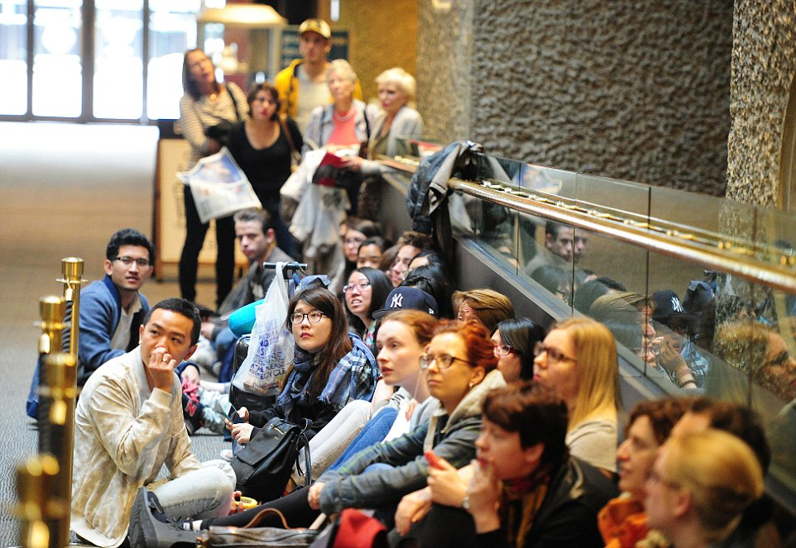
Why starting from the foyers?
Queue in the foyers, Level G

Slide 14
Foyers and liminal spaces conceptualised in museum studies as...
‘Thresholds of fear’ (Gurian, 2005)
Interfaces (Baker, V&A, 2011), ‘the beginning and the ending of the institutional narrative’(AHRC Transforming Thresholds, 2017)
‘transformative spaces’ that can ‘guide and structure the behaviour of visitors’ (Laursen, Kristiansen and Drotner, 2016)

Slide 15
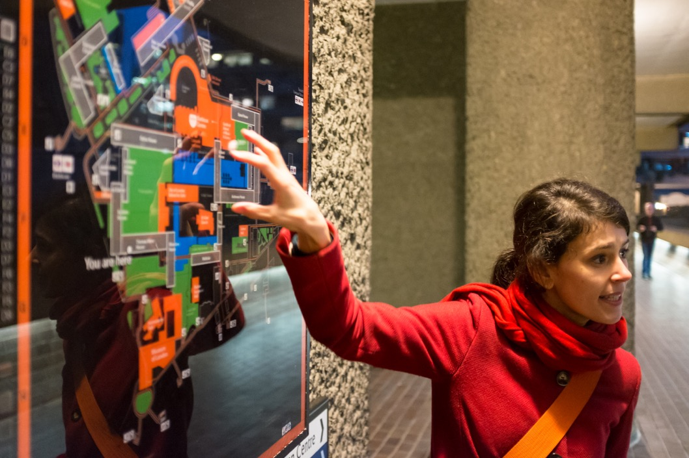
Drawing on my personal experience as researcher/host/architecture guide

Slide 16
The foyers through the eyes of hosts
Levelling effect (‘always open, always free’) between ticketed and non-ticketed audiences
Competing institutional discourses around the foyers and public spaces(civic role, branding, commercial income, ‘excellent audience experience’, ‘transforming public spaces’, artistic projects, outreach and creative learning)
But what happens in the foyers in the everyday?
Let’s ask the FoH staff members (visitor assistants, audience experience hosts, etc) who work directly with audiences and have embodied knowledge of the foyers
Personal experience of being a host/architecture guide and researcher (positionality)

Slide 17
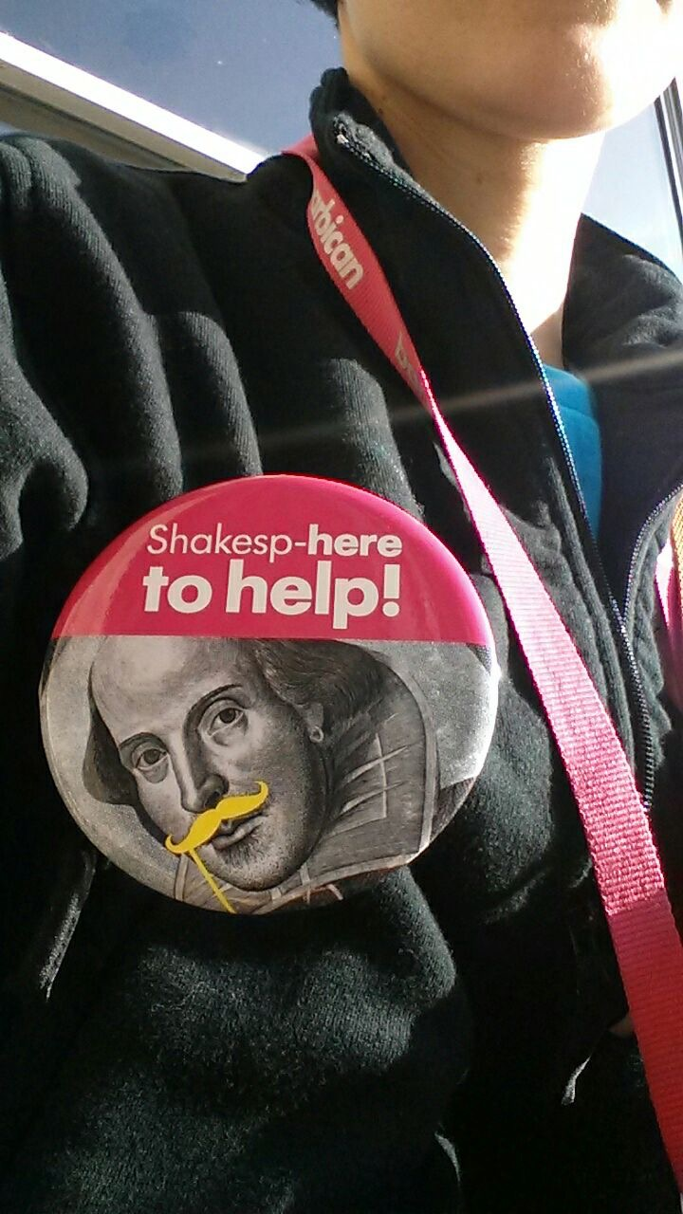
Qualitative data: 12 semi-structured interviews with Barbican Audience Experience Hosts
‘hosting is a service but not in a way that, you know, you go to a petrol station and have your car, you know, serviced… it's more like you're more engaged in someone's experience, so you're almost quite involved even though you know you're not going to sit next to them in the cinema, watch the film with them you know’. (Barbican Host; 3.332 - 335)

Slide 18
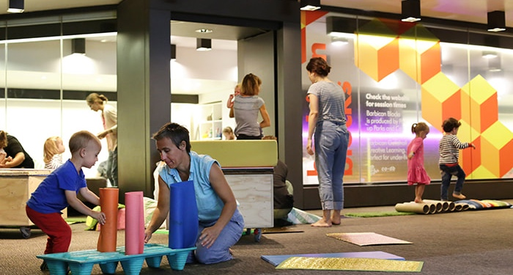
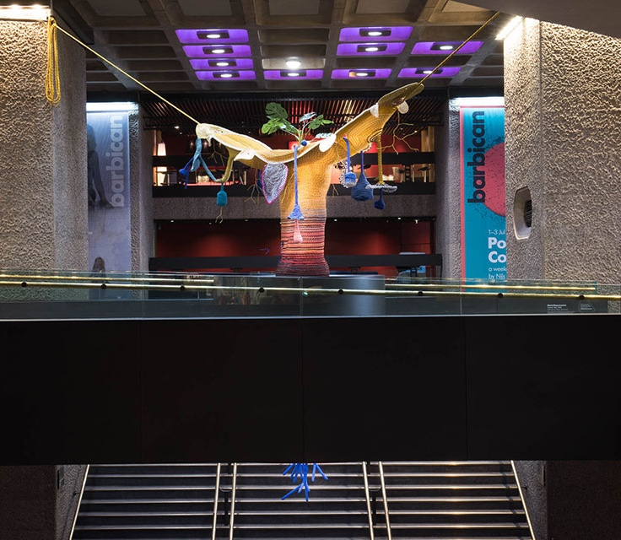
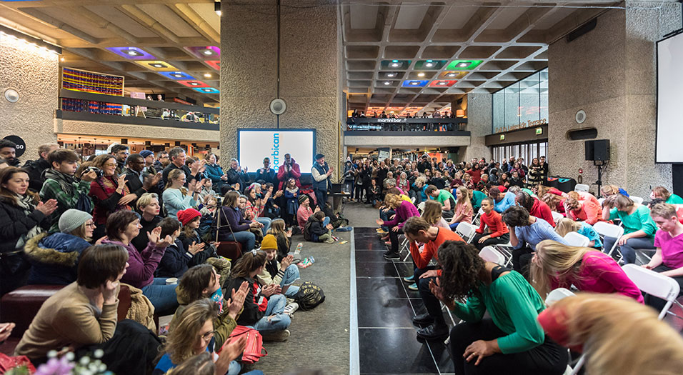
Foyers as outreach spaces: free arts and learning programmes
Barbican Blocks
Maria Nepomuceno’s Cosmic Teta
Notes:
What emerges is that the types of engagement taking place in the foyers are simultaneously with programmed and non-programmed activities, producing different uses of space and ‘cultures of participation’.
Firstly, the foyers as formally conceived by the Barbican as outreach spaces, whereby members of the public participate in the programme of arts and learning projects that are offerred as free and accessible to all. These are screen-based or sculptural installations (usually, commissioned every few months), but also the Weekenders and Open Fest, family-friendly festivals with free activities aimed to attract new audiences, as well as freestage music events organised to engage wider publics. A recently launched project is Barbican Blocks, a sensory playground for under five’s.

Slide 19
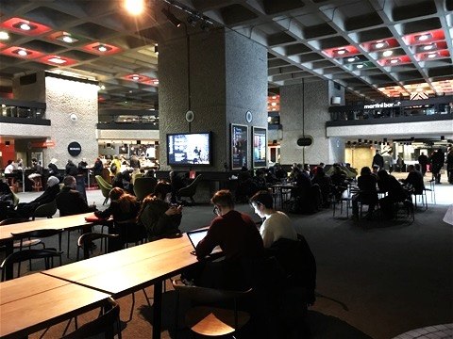
Foyers as spaces for informal and self-organised activities
‘a lot of people use the spaces… obviously at lunchtime you get a wave of office workers using it for their lunch, or to chill out, but right from the opening of the Centre you'll get dedicated teams of gamers... I think they are gaming... normally it's space with wifi... lots of people work and write in the spaces, and lots of people dance in the spaces, I think that's really, really good use of space ... you get lots of people dancing, you get actors rehearsing’
(Barbican host; 1.58 - 64)
Matteo Zamagni, Nature abstraction (Fish Island labs, Interfaces, 2015)
Notes:
However, when asked about their perspectives on the art centre’s foyers, hosts consistently articulated accounts of the foyers as spaces of informal creativity and everyday engagement beyond the programmed artistic offerings, with different temporalities of use, a broad range of self-organised activities taking place, and very diverse audiences and crowds. Infrastructural elements are also identified as crucial, such as the space having free-wifi as well as accessibility of desks and movable furniture.
This multiplicity of (often self-organised) activities is captured by a host.

Slide 20
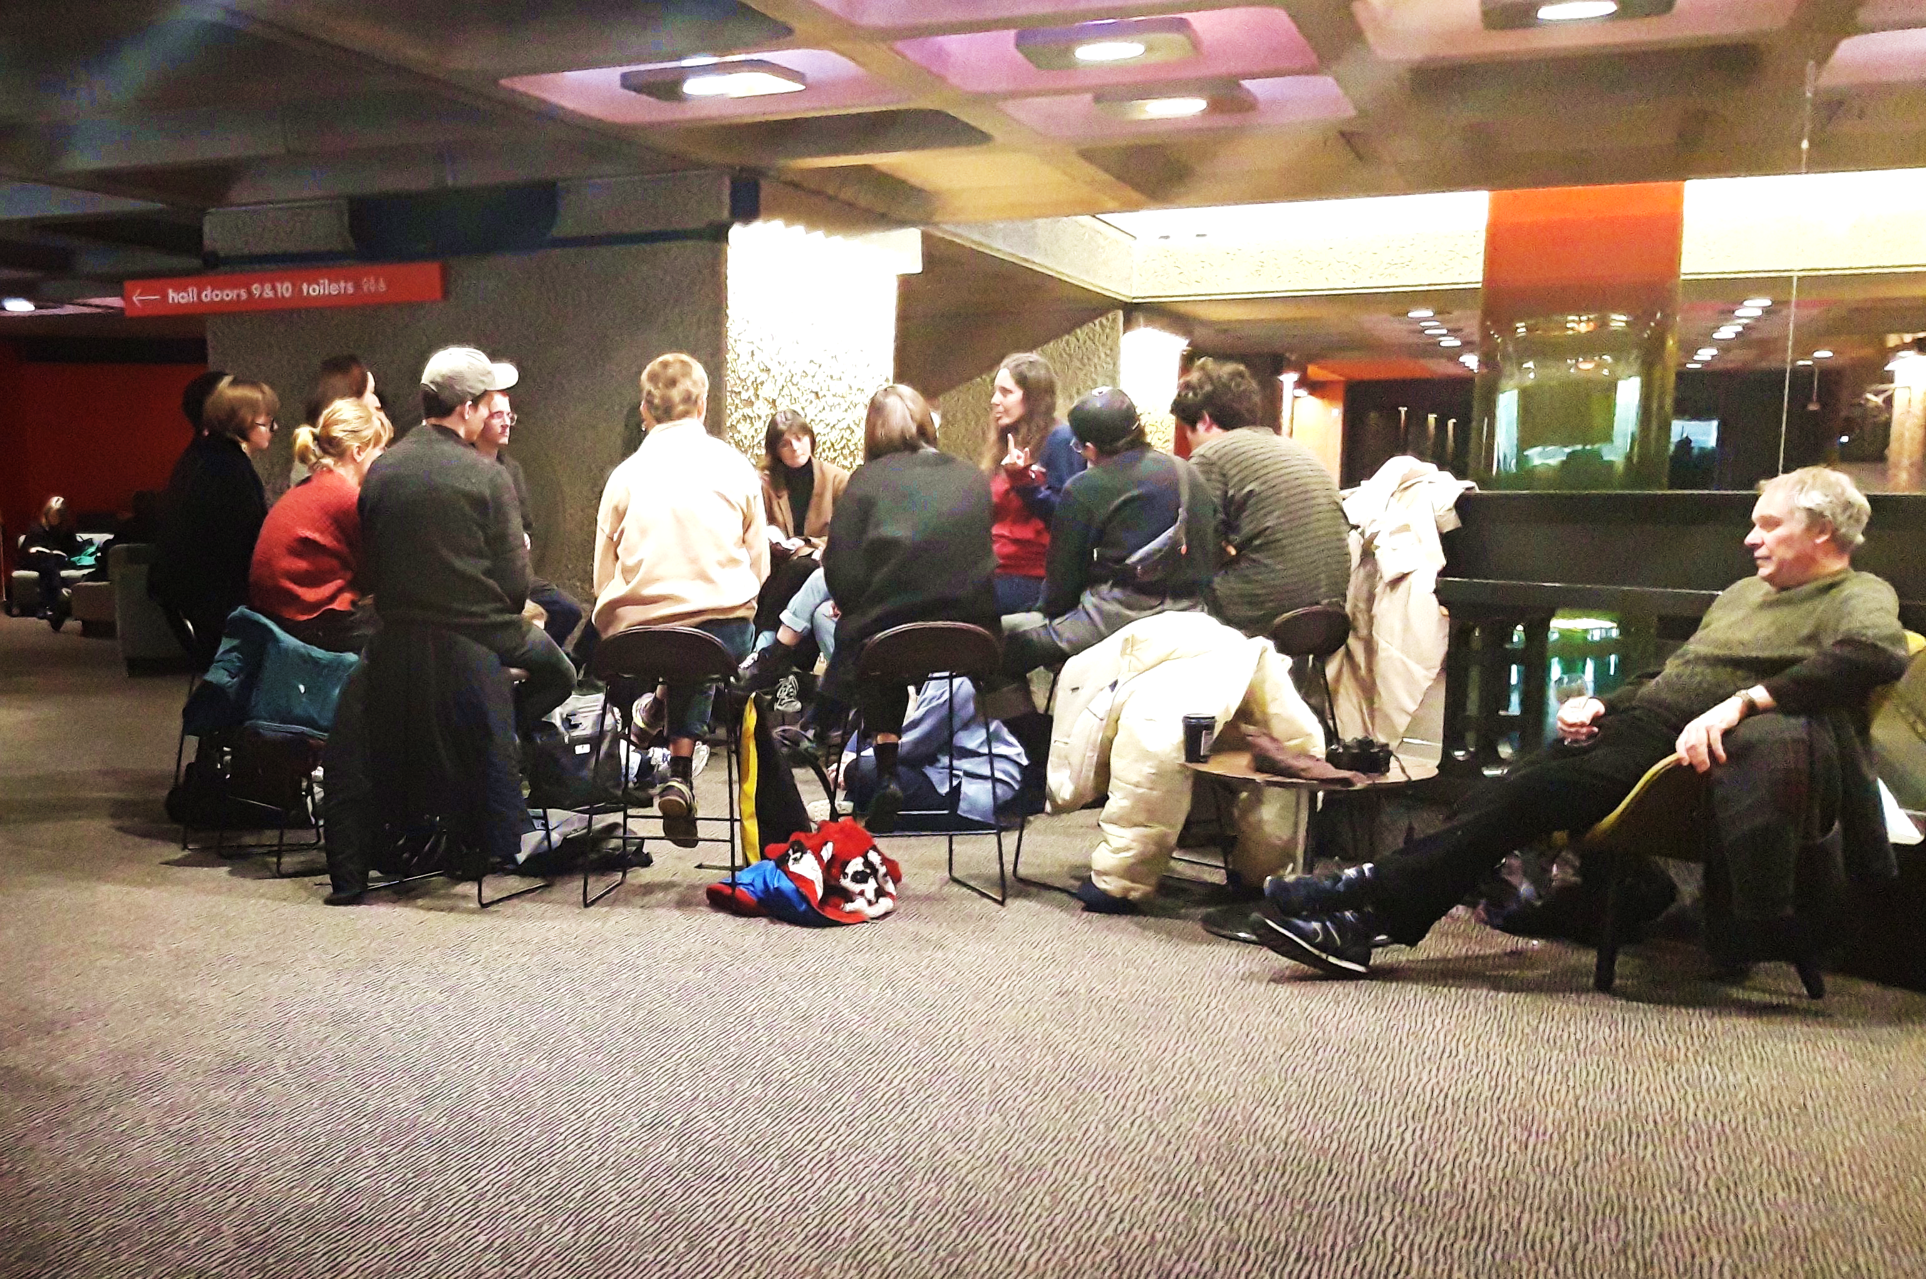
Foyers as gathering spaces
‘…I do remember this group of women […] and I remember another woman was just walking past, they didn’t know each other, and she overheard the content of the group […] and she got invited into the group, and she stayed there for a while... I was working in the door, on a concert, I was observing this, I didn’t participate, but I thought that was really positive, because there was someone who was entering the Barbican perhaps for another reason, either to go and get a coffee, or something, I don’t know... but she then interacted with another group of people that were in a focused …mmmh… activity and then she was participating just in that, just by the mere fact that she was just walking past them... So, I think that’s the beauty of the foyer spaces of the Barbican… that things can happen without the Barbican having to programme them (5.88 -104)

Slide 21
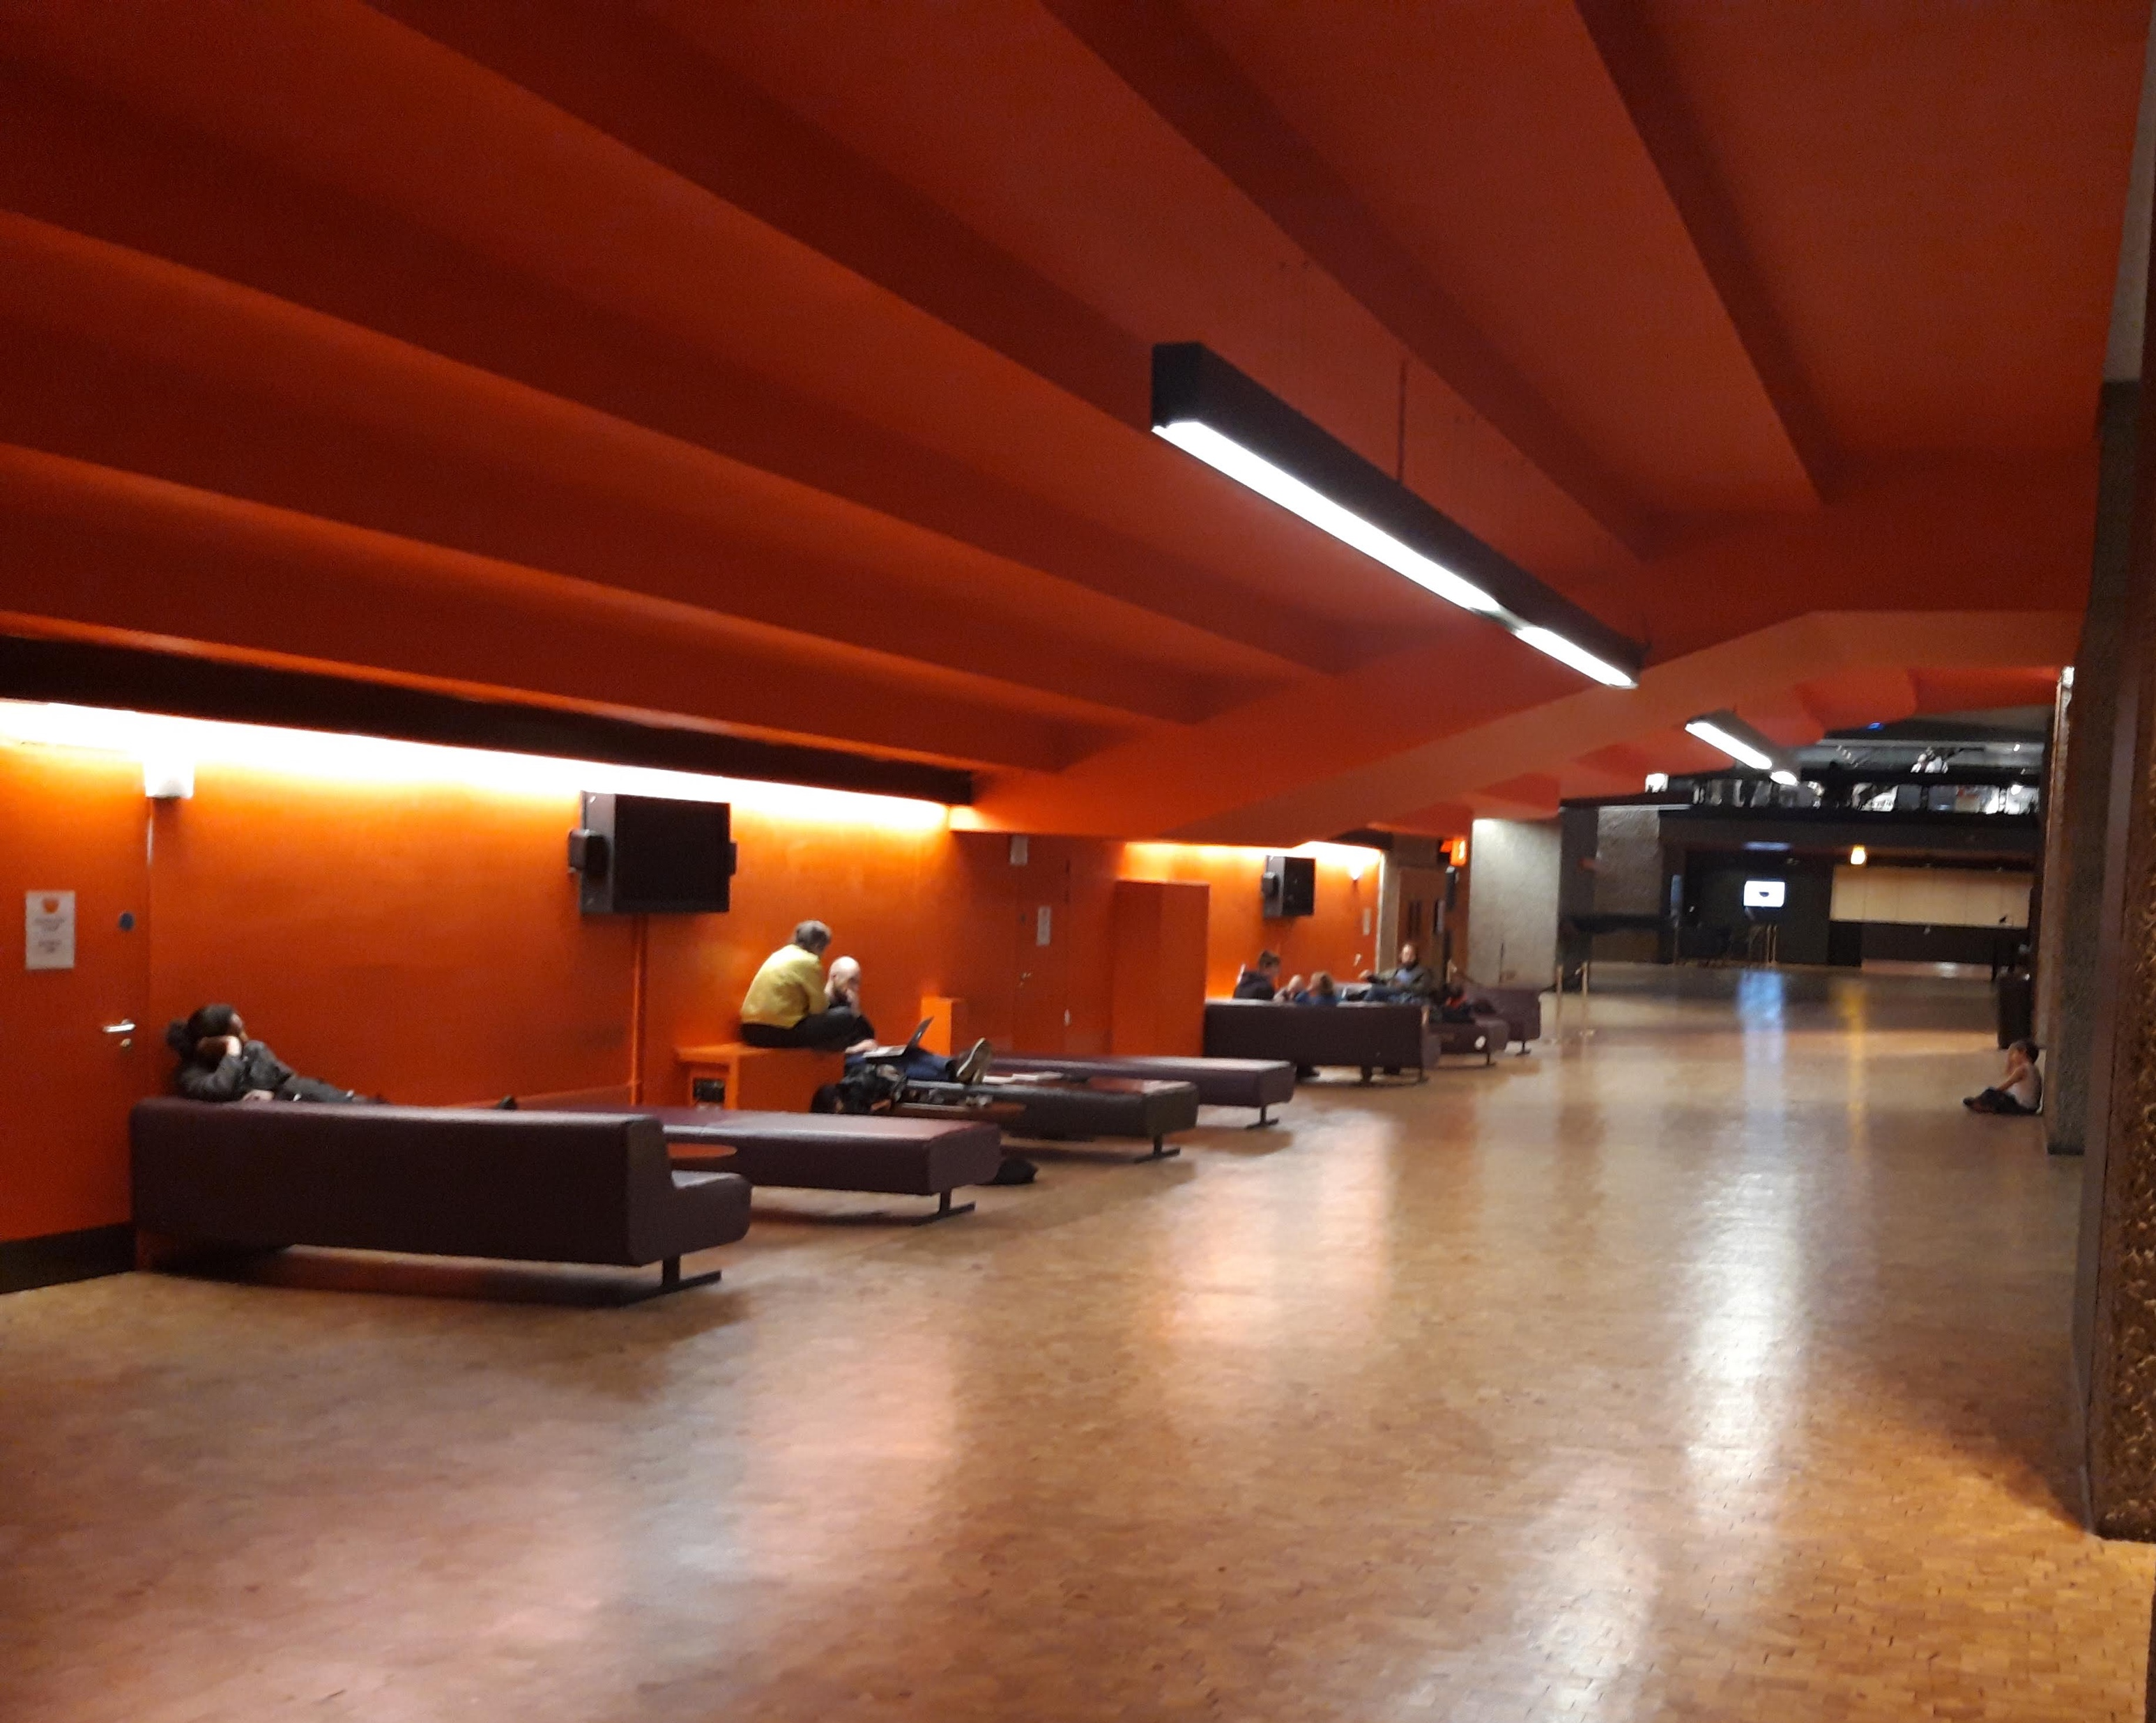
Foyers as free, accessible spaces
‘…especially younger people who may be or don’t have access to another kind of space, to meet, the fact that there are these free spaces, and people can just come and use them, and not be pushed out, and they don’t have to necessarily buy anything, and they can just come, and meet together and just use it as a social space, without any pressure of money… or, mmmh, being of a certain status, I just think that’s a really nice thing…that the Barbican offers…’ (Barbican host 3.56 - 58).
Notes:
With the increasing pressure on space in our cities, but also the emergence of new forms of organization of workforce and urban labour as well as new socio-material infrastructures in cities, such as co-working spaces, the very fact that arts institutions can provide such facilities becomes crucial as part of a process of reconfiguration of the arts centre as a civic space.
I would argue that one of the forms in which the Barbican Centre performs its civic role is in providing space that can be inhabited, informally used and appropriated for different purposes by people, without being ‘officially’ framed as such.
In urban contexts, space is increasingly commercialized and privatized. In such context, are arts centres, museums and other arts institutions moving towards a spatial model increasingly aimed at generating commercial income?
If arts centres are increasingly moving towards becoming spaces of consumption, is there a danger that they might lose their specificity as cultural spaces?

Slide 22
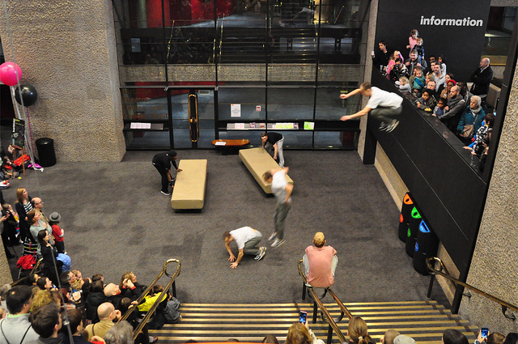
Storm Freerunning leaping off the balcony in the foyer of the Barbican Centre, Urban Stories Barbican Weekender 2012
‘…things that people shouldn't do, like […] sliding down bannisters, I think that's fun, sliding down bannisters… it’s probably the most accessible foyer installation…’
(Barbican Host 1.211 – 14).
Notes:
Blurred separation between audiences and performers, which initially was a prerogative of participatory art, now extends beyond it – we all have the capacity and technology to be producers – hence the rise of terms like prosumers -

Slide 23
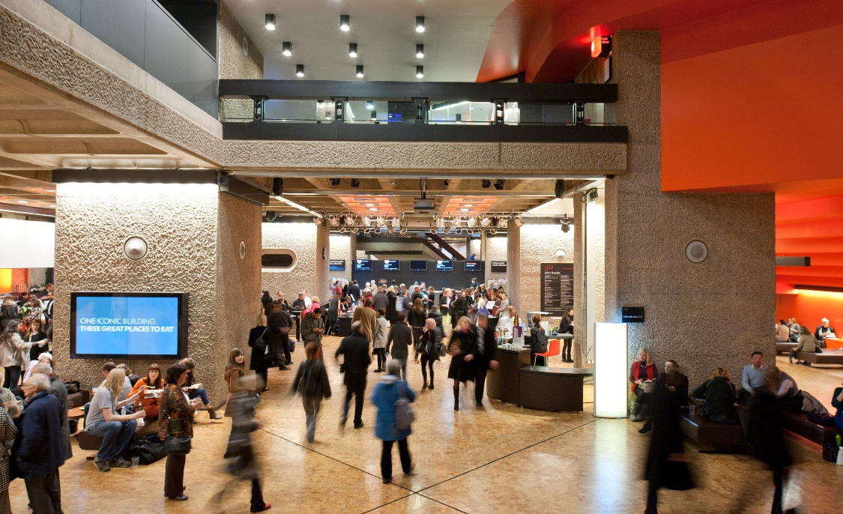
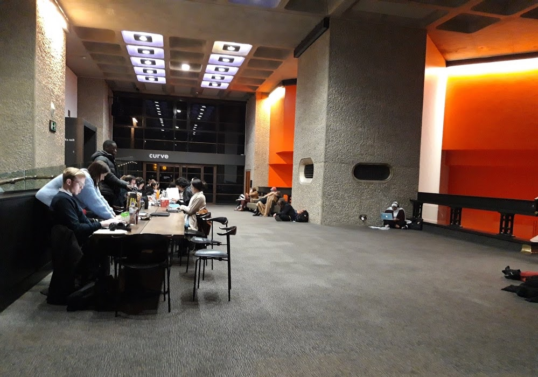
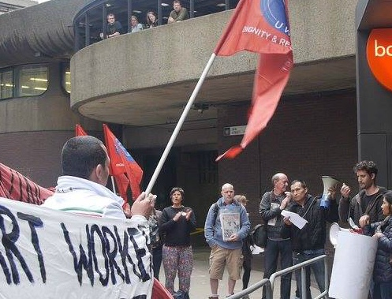
Foyers as complex cultural ecosystems used by various social groups:
formal uses of space, programmed and conceived as outreach and programming space by the Barbican (i.e. Foyers’ installations, Barbican Weekenders, Freestage events) but also private events booked by commercial clients (graduations, conferences, exhibition fairs);
Informal, non-programmed and self-organised uses of space i.e. working, studying, writing, meeting friends, socialising, learning (i.e. co-working, book clubs, game clubs)
‘subversive’ uses (de Certeau, 1984), or participating ‘in the wrong way’ (Hope, 2011) that are often policed i.e. playing, protesting

Slide 24
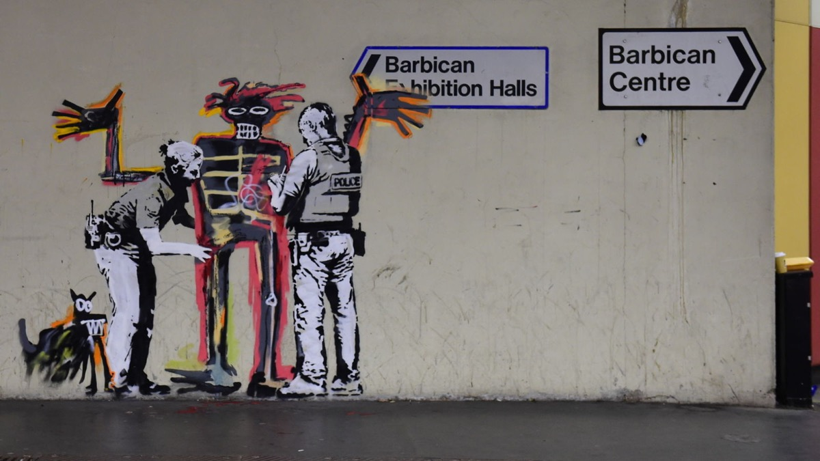
Tensions between openness/securitisation
private/public space
‘I guess it’s keeping the balance… between safety and access’ (Barbican Host; 10.242 – 43)
‘increas(ing) the security presence (and I think that) really changes the spirit of the foyers…’ (1.83 - 84)
‘there’s going to be a lot of sensitivity about the roaming around the foyers and putting on free stuff for people to do… (2.113 - 14)
Murals by Banksy, inspired by Jean-Michael Basquiat’s work, 2017

Slide 25
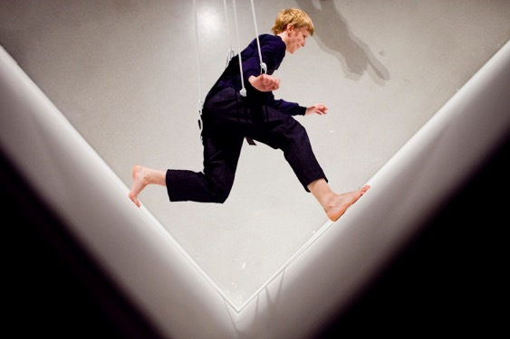
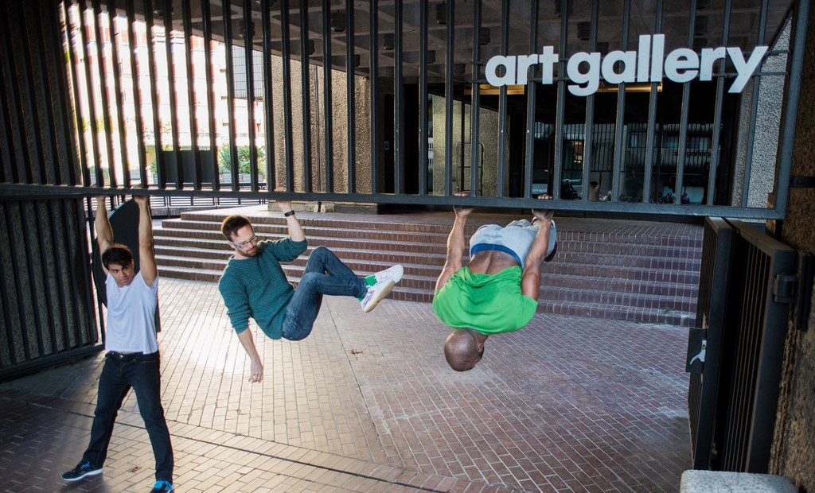
Formal, informal, subversive cultures of participation in the everyday
Laurie Anderson, Trisha Brown, Gordon Matta-Clark: Pioneers of the Downtown Scene New York 1970s, Barbican Art Gallery, 2011 (The Art Desk)
Violeta Beral photographer (CC)

Slide 26
Some implications and questions
Contested and conflicting use of the spaces, public/private, commercial, educational, informal…
Multiplicity of activities, programmed and non-programmed
Challenge to the core programme and artistic authority
Institutions facing a ‘crisis of legitimacy’ (Möntmann 2006)
Publicly-accessible areas and foyers increasingly important in cities where spaces such as libraries, artists studios, working space are less freely available, and a higher number of people are freelancing
Civic role of freely accessible spaces in building-based institutions (Calouste Gulbenkian Foundation 2016), but how to balance that within a neoliberal funding model that requires maximising income generation from spaces?

Slide 27
Thank you!
Questions and comments
stefania.donini@stu.gsmd.ac.uk
Aernout Mik, ‘Communitas’ (2010) Photographie : Florian Braun

