Slide 1


Reflecting trends
Using large scale research to impact lives in a museum environment
Matthew Sheard
Learning & Access Curator
St Andrews University Museums

Slide 2
28,500,000
16,189,781
2014 figure
19,336,251
2015 figure
20,022,444
2016 figure
Refugees and asylum seekers recorded worldwide in 2017
United Nations Refugee Agency
Notes:
28,500,000 refugees and asylum seekers.
This is the number of refugees and asylum seekers across the planet in 2017 according to the UN, highest number since records began in 1951.
6.3 million of those from Syria
The figure is growing, there’s a clear upward trend.
As museums and cultural institutions, we can’t do anything about this. So how do we respond?
Initially we responded not by looking at data, but at society around us.

Slide 3

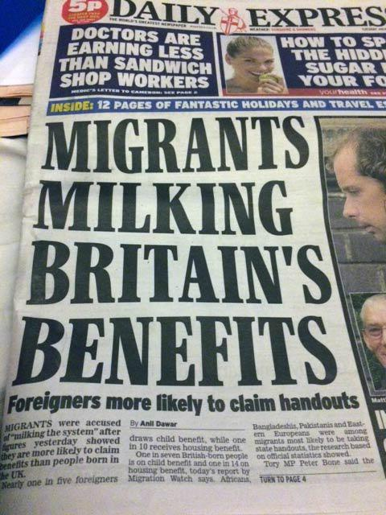
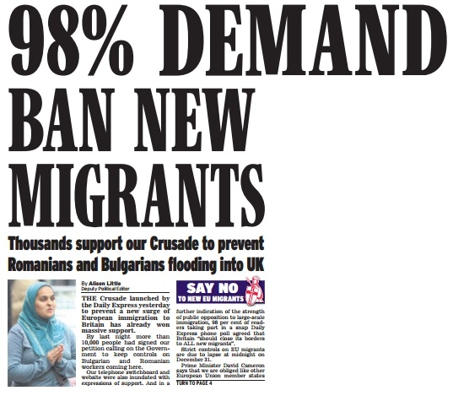
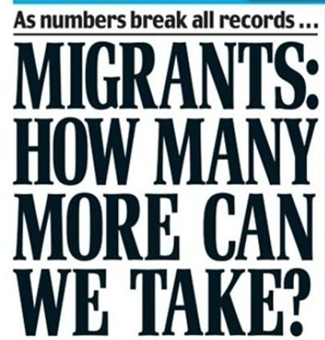
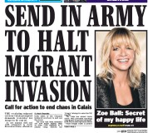
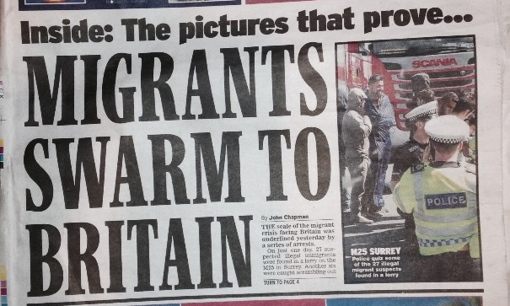


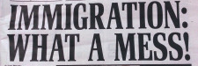
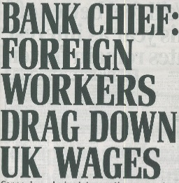
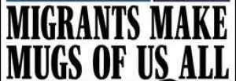
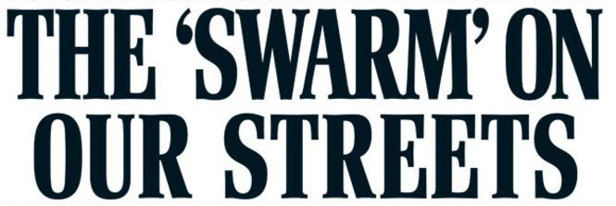
Notes:
We get an indication of what society’s response might be from newspaper headlines.

Slide 4

Notes:
Political discourse might also give us an idea.
For St Andrews University Museums, our response to migration wasn’t inspired by that initial number, it was inspired by headlines, ‘breaking point’ and ‘hostile environment’.
But could we be sure that what we could see in these things was an accurate representation of the real situation?
We needed to confirm that the perceptions we got of society’s response to growing numbers of refugees was the real response, and for this we needed data.

Slide 5
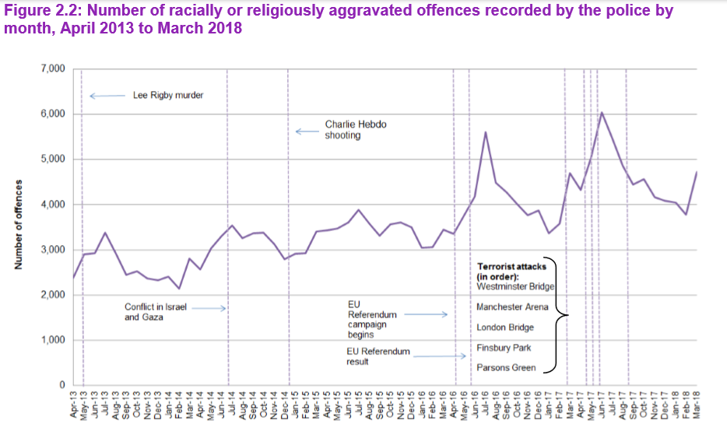
UK Home Office
Hate Crime, England and Wales, 2013 to 2018
Home Office Statistical Bulletin 2018, p.14
Notes:
Hate crime statistics back our perception up, with increases in racial and religious hate crimes recorded by police. Whereas you can clearly see spikes after terrorist incidents and after the EU referendum, there is also a general long-term upward trend.

Slide 6
31%
UK citizens who believe immigration causes more problems than opportunities
European Commission
Special Eurobarometer 469: Integration of immigrants in the European Union: United Kingdom (2017), p.2
Notes:
Attitudes surveys give facts and figures to support the perceptions that we see around us. According to research carried out by the European Commission, 31% of the UK population think immigration causes problems and 38% that it worsens crime.

Slide 7
38%
EU citizens who believe immigration causes more problems than opportunities
European Commission
Special Eurobarometer 469: Integration of immigrants in the European Union: United Kingdom (2017), p.2
Notes:
These attitudes aren't confined to the UK.
In fact Britain, alongside Germany, is one of the EU countries most favourable to immigration; 38% of EU citizens think immigrants cause problems, again according to the European Commission.

Slide 8
37% of UK citizens
41% of US citizens
52% of French citizens
69% of Italian citizens
70% of Greek citizens
Believe that immigration places a burden on society
Pew Research Centre
Jens Manuel Korgstad, What Americans, Europeans think of immigrants, 24 September 2015
Notes:
In 2015 the Pew Research Centre found that 37% of UK citizens think immigration places a burden on society.

Slide 9
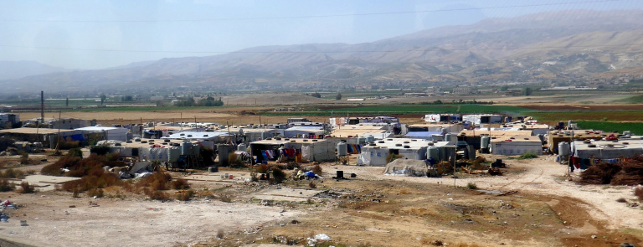
Refugee camp
Beqaa Valley, Lebanon
Notes:
The issue isn't confined to the West. Lebanon hosts more refugees per head of population than anywhere else in the world, with official figures indicating 164 refugees per 1000 people and unofficial estimates suggesting that migrants have almost doubled the country's population. This causes problems; the government limits the type of work that migrants can do in response to the public's fears that they are taking their jobs and forcing down wages, a belief I'm sure we can all recognise.

Slide 10
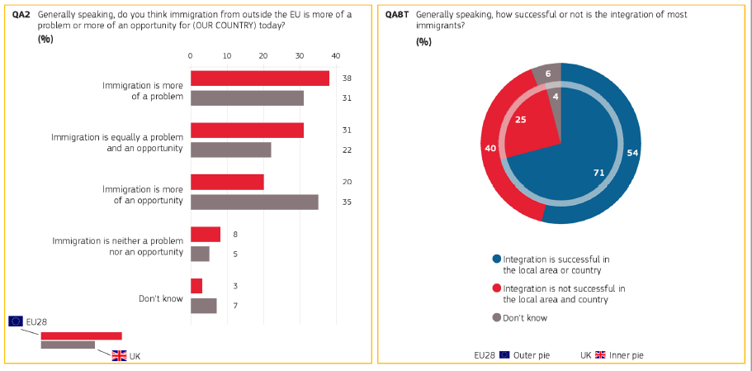
European Commission
Special Eurobarometer 469: Integration of immigrants in the European Union: United Kingdom (2017), p.2
Notes:
It would be wrong to suggest that the situation is all bad;
again according to the European Commission, 35% of Brits think immigration is an opportunity (that number is 20% across the EU in general) and 71% of UK citizens think that integration has been a success in their local area.
But there is clearly more that can be done.
So, having identified a problem, a growing trend, using data, what can museums do to respond?

Slide 11
77%
UK citizens who think integration programmes are necessary for their country’s long-term future
European Commission
Special Eurobarometer 469: Integration of immigrants in the European Union: United Kingdom (2017), p.4
Notes:
Data, again, can give us an answer.
That answer might be integration programmes.
According to that European Commission research, 77% of UK citizens think that integration programmes for immigrants are a necessary investment for the long-term future of the country.
As a museum, we decided to respond to the increasing trends of migration and of negative attitudes towards those migrants and to contribute to the country’s future by piloting our own integration programme, but where would we start?
The obvious answer was to use the same large scale research to give us more detail about what we can do.

Slide 12
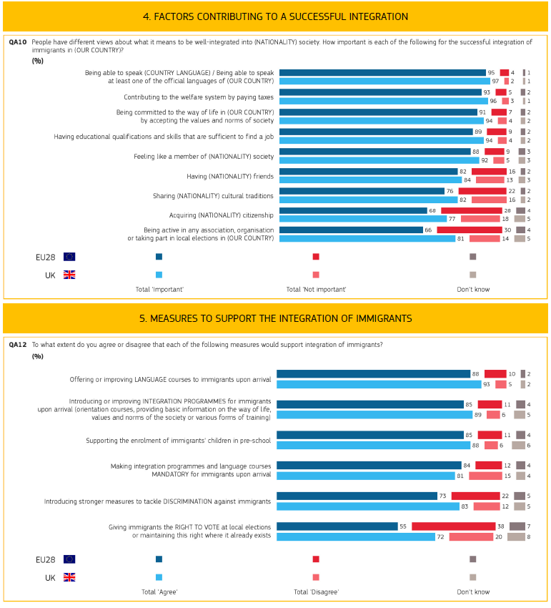
European Commission
Special Eurobarometer 469: Integration of immigrants
in the European Union: United Kingdom (2017), p.4
Notes:
That research tells us that language learning and getting to know locals is an important part of these programmes:
97% of UK citizens think that language learning is important to integration and 84% think that having British friends is necessary.
So, we decided that real-world opportunities for language development would be key to the project that we would develop. and thus formed a partnership with the council’s English for Speakers of Other Languages, or ESOL, team, working alongside one of their tutors to develop plans and working with a self-selecting group of their students, all in the late teens and early 20s.
We also decided that we would give the participants the opportunity to get know local people, about which more later.

Slide 13
55%
UK citizens who believe they are poorly informed or not at all informed about immigration
European Commission
Special Eurobarometer 469: Integration of immigrants in the European Union: United Kingdom (2017), p.1
Notes:
When it comes to knowledge of immigration, 55% of Brits believe that they personally are either poorly informed or not at all informed, while 54% think that the media portrayal of immigrants is too negative.
Research also indicates that museums are highly trusted institutions.
We decided, therefore, that our project would also share information about migration with the public in order to inform them and supply them with a corrective view of the migrant experience.

Slide 14
New Scots Refugee Integration Strategy
2018-2022
Get to know Scottish people
Employability skills
Language development
Community understanding re. how to communicate with low-level English speakers
Community understanding of migrant needs
Community actively involves migrants
Tackle social isolation
Support migrant participation in cultural activity
Scottish Government
Notes:
In Scotland, the New Scots strategy for integrating migrants is based on extensive research and emphasises the need for cultural participation to aid integration. This again played a key role in our development of the programme.
It notes a desire among migrants to meet and get to know Scottish people and yet states that there is an absence of opportunities to do so.
It records the importance of employability skills and the opportunity to demonstrate these skills to society, with the aim of gaining long-term employment.
It highlights the need to develop language skills, but also for host communities to understand how to communicate with and accommodate those whose English is limited.
It also focuses heavily on the requirements of communities to play their part, for them to understand the needs of migrant communities and to actively involve them in community life.
There is a need, the report says, to tackle the social isolation the migrants often feel in their host communities and, notably for us, to support migrant participation in cultural activity.
Museums are well-placed to help in all these situations.
Research shows that we are trusted to communicate truth, so we can play a role in countering the negative media portrayal of immigrants and ensure that communities are better informed about migrants.
We are cultural institutions, we can tell stories, we can develop skills.
We used all of this to inform our programme. We had the bones of what we wanted to do and achieve and an idea of how to get there, but we hadn’t fleshed anything out.

Slide 15
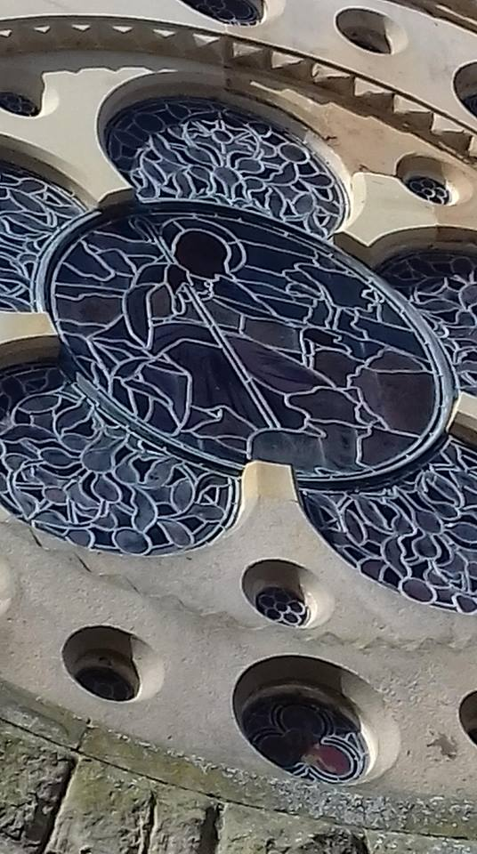
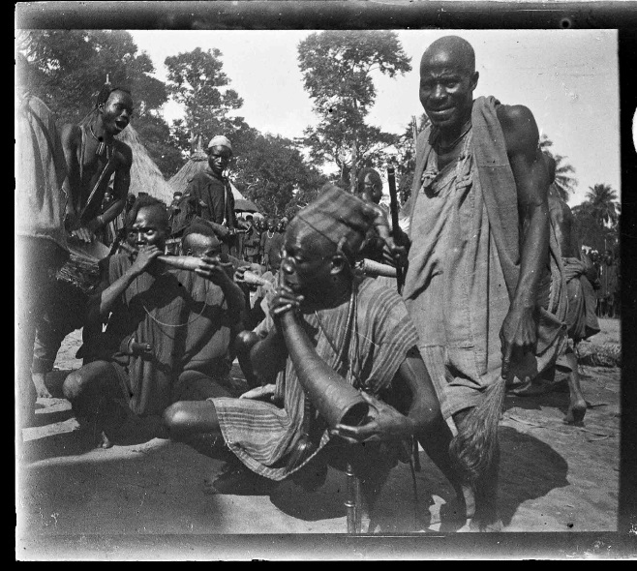
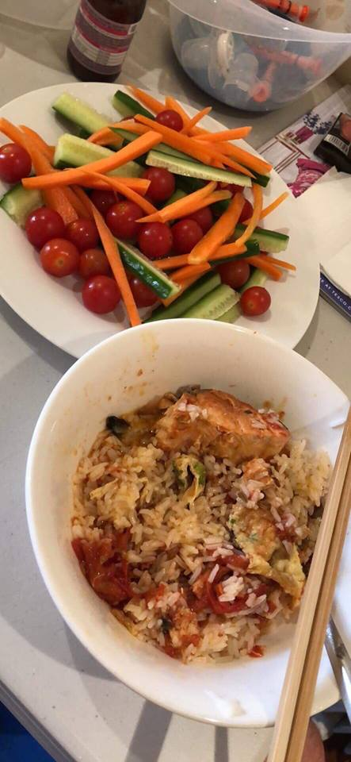
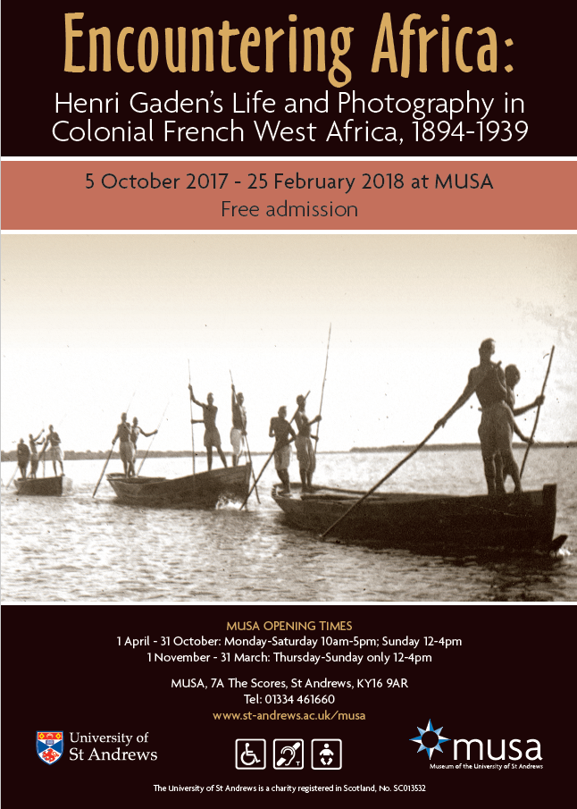
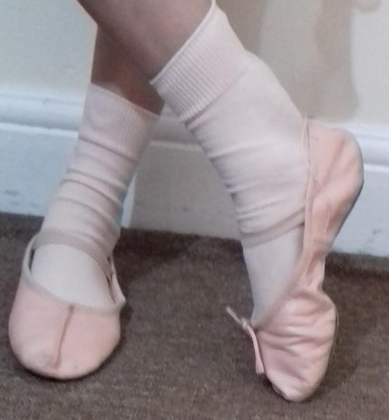
From Encountering
Africa…
…to Encountering Fife
Notes:
This final piece of the puzzle came not from research, but from another project at MUSA.
Entitled Encountering Africa, it displayed photographs taken by Henri Gaden, a French colonial officer, at the end of the 19th and start of the 20th centuries to present his perspective on West Africa. It both examined this region as an alien culture and looked at the opinions and prejudices of the incomer. What was missing from the presentation was the voice of the local people whose way of life was under examination.
[*****]
And thus the Encountering Fife project was born, deliberately turning this around to give migrants to our corner of Scotland the opportunity to use photography, as had Gaden, to present their own perspectives on an "alien culture", though this time the alien culture would be one with which those visiting the resulting exhibition would be very familiar, the one in which they live. In turn, it was hoped that the migrants would share something of their own experiences.
The intention was to give migrants, whose voices are largely hidden from media reports on immigration, the opportunity to speak and be heard.
This in itself doesn't seem particularly audacious; museums have been doing arts projects with under-represented communities for many years.

Slide 16
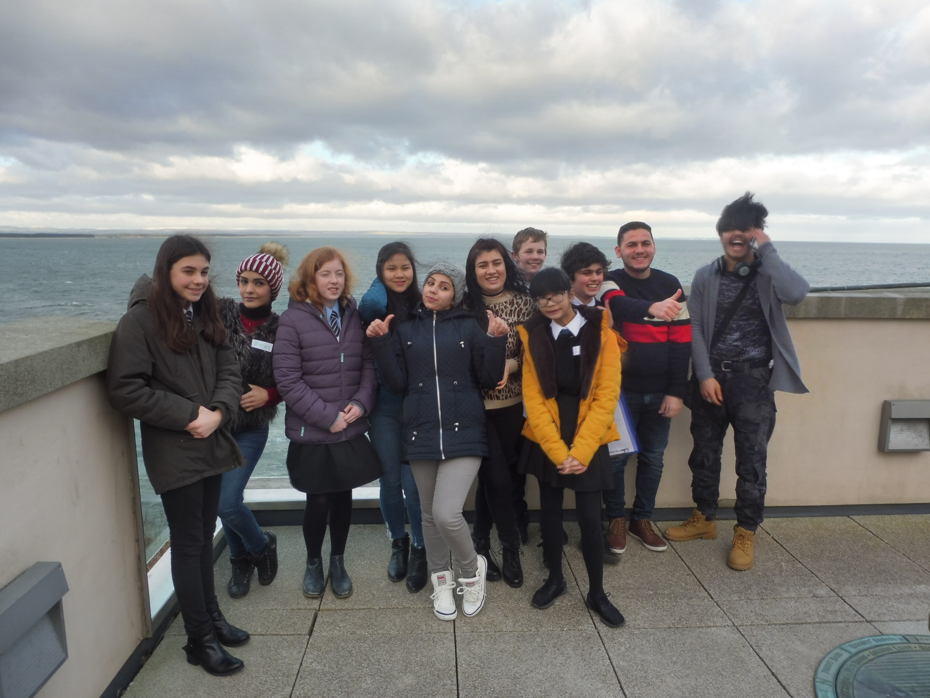
Notes:
Rather than working solely with migrants, however, we introduced a group of British secondary school pupils into the mix.
While the migrants would take the photographs, the school pupils would work closely with them to create the exhibition.
This would give the pupils the chance to develop skills such as budget and project management, clear communication, marketing, negotiating and more besides - employability skills that can be transferred across different working environments, as well as experience of employment opportunities in the arts and culture, as well as to learn about migrant life directly from the migrants themselves.
Importantly, it would also allow the migrants to get to know some local people while being forced to use their English, creating that language-development opportunity.

Slide 17
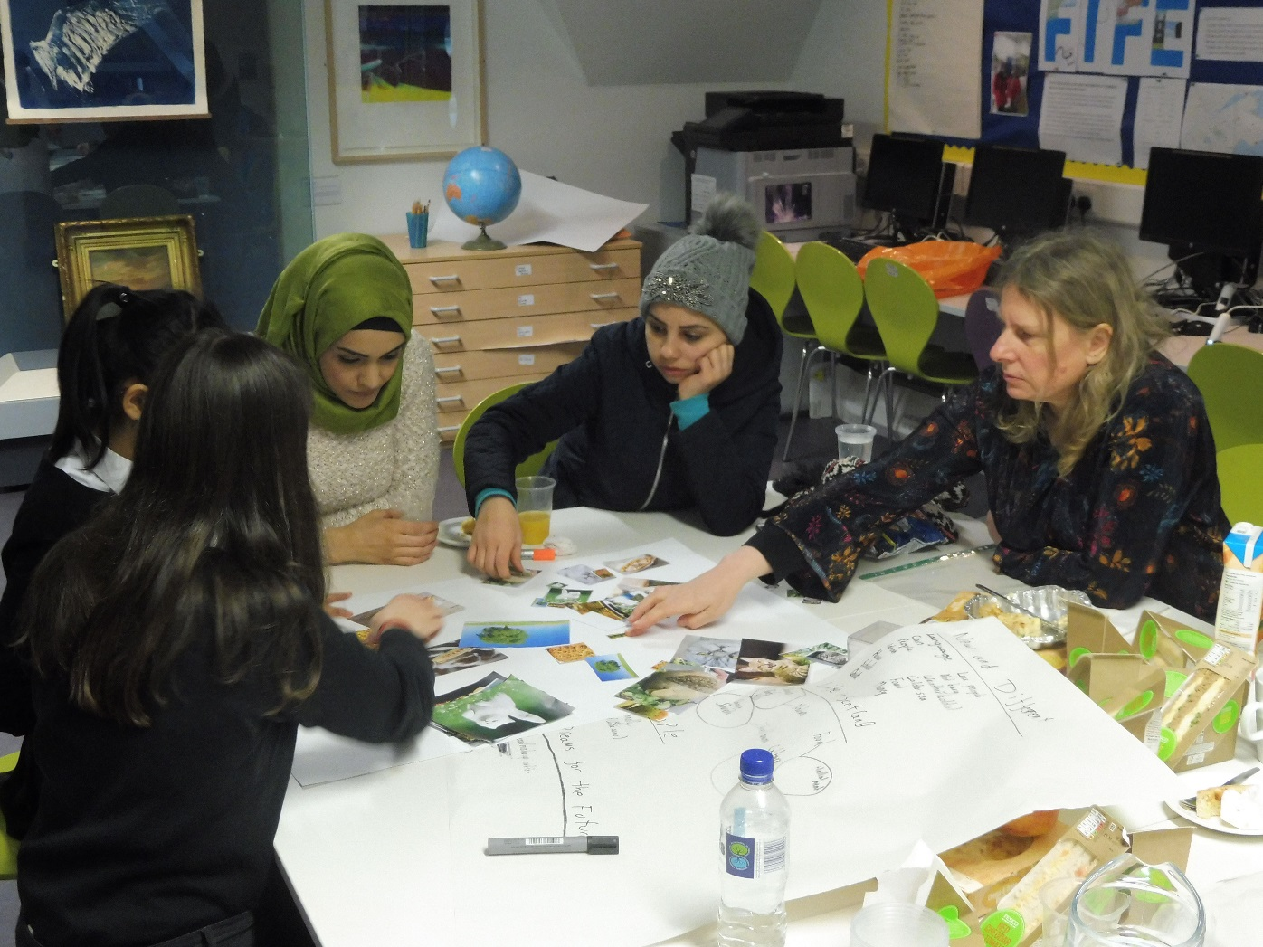
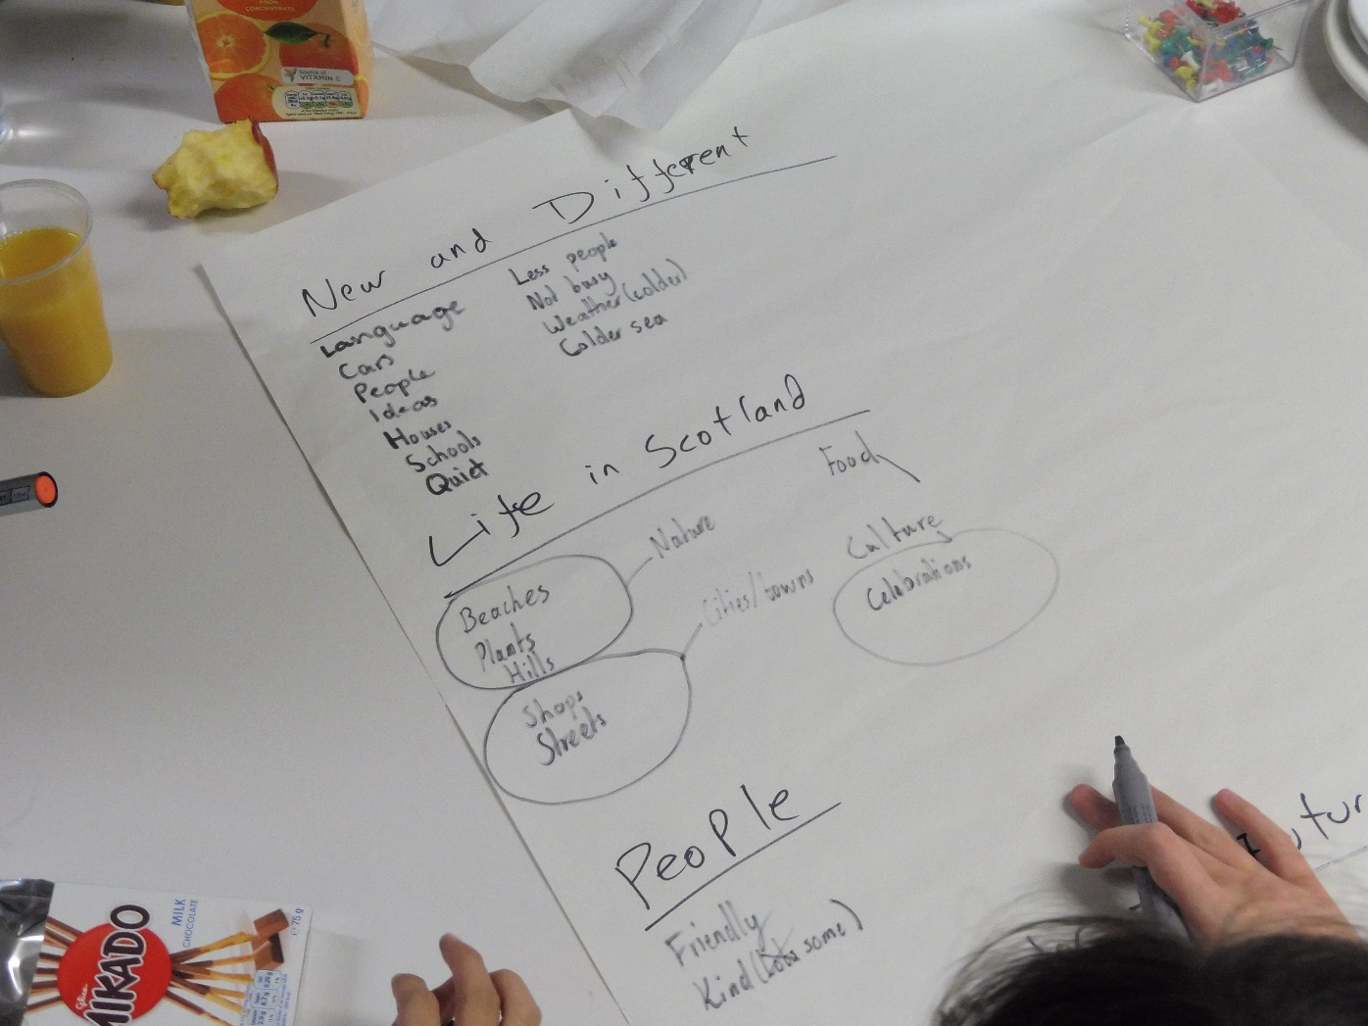
Notes:
Over the course of seven months, the group met regularly to develop the project.
The school pupils would arrive at a session first and have one or two hours of hands-on training before the arrival of the migrants. This training began with how to engage with migrants and low-level English speakers, looked at how to plan an exhibition, manage budgets, carry out fundraising, negotiate, write engaging interpretation, take notes, research and more besides that will be useful to them in the world of work.
This part of the project was also based on research, this time into how to engage and build skills among teenagers that we had carried out back in 2012.
The pupils were set challenges: how much of the gallery text in the museum could the students read in the average length of time that visitors spend there (answer: not very much), which of the labels are interesting, which get the information across well, how much do they think the different aspects of this exhibition cost?
We'd also discuss more detailed issues in which the migrant group didn't need to be involved; issues related to marketing, for example, or the more technical side of the display.
These training workshops prepared them for what they would do in the rest of the session.
They then spent the rest of each session engaging with the migrant group, discussing issues such as what they find difficult about life in Scotland to enable them to decide what to photograph, listening to explanations of their photography and discussing the layout of the exhibition.

Slide 18
Aims
Build relationships between young migrants and young locals
Develop employability skills of migrants and school pupils
Develop language skills for migrants
Help school pupils understand how to help low-level English speakers
Allow migrants to share experiences
Help communities understand migrant needs
All taken directly from New Scots Refugee Integration Strategy
Notes:
We aimed in our programme to respond to many of points made by the government's New Scots strategy.
We devised a project that would allow young migrants to get to know young local people and combat social isolation.
It aimed to allow them to develop skills, demonstrate their potential and share their dreams for the future.
We planned that the close working of migrants and school pupils would enable the former group to practise their English in a real-world setting outside the classroom and help the pupils understand how to help low-level English speakers to communicate.
It was also hoped to allow migrants to share their experiences of life in their host communities, both by talking with the school participants and through the stories told in the exhibition. This, in theory, would help those communities begin to understand their needs and to accommodate them.

Slide 19
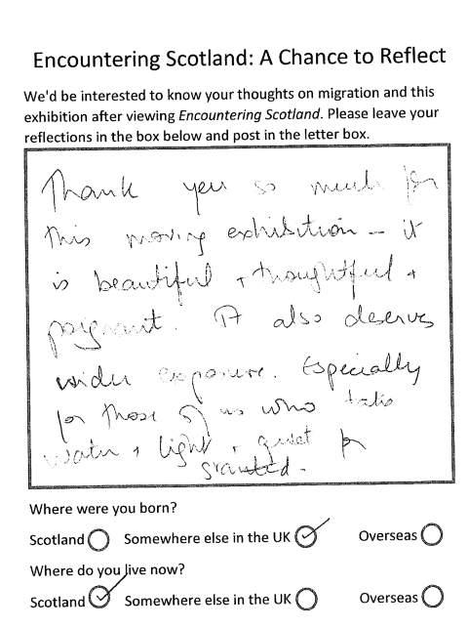
Research
In-depth interviews with participants
Reflection cards at the end of the exhibition
No attempt to compare attitudes before and after the display
Intention to study long-term effects of project on participants, currently too early for results in this area.
Notes:
Having based most of what we were planning to do on research, of course we used the opportunity to evaluate and research how this programme works and what it can tell us about seeking to achieve these aims through museum-based integration programmes.
We carried out in-depth interviews with participants and with their tutor.
The exhibition was displayed at our own venue in St Andrews before moving to Fife Cultural Trust’s museum in Dunfermline, where it will be until the middle of next month. At the end of the displays visitors are asked to complete reflection cards, on which they are simply asked to leave their thoughts about what they’ve seen and the topic of migration.
We didn’t attempt to record the attitudes of visitors before or after visiting – the exhibition is one aimed at stimulating reflection and we didn’t wish to intrude at the start in a way that would make visitors feel studied.
We do intend to investigate the long-term effects of this project on the participants themselves, though we’re already facing problems around this, of which more later.
So, what has and hasn’t worked?

Slide 20
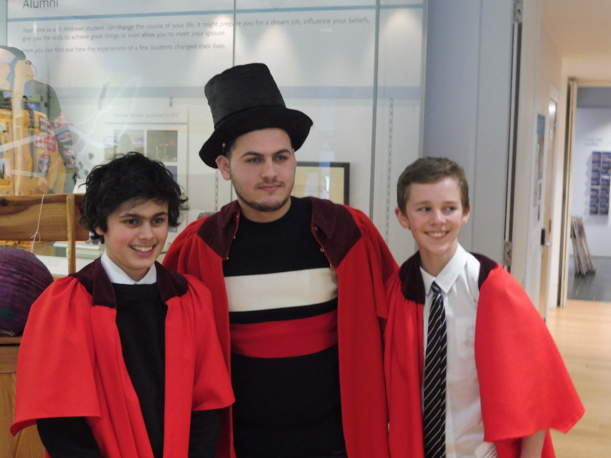
Positive outcomes: Sharing experiences
“I liked seeing how different cultures operated and the stories they tell.”
School participant
“They struggle with loneliness.”
Charlotte, school participant
“They like to joke, they’re happy. I expected them to be sad.”
Gregorz, school participant
Notes:
So has it worked?
The project has had a number of positive outcomes and achieved many of the objectives:
1. The migrants state that they have had the opportunity to share their experiences of life in a new place with the school pupils, and the pupils have certainly learnt a lot about life from them.
[*****]
When asked what they had enjoyed most about the project, all of the pupils mentioned learning about the migrants' experiences.
There is also evidence that the pupils learnt specific things about life for migrants.
[*****]
"They struggle with loneliness," said one pupil, picking up on one of the key problems that the migrants had brought up and which the Scottish government's own research had highlighted. "Their family isn't here, so they feel upset. They also have communication difficulties, which makes it harder.“
[*****]
Expectations and preconceptions were changed.

Slide 21
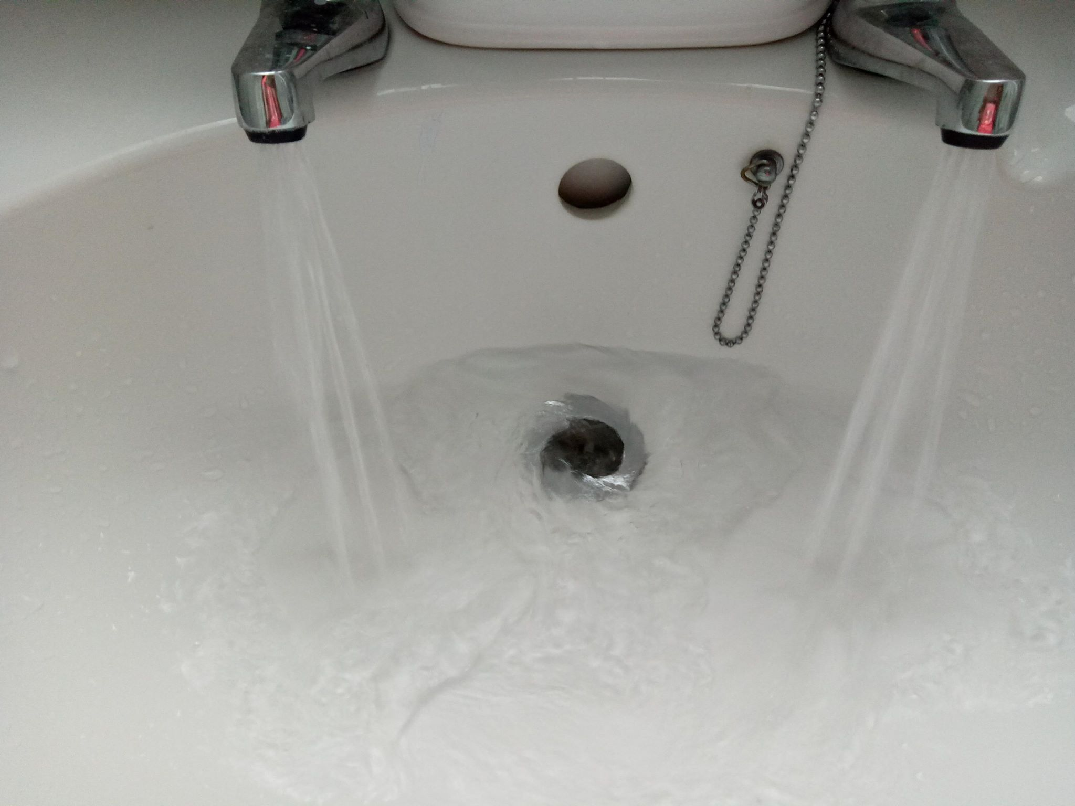
Positive outcomes: Sharing experiences
“…Rayan took this picture because she is grateful for the water here. Even if you have water in Syria, it is very dirty and can carry diseases…”
Label, written collaboratively by pupils and migrants
Water
Rayan
Notes:
The sharing of experiences is evident from the participants' photographs coupled with the labels the pupils and migrants wrote in collaboration.
This picture was accompanied by the following:
"This is different from Syria because there there is very little water or no water at all. Rayan took this picture because she is grateful for the water here. Even if you have water in Syria, it is very dirty and can carry diseases. This is why she likes living in Scotland. How would you feel living with dirty water?“
This aspect of life in Syria was something all the pupils remembered and brought up in conversations after the project.

Slide 22
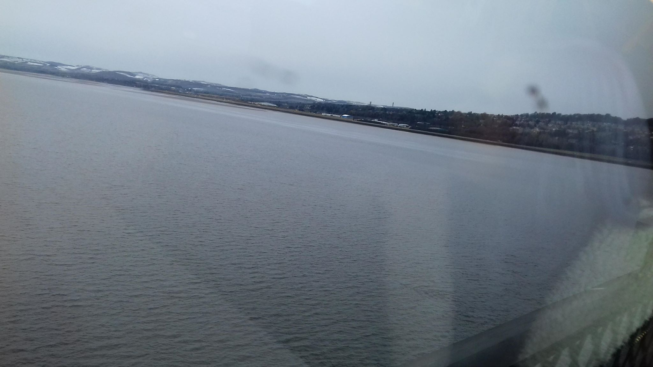
Positive outcomes: Sharing experiences
“…She didn’t mean to capture her friend’s reflection originally and when her friend saw the photo they both smiled…”
Label, written collaboratively by pupils and migrants
Reflection
Marwa
Notes:
We get insights of happiness and joy:
"This was taken on Marwa's first train trip to Dundee. She liked how the sea surrounded her and she felt happy and excited. She didn't mean to capture her friend's reflection originally and when her friend saw the photo they both smiled. The sea gives Marwa a calming, romantic feeling."

Slide 23
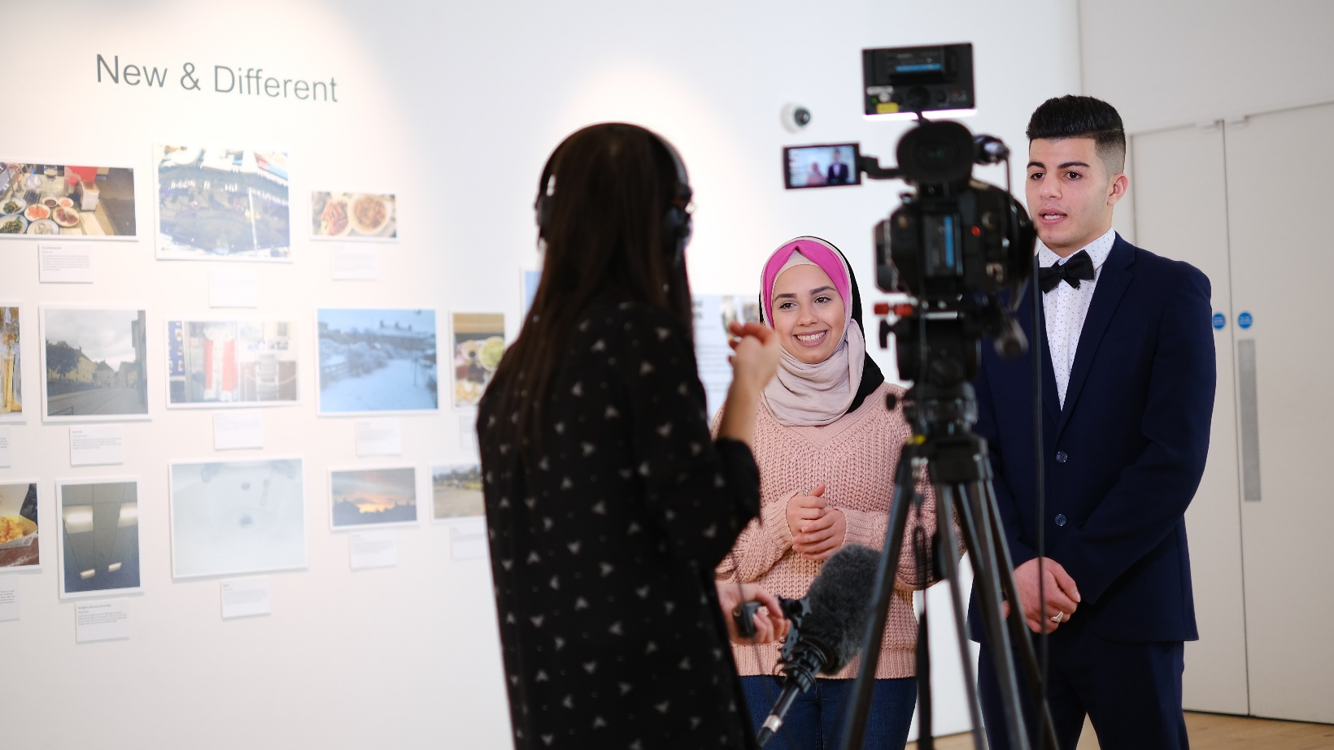
Positive outcomes: Sharing experiences
“In Syria you can’t do anything, no jobs, no work, hard to go outside, you go outside you die.”
Feras, migrant participant, in television interview about the project
Notes:
Opportunity to share stories to a wider audience through spot on Scotland-wide news, opportunity to give the migrant’s point of view, one of our aims.
The use of data told us that this might be a positive outcome, and it was.

Slide 24
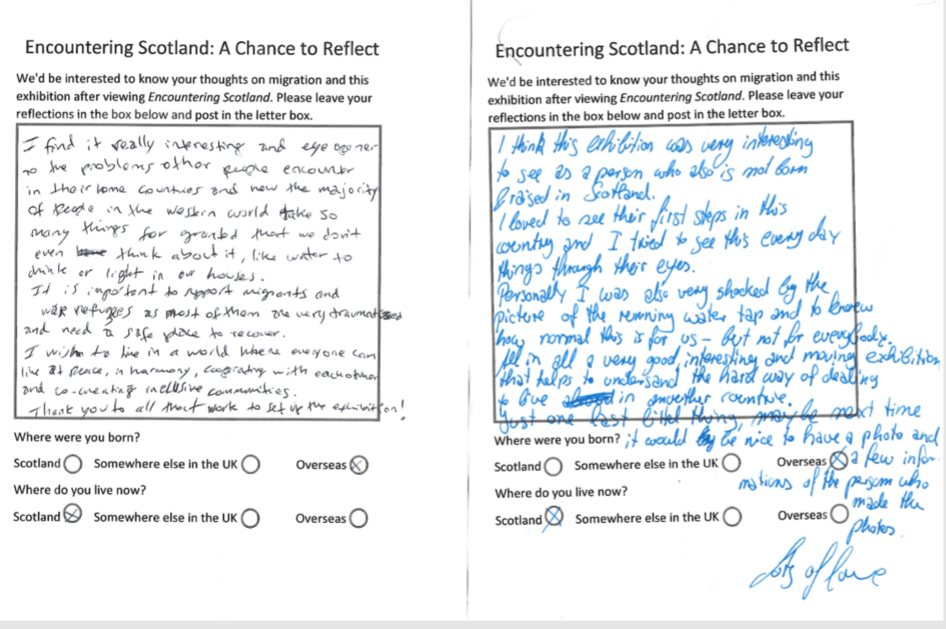
Positive outcomes: Thought-provoking
“The photographs do encourage one to reflect.”
Visitor reflection card
“Thought-provoking to see the things/differences that people notice.”
Visitor reflection card
“A fascinating insight – seeing life in Scotland through the eyes of others.”
Visitor reflection card
Notes:
2. Visitors were certainly encouraged to think, indicated by the comments left on reflection cards, and to see things from a different perspective. Many of the comments received were extensive, far longer than we’d expected, and often very insightful.

Slide 25
Positive outcomes: Thought-provoking
“It was very interesting to see the photos, things that most people take for granted, like clean water, electric light.”
Visitor reflection card
“Made me reflect on what we take for granted.”
Visitor reflection card
“Our abilities are usually something we should grow, but many of these photos teach us that we have one ability we should decrease – the ability to take things for granted.”
Visitor reflection card
“We never thinking about we had in own life, on something very simple like water [sic].”
Visitor reflection card
Notes:
One notable aspect was the way in the exhibition encouraged people to consider the things they take for granted, a response seen in a lot of the cards.
This is good, they’re certainly positive responses, but isn’t exactly what we set out to do, which was to give people a more balanced view of migration than that presented in the media.

Slide 26
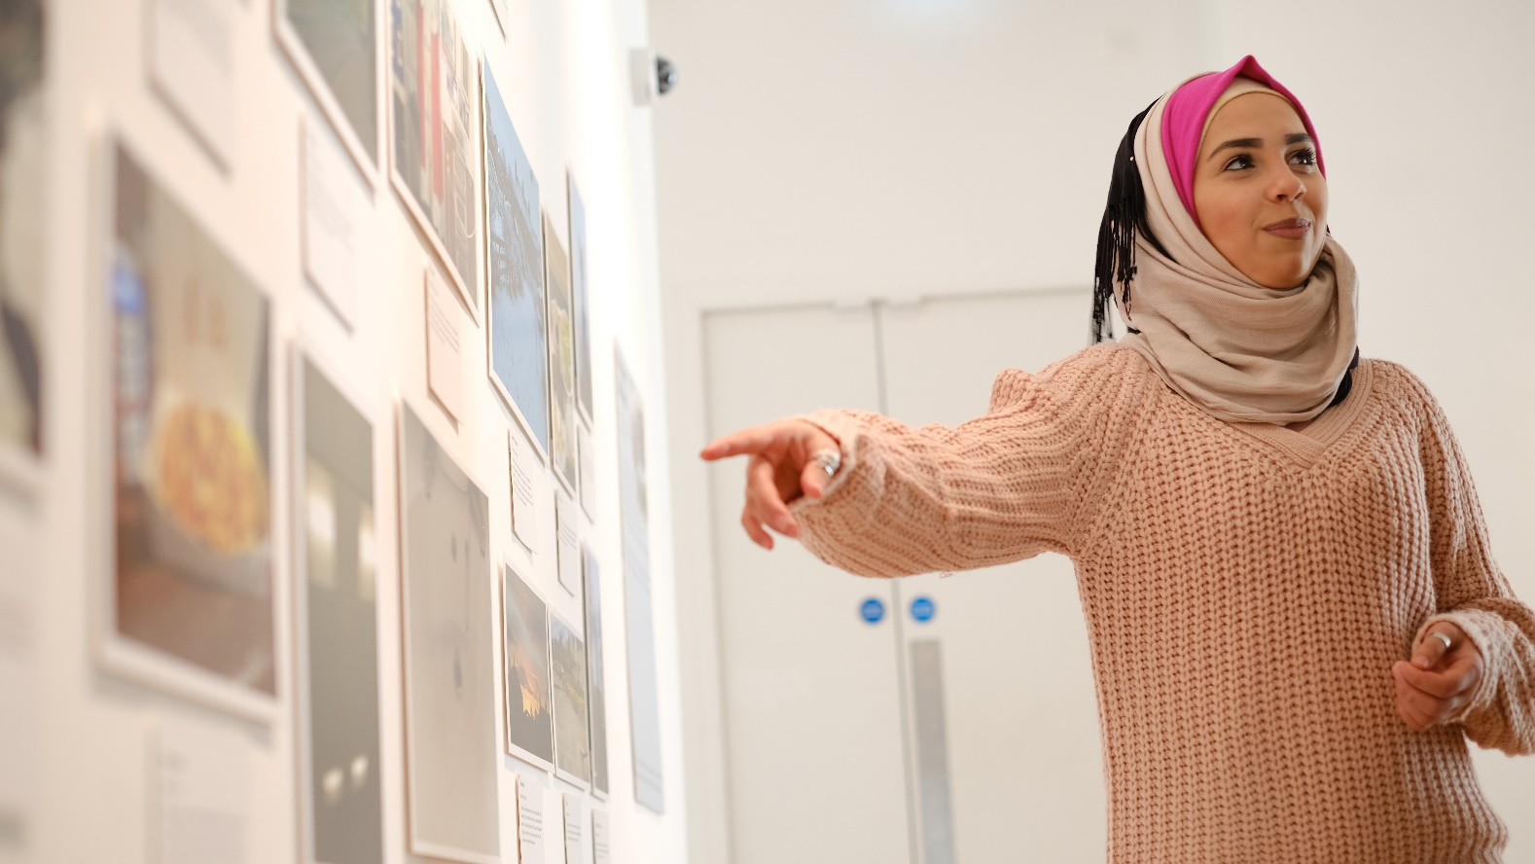
Positive outcomes: Thought-provoking
“…interesting and moving exhibition that helps to understand the hard way of learning to live in another country.”
Visitor reflection card
“I can only imagine how it must be hard to migrate to another country when you were forced by the circumstances but the emphasis put on these little pieces of happiness is really nice.”
Visitor reflection card
Notes:
This was seen in some of the responses. Some reflection cards demonstrated people thinking from the migrants’ perspective, both about the positives and negatives of the migrant experience, which is what we had hoped to achieve.
However, these responses were not as extensive as we had hoped and a large proportion of them came from visitors with personal experience of living in a country other than the one in which they were born.
The use of data told us that this was something we should aim for, but it didn’t tell us how successful we’d be. The jury’s out at the moment, some success but not as extensive as we’d hoped.

Slide 27
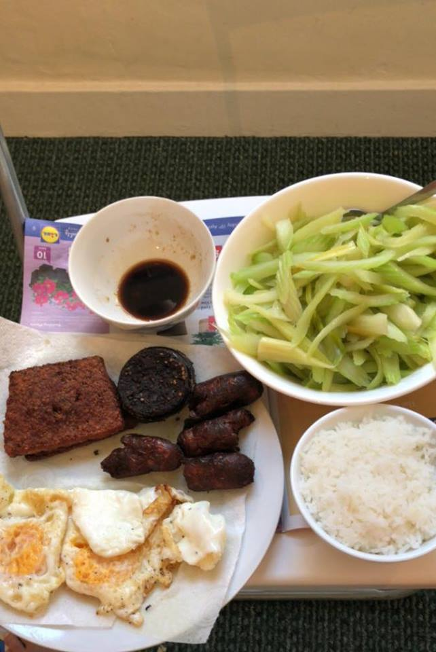
Positive outcomes: Use of photography
“Previously I took photos for good memories, I took selfies. Now I learnt how to take good photos, I can translate photos.”
Marwa, migrant participant
“Photos show feelings, everyone likes photos. I like to know my photos will be seen.”
Naila, migrant participant
Fusion Food
Quyen
Notes:
3. The use of photography didn’t come from the data, this is something that we’d used our professional specialisms for. The aim of using photography was to illustrate experiences and provide the need to discuss why certain photographs had been taken, playing a key role in this sharing.
In order to write interpretation for the photographs, the migrants and the pupils had to discuss the reasons for what they had chosen to capture, forcing conversation to go deeper.
Two of the pupils highlighted seeing the migrant group's work and discovering their thoughts behind the images as the thing they enjoyed the most.
[***]
Photography was also key to the migrants' experience. They feel a sense of pride that their work is going to be put on display and seen by others. Their own sense of how photography can be used has also developed.

Slide 28
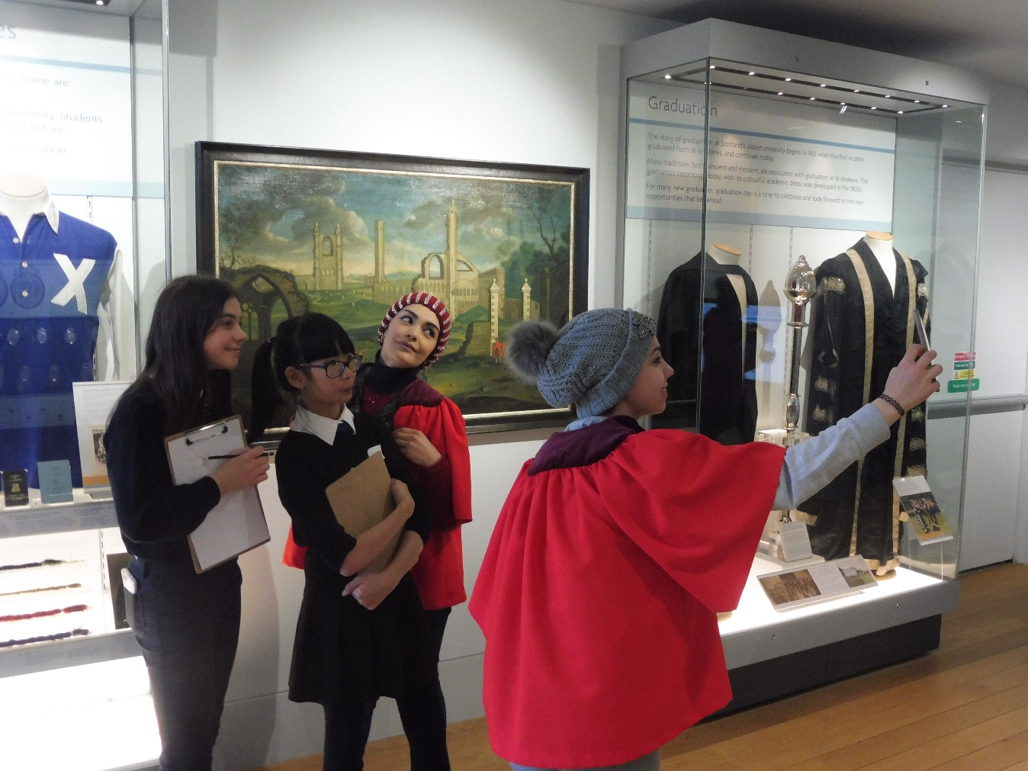
Positive outcomes: Working with school pupils
“They are friendly. They help us a lot and give us good ideas.”
Migrant participant
Notes:
4. The migrants enjoyed working with the school pupils.
The pupils were quite young, around 13 years of age, while the migrants were older, aged between 16 and 30. At times I thought things were strained, that the migrants were struggling with the relative immaturity of the pupils. When asked what they thought of working with this group, however, they were quick to respond positively.
"They are very friendly," said one of the group. "They help us a lot and give us good ideas.“
Members of the group regularly highlighted how few Scots they know in their new homes, with most of their friends coming from the migrant community. They expressed pleasure at being able to meet local people and build friendships through the project.
Nevertheless, given the age differences, it seems unlikely that these friendships will continue beyond the end of the project.
This aspect of the project came from the data and worked well.

Slide 29
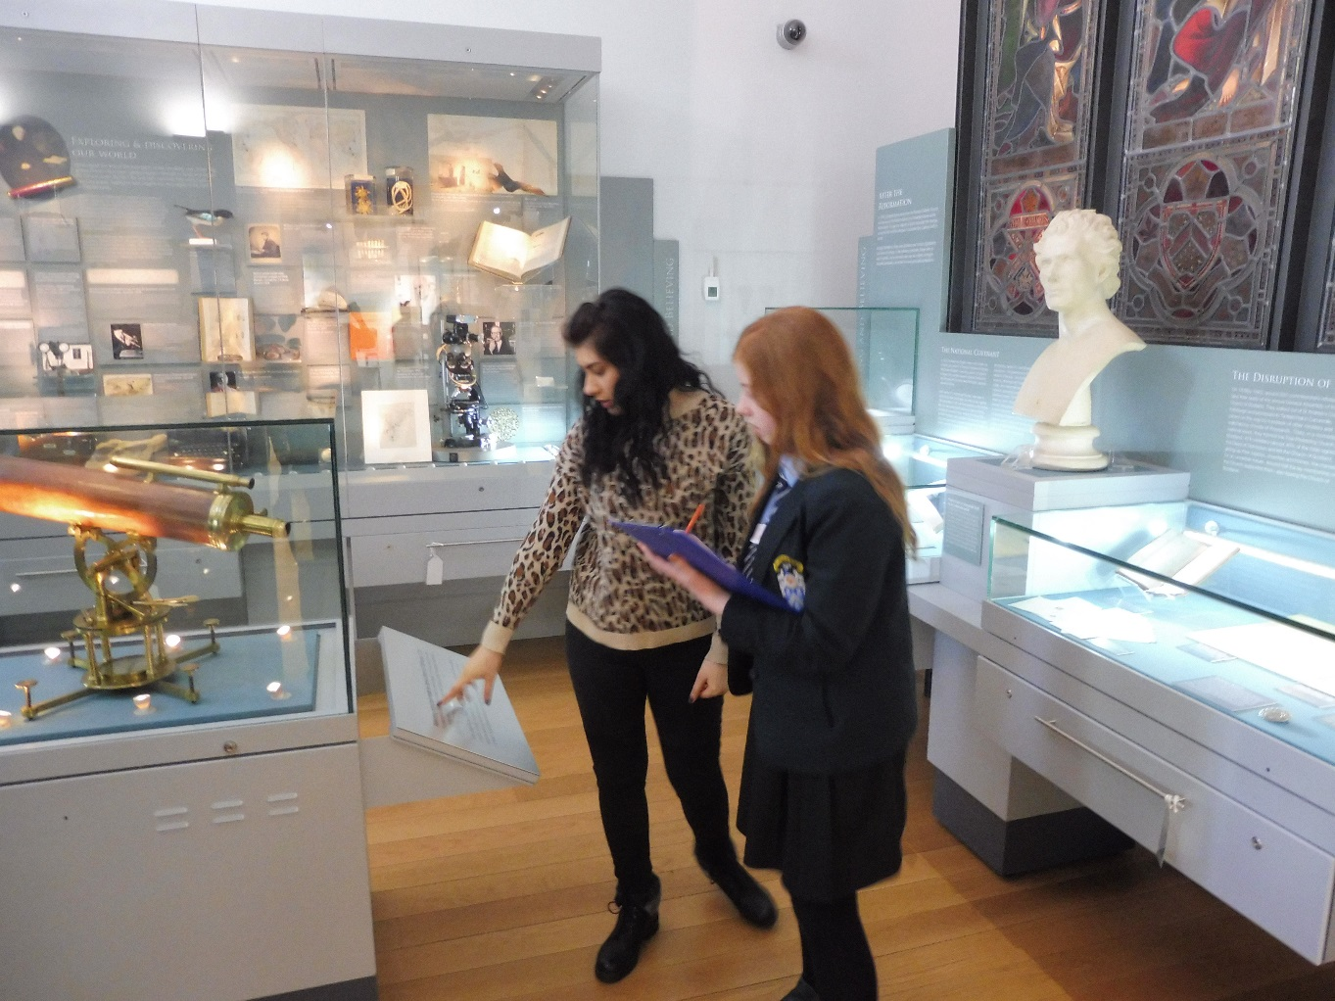
Positive outcomes: Language learning
“I like practising English… My English has improved, it’s given me confidence.”
Rayan, migrant participant
“Sometimes I’m shy to say that I don’t understand, I can say this now.”
Migrant participant
“Nobody here laughs when you get something wrong.”
Migrant participant
Notes:
5. As hoped, the project has also had a positive effect on language learning and confidence.
[*****]
"I like practising English, I didn't learn English in Syria," said 16 year-old Rayan, the youngest member of the group. "My English has improved, it's given me confidence. I've learnt two things - English and photos.“
All members of the group highlighted learning English, and in particular being given confidence in English, as something they had gotten from the project.
[*****]
[*****]
"Nobody here laughs when you get something wrong," said another. "I've gained confidence.“
The ability to practise English with native English-speakers in a non-classroom setting, one that allowed for more natural interactions, appears to have had a strong impact on this growth in ability and confidence.
"I now know how to speak to people," said one of the group.

Slide 30
Positive outcomes: Language learning
“It was a very rewarding way to work. To facilitate an opportunity for ‘real’ language contact with native speakers. It’s a surprisingly difficult thing to achieve… I truly felt the students benefitted greatly, especially with regards to their confidence.”
Alison Marshall, ESOL tutor
Notes:
Putting migrants in a setting where they have had to use their English and need to make themselves understood to those with only a limited ability to help them has also been key to this.
Their teacher agreed: "It was a very rewarding way to work," she said. "To facilitate an opportunity for 'real' language contact with native speakers. It's a surprisingly difficult thing to achieve, the way we [at the college] are currently set up. I truly felt the students benefitted greatly, especially with regards to their confidence.“
Again, the data highlighted this as an important factor.

Slide 31
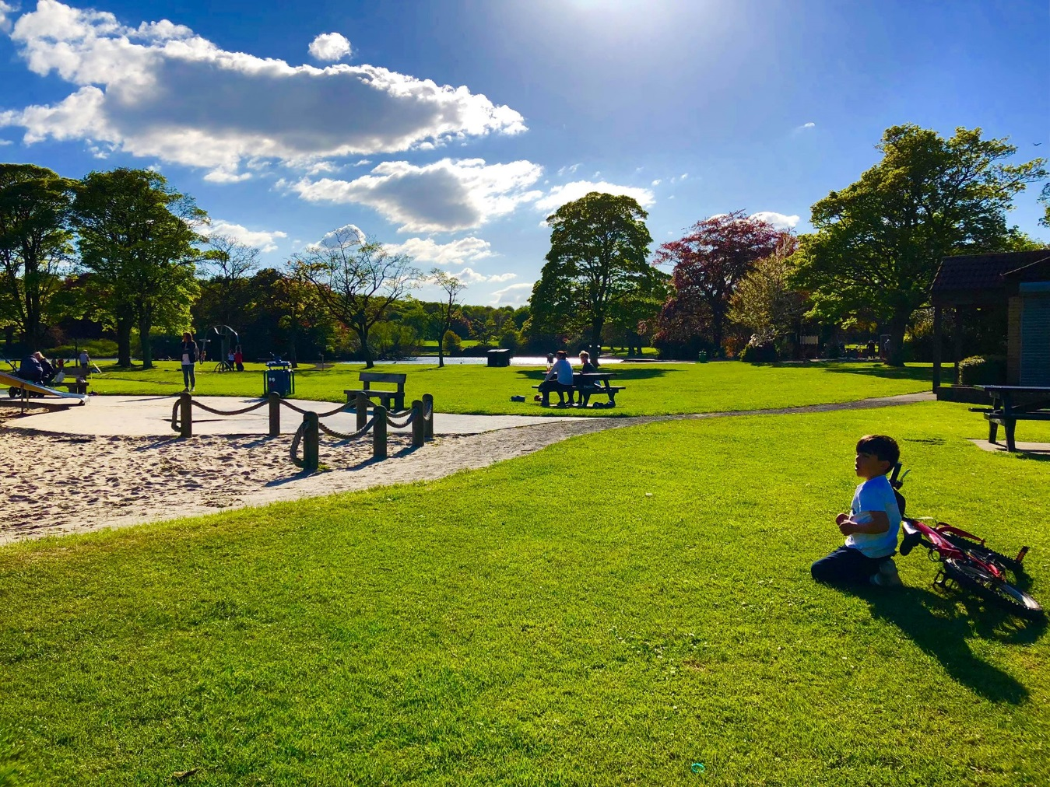
Positive outcomes: Travelling
“I’ve gained confidence in travelling. I was nervous [about travelling] before this.”
Migrant participant
Perfect Day
Fidan
Notes:
6. There has also been a big unexpected outcome, and that is the confidence that the group have gained in travelling.
The group members live all over the region, some as far as thirty miles from the museum, and have had to use public transport to travel to sessions.
This was greatly helped by the donation of bus passes by the region's bus company, which allowed them to travel for free throughout the area.
Initially the group's ESOL teacher made travel plans with the group and travelled with them, but towards the end of the project the group travelled alone.
Their teacher noted a growth in confidence in this area and one of the group stated this:
"I've gained confidence in travelling, I was nervous [about travelling] before this."

Slide 32
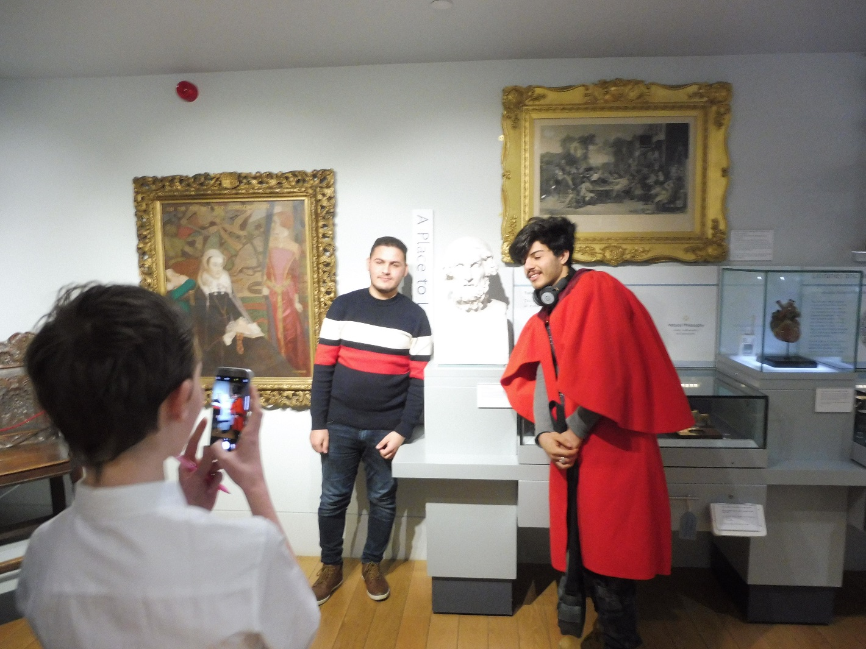
Positive outcomes: Sense of belonging
“I have a strong sense they felt ‘I have a place here.’ Knowing how to make their way there, and knowing they would see familiar, friendly faces, is a very precious thing and its value shouldn’t be underestimated.”
Alison Marshall, ESOL tutor
Notes:
7. The ESOL group benefitted greatly from visiting an educational establishment on a regular basis.
They gained a strong sense of belonging, which for people in their position is of great importance.
For migrants to be able to feel that the University is a place for them is not only important for them, but it's also a notable PR opportunity for an institution that's seen as being for the privileged and a key achievement for a museum that wants people from all backgrounds and situations to visit and feel welcome.

Slide 33
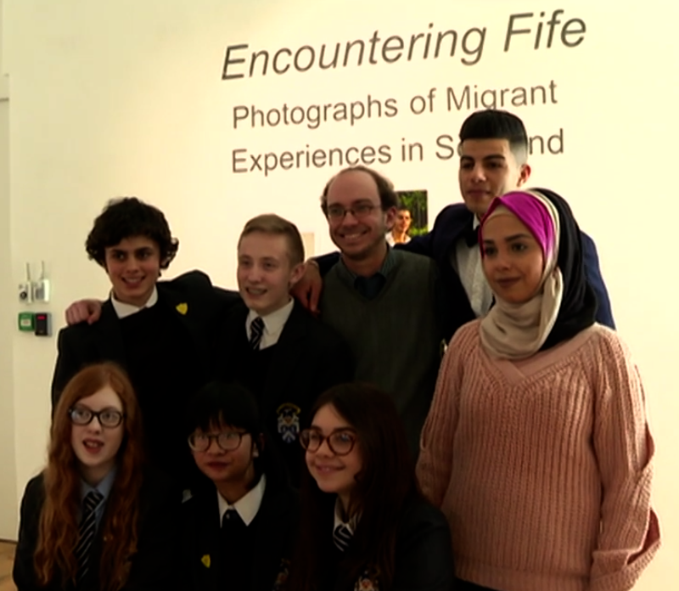
Positive outcomes: More representational content
“When I came to Scotland from Denmark I thought the culture here would be more or less the same, I found it very difficult in the start [sic], so I can understand it must be very difficult since you can’t understand English.”
Visitor reflection card
“As a foreigner I recognised myself in some of the elements the photographers were surprised about.”
Visitor reflection card
“I think this exhibition was very interesting to see as a person who also is not born and raised in Scotland.”
Visitor reflection card
Notes:
8. We asked on each reflection card where the person filling it in had been born and where they lived now. A large proportion of reflection cards were filled out by visitors who had been born overseas, many of whom reflected on the exhibition in relation to their own experiences moving to the UK.

Slide 34
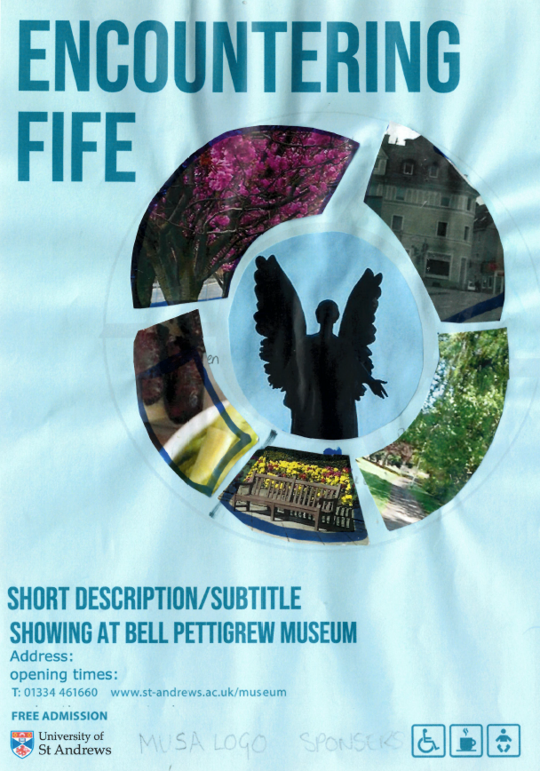
Positive outcomes: Employability skills
“[Museum work is] a lot harder than it looks! I thought labels were just a description of the photo, but it’s not!”
Gregorz, school participant
“It’s more fun than I thought, it’s not just putting up pictures. You get to work with people.”
School participant
Early poster draft and marketing experience
School pupils
“The budget! It’s more expensive than I thought!”
School participant
Notes:
9. The school pupils have also learnt about museum work and gained new skills.
[*****]
"There's a lot of thought put into panels.“
[*****]
[*****]
Pupils were particularly wide-eyed when they discovered how much some things cost and how their limited budget would not buy them nearly as much as they thought it would, an important life-lesson!

Slide 35
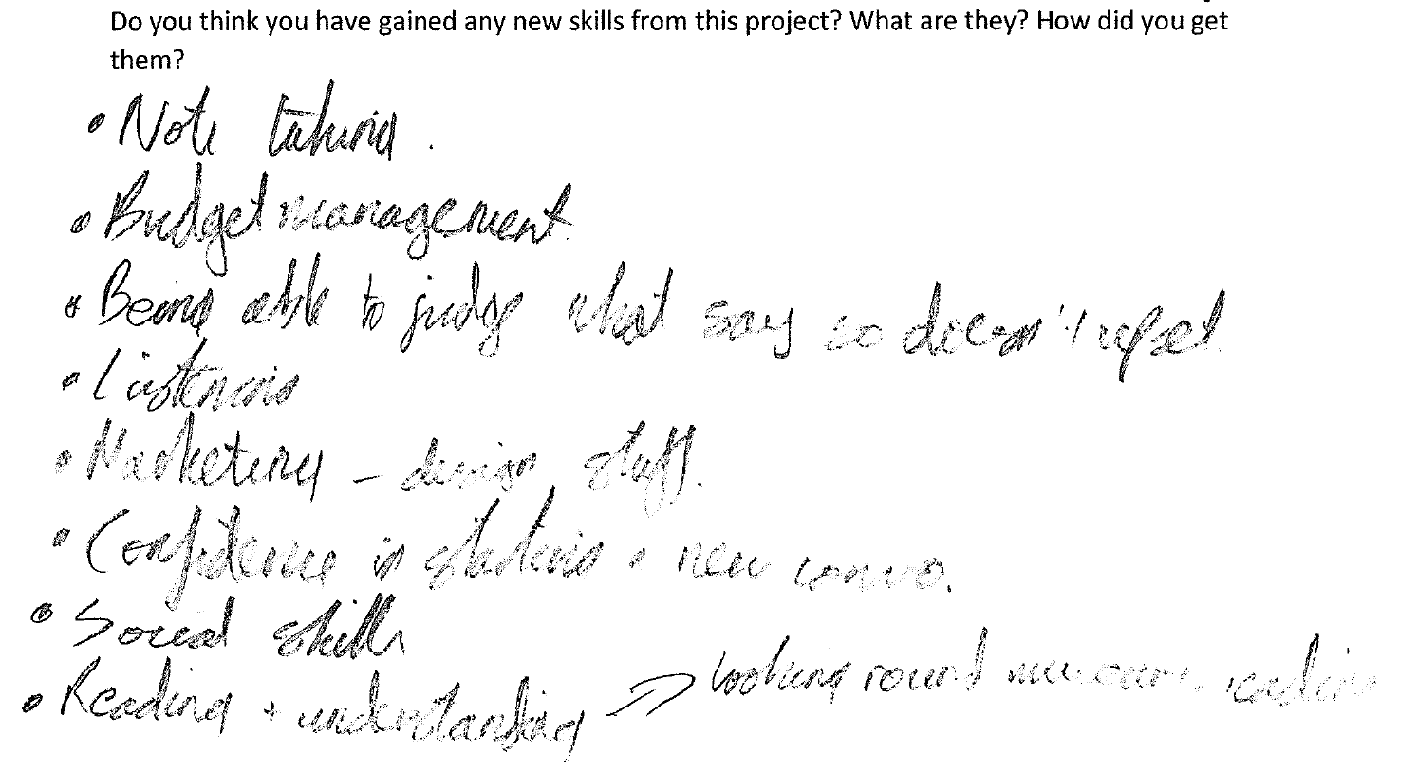
Positive outcomes: Employability skills
“ Social skills… I’m more confident in starting conversations.”
Daisy, school participant
“I didn’t like working in pairs. It was hard to communicate, I felt nervous. I’ve found this easier as time’s gone on.”
Gregorz, school participant
Notes:
When asked to list the new skills they had gained, the pupils included much of what we had aimed for - note taking, budget management, marketing - but also some that we hadn't.
"Being able to judge what to say so that it doesn't upset," said Charlotte, a soft skill that some of the conversations she'd had with the migrants had required.
[*****]
"Social skills," said Daisy. "I can be awkward to start a conversation, I've got better at this, I'm more confident in starting conversations.“
[*****]
Gregorz, one of the pupils who suffers from social anxiety, also developed important social skills. "I didn't like working in pairs," he told me. "It was hard to communicate, I felt nervous. I've found this easier as time's gone on.“
It's been possible to witness the development of skills by the pupils as well. The group have moved from writing descriptive, rather dull labels to interpretation that is better than some of that written by professionals!

Slide 36
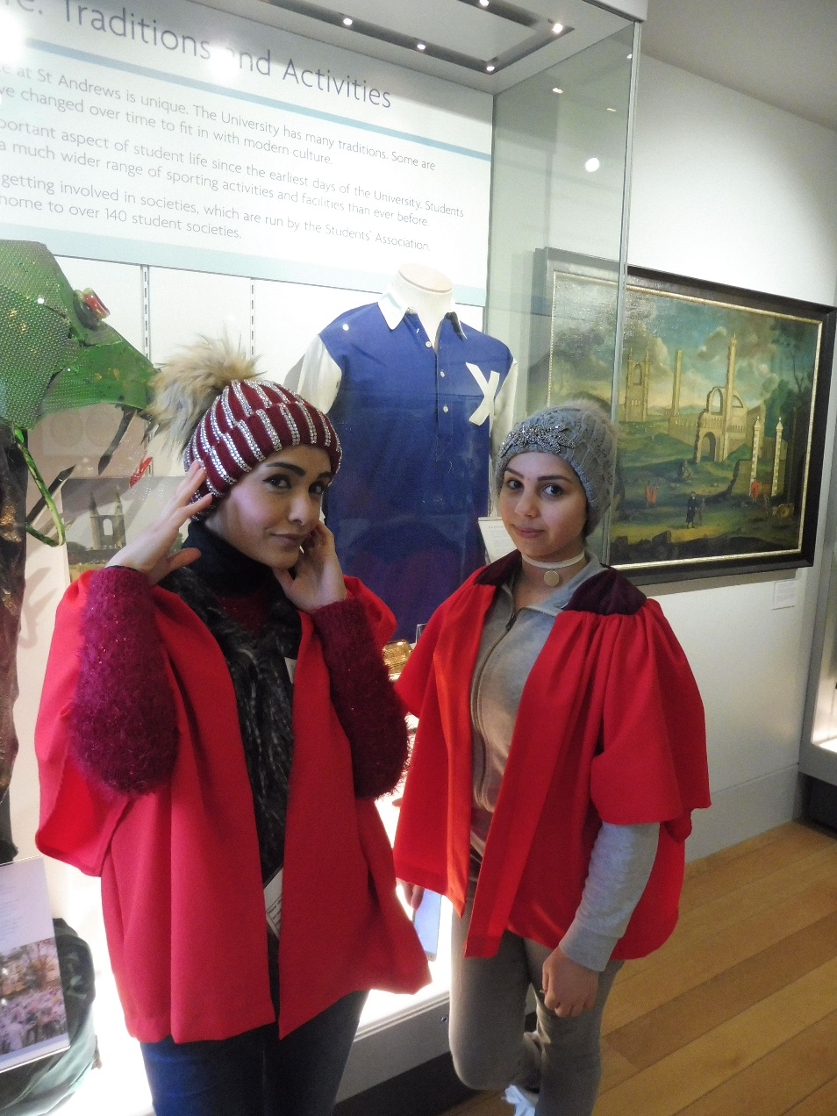
Positive outcomes: They enjoyed it!
“I will miss the project when it finishes. I don’t know what to do when it finishes.”
Marwa, migrant participant
Notes:
10. Finally, it's clear that all members of the group have enjoyed the project. All stated that they would take part if it happened again and some of the migrants became very emotional in the penultimate session.
"I will miss the project when it finishes, I don't know what to do when it finishes," said Marwa

Slide 37
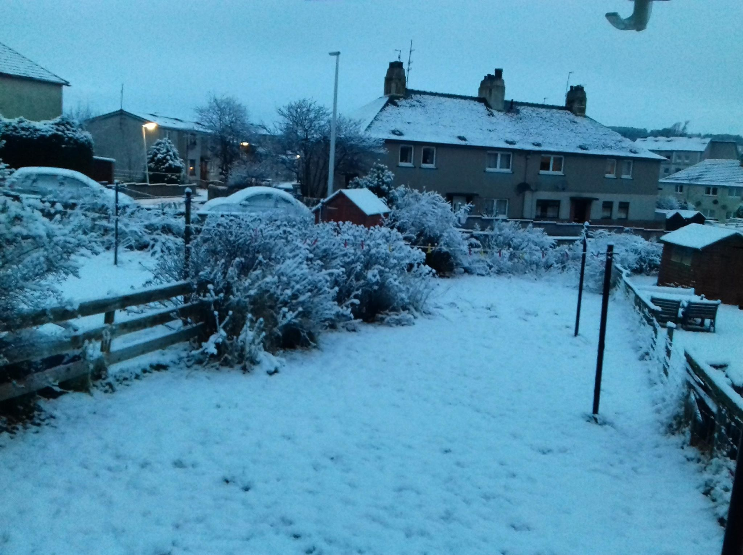

Challenges: Timing
Snake Waves
Feras
Snow
Marwa
Notes:
It would be wrong to suggest that the project has all been plain sailing. There have been a fair share of challenges also. A lot of these challenges were not related to our use of data, or were things that I’m not sure data could have helped us to foresee.
1. The whole project took a lot longer than initially intended.
Funnily enough, seven months is not enough time to carry out a project like this.
Even without heavy snow which forced some significant delays upon us, we would be struggling to have met the original timetable.
The project was originally intended to be carried out over the course of almost an entire school year, but communication problems with the participating secondary schools also caused delays.

Slide 38
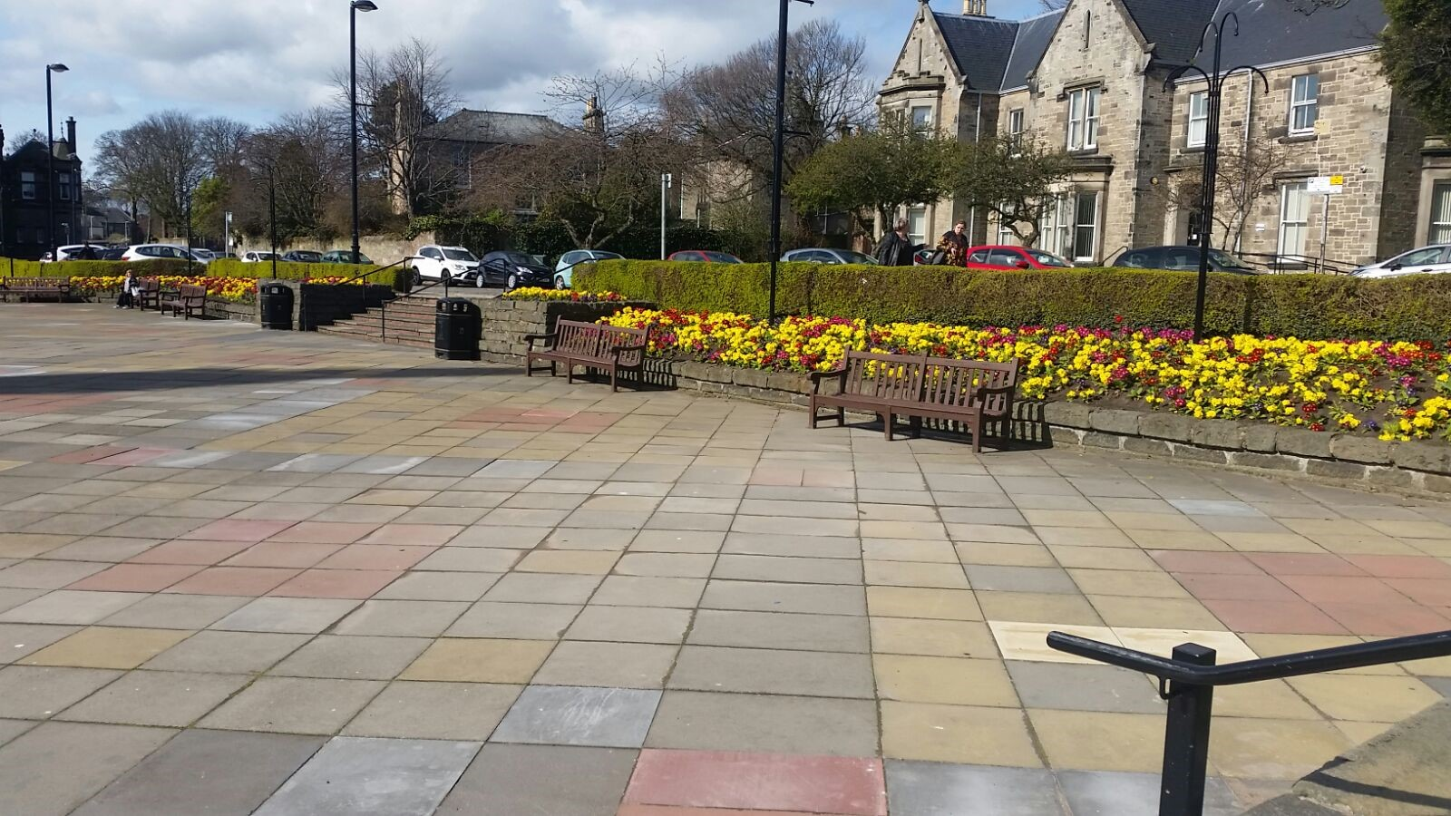
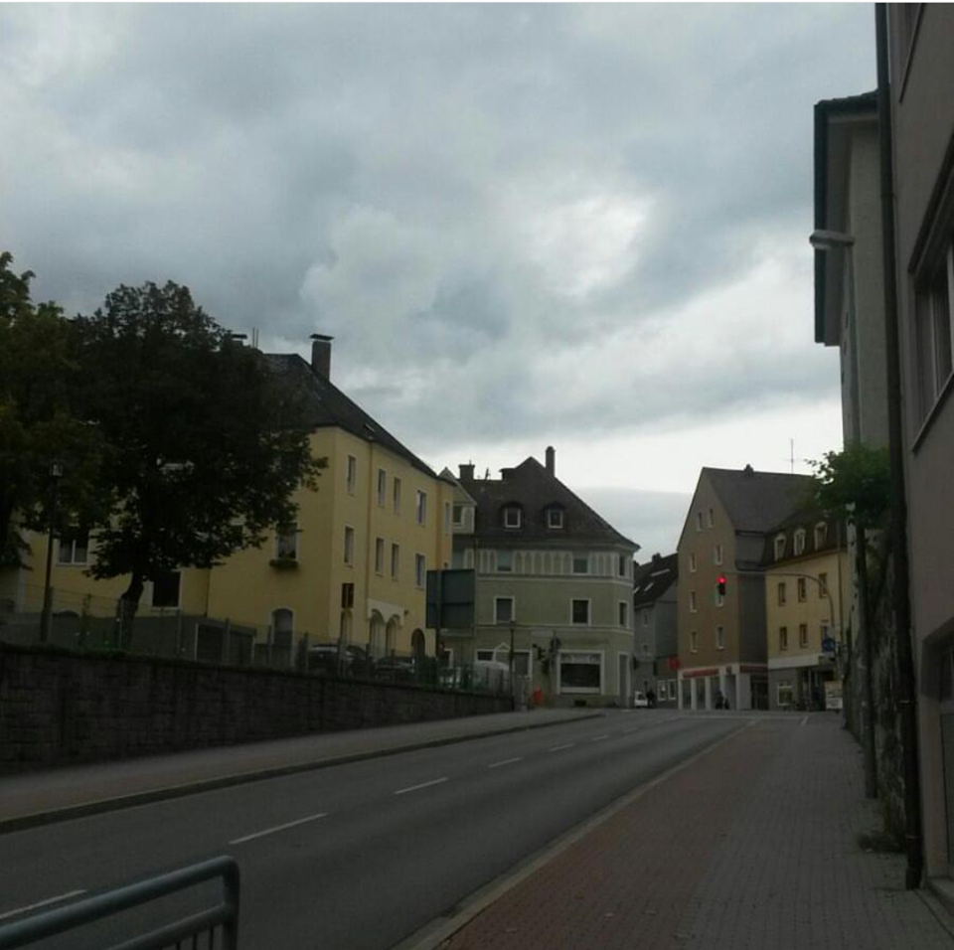
Challenges: Obtaining photographs
Quiet
Naila
Street Life
Feras
Notes:
2. Obtaining photographs was difficult also.
Initially we aimed to encourage participants to photograph under four themes: New and Different, Life in Scotland, People and Dreams for the future. In preparation we made lists in groups of some of the things they could photograph under each of these themes and the migrants went away to do their photography and did nothing.
The themes were just too broad for them. I had to sit down with each of them individually, discuss the biggest differences between their homes countries and Scotland and help them decide on a very specific theme; so for New and Different one theme was peace, another cleanliness, another food. Then I’d challenge them to take three photos on the specific theme during the week.
For a number of weeks I was concerned that we wouldn't have enough images for an exhibition.
The images were also not as expected. Because they were take on camera phones, the quality was often poor and the largest any could be displayed was at A4 size. Some will have to be much, much smaller. This limits some of the creativity that the pupils can exercise when choosing how to display the work.
The composition of the images was also better from some than with others; some participants showed real effort and development in their approach to photography while others took pictures that reflect holiday snaps. Getting some members of the group to move away from selfies was a challenge in itself.
This type of image makes the exhibition a harder sell and is less interesting visually, but isn't necessarily a problem in itself; each image still carries an important message. It has been, however, a lesson in having realistic expectations.

Slide 39
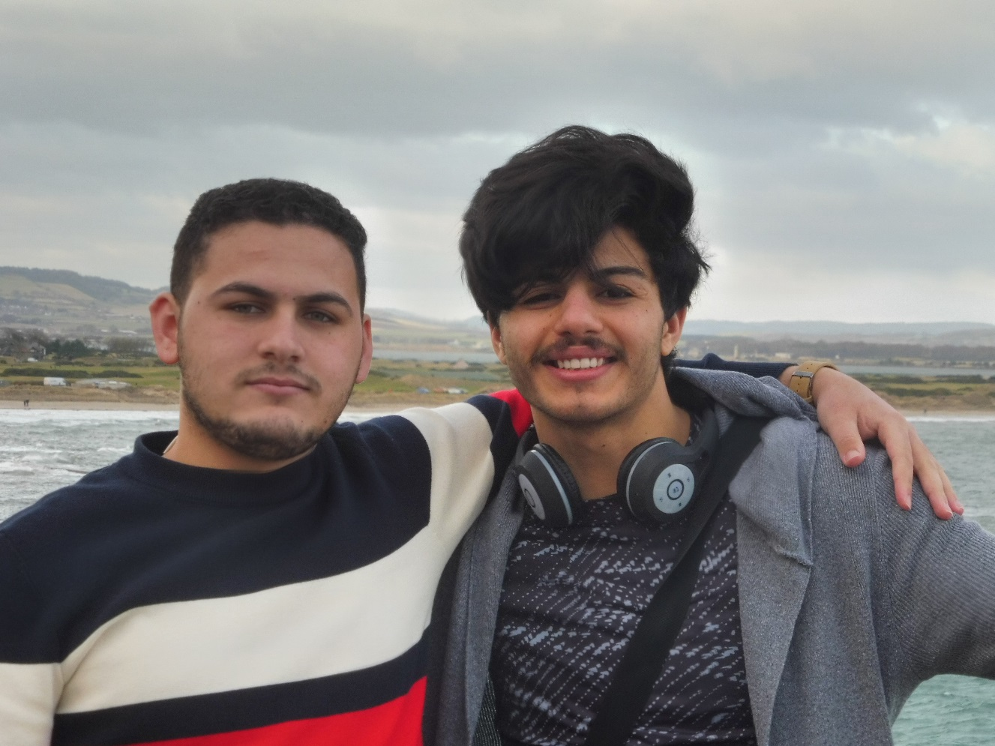
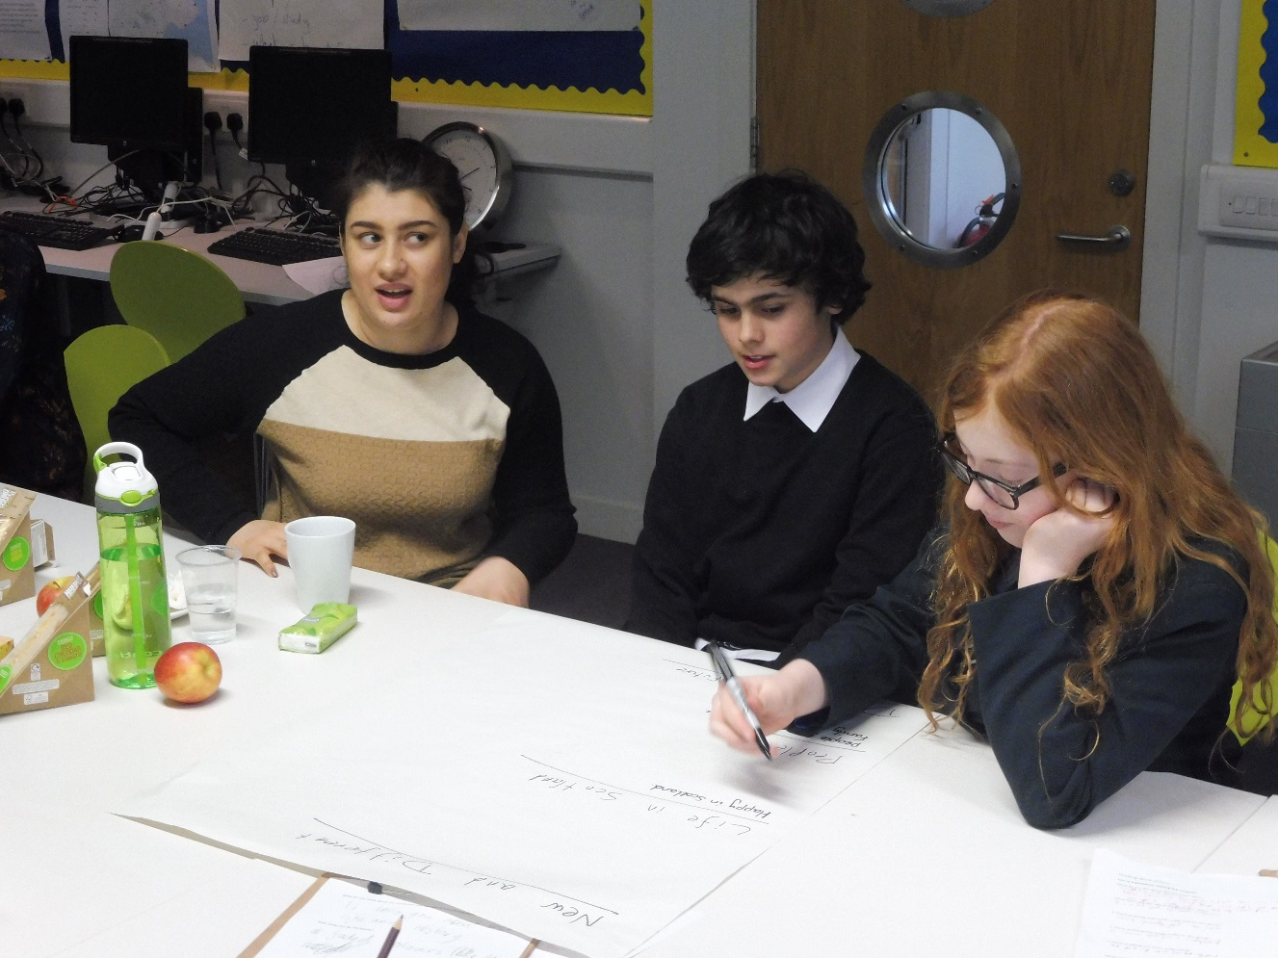
Challenges: Cultural expectations
Notes:
3. The cultural expectations of the participants was also very different to what I would have anticipated.
Not all were fully committed to coming to every session and some have different ideas surrounding punctuality; this made some of the work difficult.

Slide 40
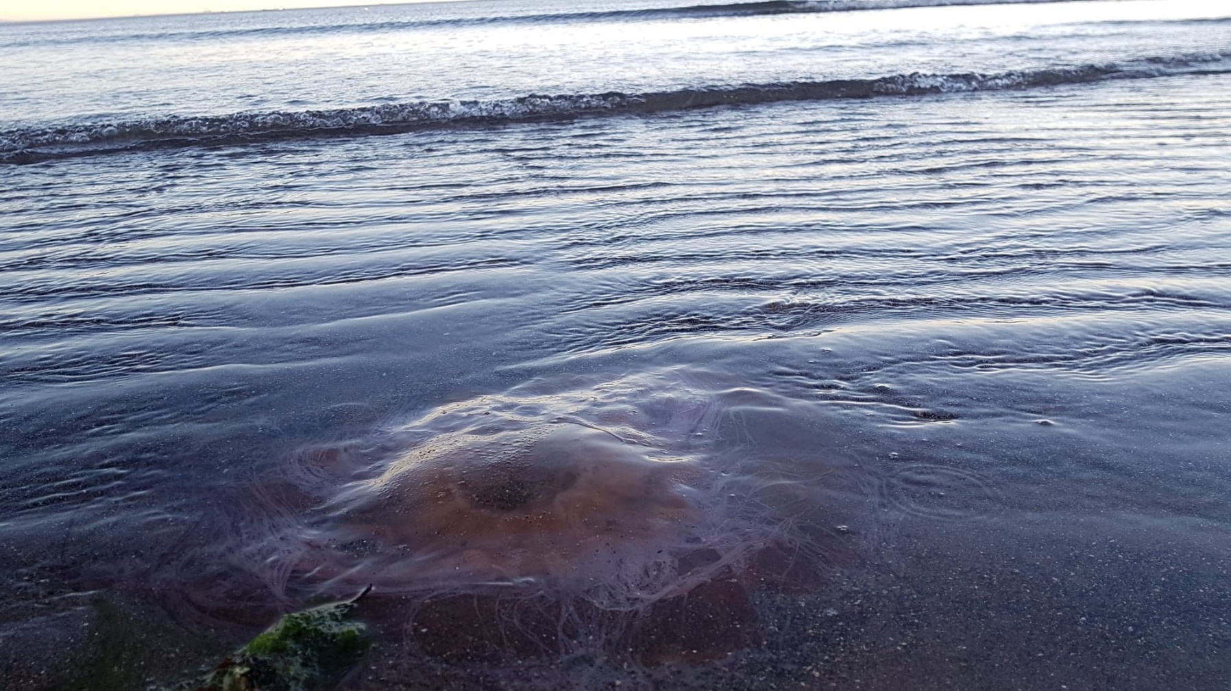
Challenges: Did perceptions really change?
Big Eye in the Sea
Feras
Notes:
4. We know that the school pupils changed their perceptions, though it’s too early for us to assess how long-term these changes are.
No idea whether visitors did or not. As mentioned, we know that it provoked them to think and that for some it brought home the difficulties migrants face, but did it change their attitudes?
Research method selected didn’t allow for this – didn’t want to intervene at the start of the exhibition, didn’t want to make anything seem too survey-like. Wanted all visitors to leave reflecting, not feeling interrogated.
Many of those who left cards reflecting on the experiences of migrants were those who were born overseas themselves. Not entirely the case, but perhaps indicative. Are those with negative views of migration likely to visit an exhibition giving the migrant perspective in the first place?

Slide 41

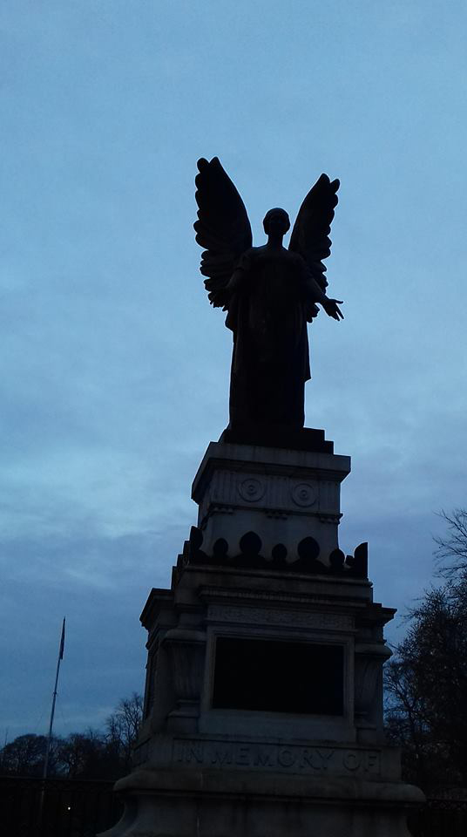
Challenges: Changing circumstances
Peace Symbol
Marwa
Fish Supper
Naila
Notes:
5. Intended to continue this, build the partnership with ESOL department and with the participants, plans well extended when circumstances changed.
Something happened not related to the project which ripped apart the relationships among the ESOL group, meant that many of them were either unable or unwilling to come back for a second year.
Migrants had previously been directed each year to Fife Council for ESOL, this unexpectedly changed and they now go to a different college, means we have to start the partnership from scratch. As a result, the project has unexpectedly ended, though we hope to pick it up again.
Changing circumstances also means that we’re not sure how easily we’ll be able to monitor the long-term impact of the project on the participants. Some participants have moved away, another has had to go into hiding, getting in touch with them since the end of the project has been difficult. Real barrier to researching the long-term impact.

Slide 42
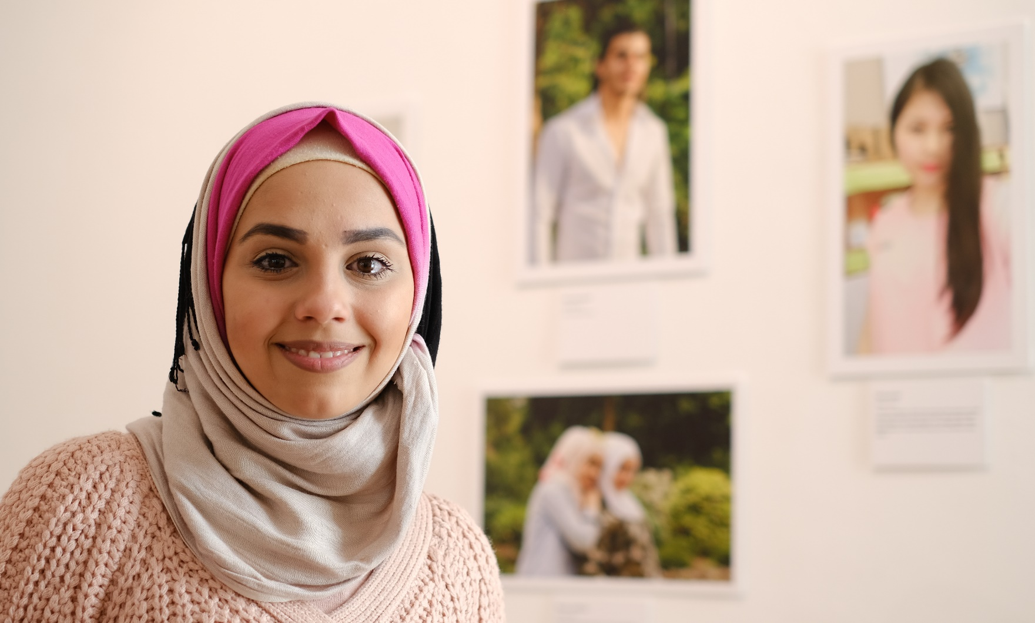
Challenges: Legal issues
Notes:
6. Legal issues, particularly around gaining consent, rights around the use of work, were extremely challenging, born out of:
working with those with limited English – not great for navigating legal documents
different cultural expectations – they didn’t see the need to do this, of course we could use their stories and photos. But for what?
Distrust of bureaucracy – negative associations for some of them.

Slide 43
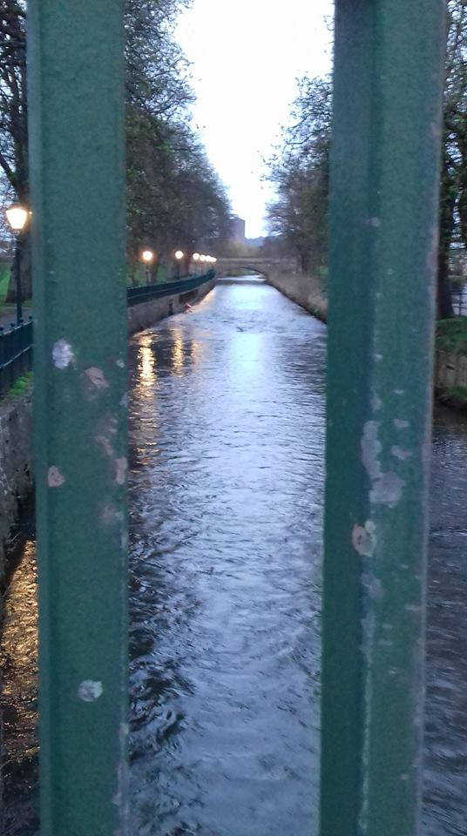
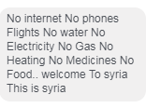
Challenges: Challenging conversations
Nature
Marwa
Notes:
7. Finally, one of the challenges I expected but wasn't able to sufficiently prepare for were the challenging conversations that resulted.
Out of the blue one day, one of the participants from Syria showed me a video of her home city being bombed, children running through the streets screaming and covered in dust. There is no adequate response to this. I have no knowledge of what it is like to have your home bombed, there are no words that can adequately express the compassion, understanding or any other sentiment that is required and no amount of training could have given me that. It wasn't the only time that I felt helpless in what to say.
We communicated a lot outside of the sessions using facebook messenger to discuss photography topics.
One day I asked one of the participants the biggest difference between Scotland and Syria.
She wrote "No internet. No phones. Flights. No water. No electricity. No Gas. No Heating. No Medicines. No food… Welcome to Syria. This is Syria."
How do you respond to that? I felt in part stupid at my own naive question, concerned that she was angry with me or that I had upset her. It's hard to tell when it's in writing and not face to face. This was a huge learning curve.
The challenge wasn't just one that I encountered. Two of the pupils were discussing a label they were writing with Marwa for one of her photographs.
The picture showed a river with greenery around it and Marwa said that she liked nature that had been unspoilt, then discussed how there was no nature in Syria because of the war.
She became emotional and wanted to move on. The pupils found this very difficult.

Slide 44
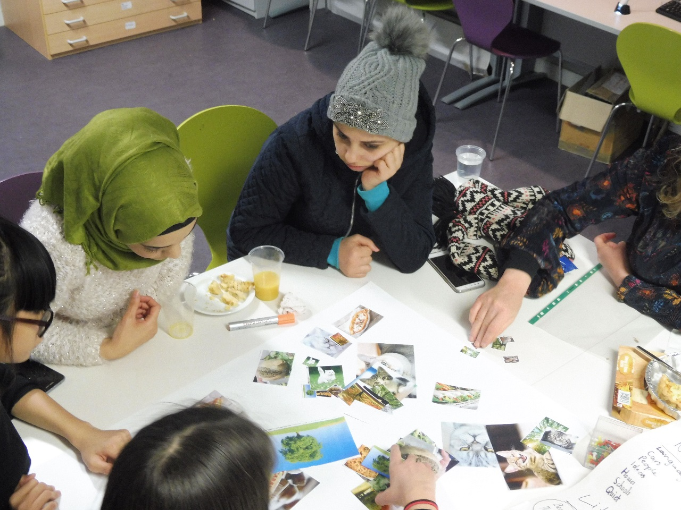
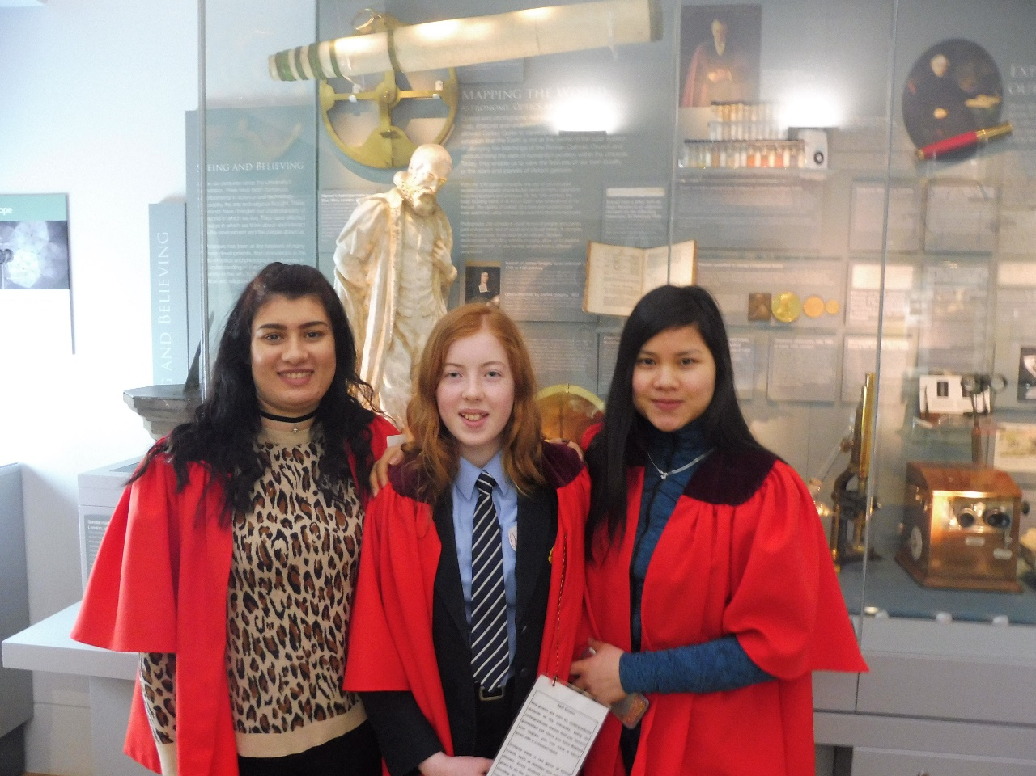
Visitor studies helping us impact lives?
Notes:
This was a pilot project. I knew at the start of it that some things wouldn't work as planned and I hoped that some things would.
Importantly, we needed to learn from it. Could museums pull something like this off? If they can, would it have any positive and lasting effect? If they can, how could they do it? And if they can, what role can audience research play?
We've discovered that museums can do this and that data can certainly help. A lot of the aspects of the project where we were successful were the areas developed off the back of data telling us what would be useful. Without that research we wouldn’t have taken the same approach; we probably wouldn’t have focussed so much on relationship building, or on sharing stories.
But data didn’t tell us everything – it didn’t tells how we should do this; that was based on our specialisms as museum professionals, which allowed us to learn that museums are really well placed for doing something like this.
It also didn’t forewarn us of the challenges we’d face. In many areas we were feeling our way forward, learning from our sometimes quite big mistakes.
There are legitimate criticisms that can be made of the project; it’s very difficult to tell what the effect is on the public because of the deliberate choices we’ve made around how we carry out visitor studies in the exhibition; you might argue that the school pupils were self-selecting and so already positively inclined towards migrants, so perhaps not having as big an effect on them as we might have had.
Has Encountering Fife impacted lives? In a small way, but we will have to wait to find out exactly how much.

Slide 45
Ten top tips
The problems in your community aren’t always difficult to spot
Use data to confirm those problems and clarify exactly what they are
Use data to identify solutions
Collaborate – but pick your partners carefully
Play to your strengths
Be laid back and flexible
Be bold but don’t bite off more than you can chew
Be prepared to get things wrong
Evaluate, learn and revise but…
Be prepared to sacrifice evaluation if it might impact on what you’re trying to achieve
Bonus tip: Be prepared to be personally challenged
Notes:
A few tips for doing this kind of project.
Number 4 in particular. The ESOL tutor we worked with was absolutely key to the project’s successes, would have been disastrous without her. In contrast, the photographer we used to deliver a photography workshop gave a session with a lot of talking, difficult concepts and complicated words, not ideal for an ESOL group. This was in spite of in depth preparation that we’d done with her.
Number 8 – If we weren’t prepared to get things wrong we would never have carried out this project, we knew for certain that we’d make mistakes.

Slide 46
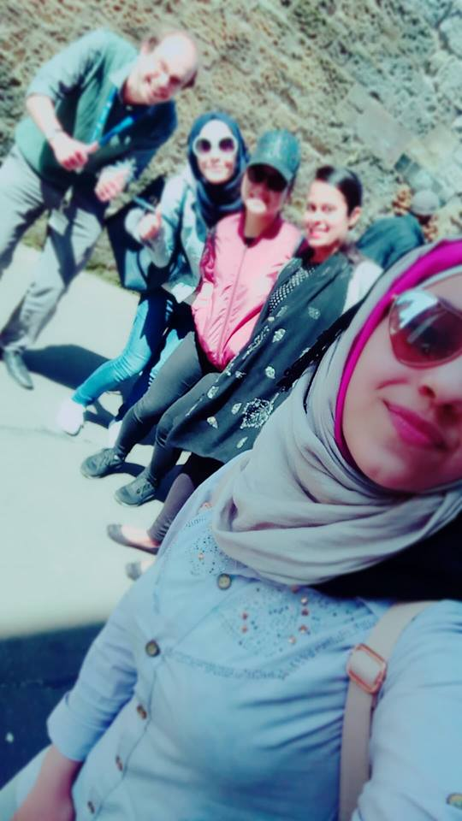
“That’s a beautiful picture. It was a really good day.”
Rayan, migrant participant, talking about a photograph she took of participants in the project
Friends
Rayan
Notes:
Of all the projects that I've ever worked on, this is the one about which I've been the most nervous.
I didn't know if it would work, I didn't want to let anyone down.
It's also been the project that has brought me the most joy.
Getting to know the participants has been a genuine pleasure, seeing their development, their enjoyment, their desire to do well, their pride in their work has been fantastic. Seeing some of them encounter a zoology museum and stuffed animals for the first time, responding with a child-like mixture of fear and wonder, brought laughter from my lips. I will be genuinely sad to say goodbye to the participants and see the project, for now at least, come to an end.
It’s also changed my outlook on life. The participants have difficult lives here, and yet they’re happy. One of the Syrians told me that he gets shouted at in the street to go home and that his door was kicked down, but he’s grateful to be here because we have peace. That makes you think.
So…
Can you use large-scale research to impact lives in a museum environment? Yes, you can. But be prepared to learn and be challenged along the way.

Slide 47

To discuss…
How have you used data to respond to trends and changes in society?
How successful have you been in applying data within your organisations to help affect change?
How important is it for the cultural sector to respond to wider societal trends and changes?
mjs42@st-andrews.ac.uk
@musa_standrews
www.st-andrews.ac.uk/museum
Encountering Fife: Photographs of Migrant Experiences in Scotland
at Dunfermline Carnegie Library & Galleries until 14th April
Notes:
Five minutes to discuss with those around you.

