Slide 1




Good enough?
March 2017
Notes:
Mandy Barnet and Ruth Melville - Socialreturn on investment
SROI combines narrative with numbers tocreate a value for money ratio of return oninvestment. At its heart is the principle that weare guided by the participants themselves inmeasuring what really matters, measure theknock-on effect of services, beyond the obviousbeneficiaries and into the future.
Mandy Barnett, MBA FRSA, MB Associates.Management consultant and member of theSocial Value UK council. Ruth Melville is a freelance researcher actingas Critical Friend to Transported
Themes
Relationship of empowerement and rigour
Relationship of values/principles with
Mandy Barnett
Management consultant
3 case studies

Slide 2
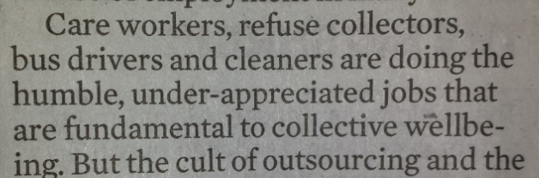
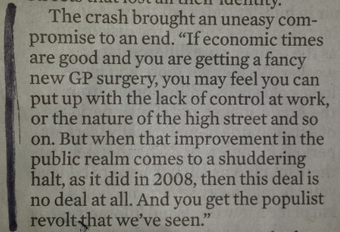
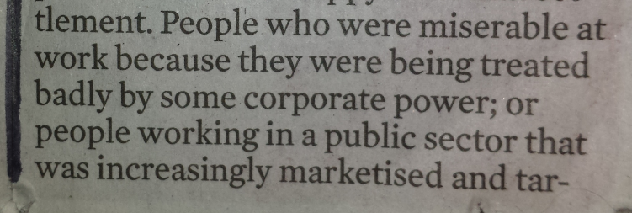
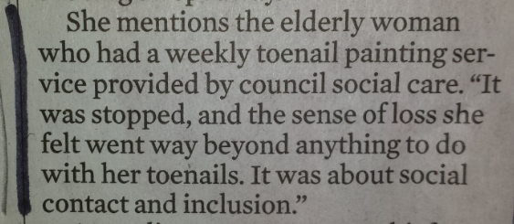
The dark art of Social Value is just a matter of talking about society around us
Notes ‘the crash’ wants to be on its own on the right
A party in crisis: Can Labour connect with its heartlands. Observer 12Feb17
Notes:
And making comparisons

Slide 3
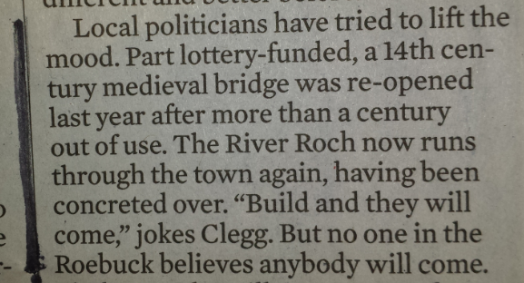
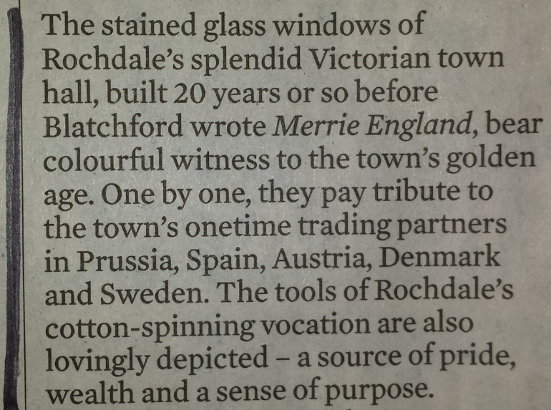
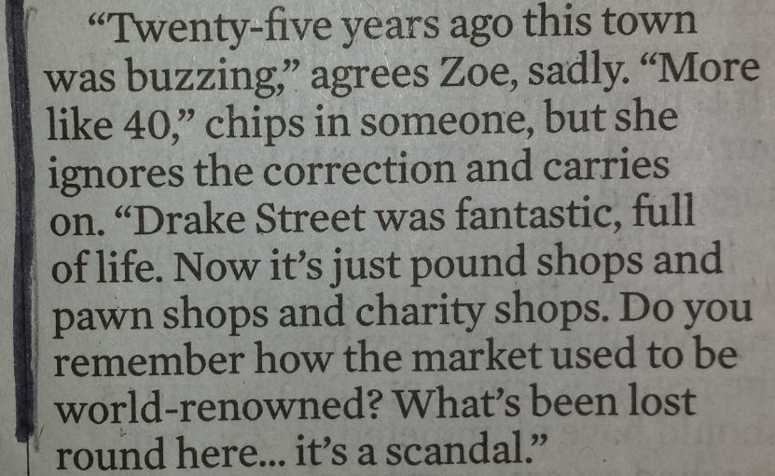
It can help us be more analytical about ‘culture’
Notes roughly this placement

Slide 4
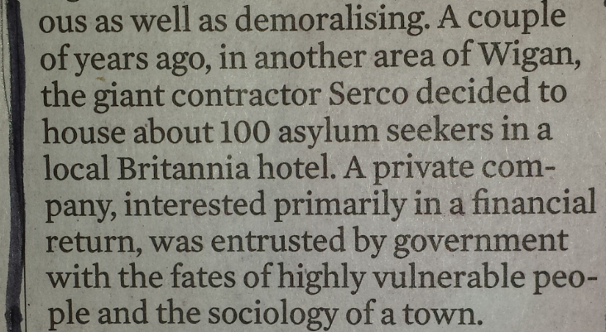
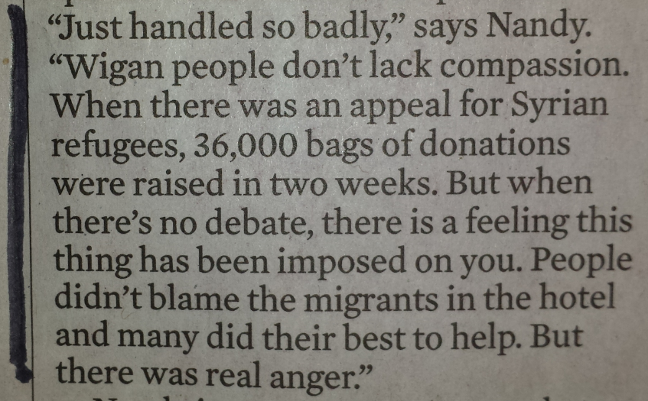
And as important, help with shared decisions

Slide 5
Social value work has to be good enough, robust enough and creative enough…
…but also good enough, proportionate and manageable
A party in crisis: Can Labour connect with its heartlands. Observer 12Feb17
Notes:
Make Culture Work

Slide 6
Mandy’s theory about evaluation – no-one feels good enough
Don’t let perfection get in the way of progress
Notes:
But often it is good enough
Bake Off ratings - THERE is a panel, administered by BARB, of around 4,000 UK households, each of which has a monitoring device - a "peoplemeter" - attached to the television set(s). The 13,000-odd individuals in these households are taken to represent the entire viewing population, although the importance (weight) of each panellist is varied so as to represent the general population as accurately as possible when grouped by socio-demographic criteria. You only have to watch a programme for one minute to be deemed a viewer, but if the programme is, say, 30 minutes long, then this single minute only counts for 1/30 of the programme. So the published "ratings" are actually an average for each of the minutes of the programme
GDP is based on turnover data from monthly surveys as well as other data sources. The data used are considered the most timely and robust over a short time horizon. Output can be measured in three (theoretically equivalent) ways: by adding up all the money spent each year, by adding up all the money earned each year, or by adding up all the value added each year. Some economies, including Britain, combine all three methods into a single GDP figure, whereas others, like America, produce different statistics for each. (American GDP is estimated via the spending approach; GDI, or gross domestic income, by the income approach.) Data are gathered from many small surveys. America’s Bureau of Economic Analysis draws data from surveys of manufacturers, builders and retailers, as well as from trade and financial flows, among other sources. These data are used to estimate the components of GDP, such as total investment and net exports. Owing to the demand for timely data, preliminary estimates are released and subsequently revised as more information is obtained.
Don’t let perfection get in the way of progress

Slide 7
But it’s all a trade-off
QALY debate is ongoing – not yet including wellbeing
BBC’s panel
of 4,000 households
Don’t let perfection get in the way of progress
GDP data from many small surveys, with estimates and revisions
Notes:
But often it is good enough
Bake Off ratings - THERE is a panel, administered by BARB, of around 4,000 UK households, each of which has a monitoring device - a "peoplemeter" - attached to the television set(s). The 13,000-odd individuals in these households are taken to represent the entire viewing population, although the importance (weight) of each panellist is varied so as to represent the general population as accurately as possible when grouped by socio-demographic criteria. You only have to watch a programme for one minute to be deemed a viewer, but if the programme is, say, 30 minutes long, then this single minute only counts for 1/30 of the programme. So the published "ratings" are actually an average for each of the minutes of the programme
GDP is based on turnover data from monthly surveys as well as other data sources. The data used are considered the most timely and robust over a short time horizon. Output can be measured in three (theoretically equivalent) ways: by adding up all the money spent each year, by adding up all the money earned each year, or by adding up all the value added each year. Some economies, including Britain, combine all three methods into a single GDP figure, whereas others, like America, produce different statistics for each. (American GDP is estimated via the spending approach; GDI, or gross domestic income, by the income approach.) Data are gathered from many small surveys. America’s Bureau of Economic Analysis draws data from surveys of manufacturers, builders and retailers, as well as from trade and financial flows, among other sources. These data are used to estimate the components of GDP, such as total investment and net exports. Owing to the demand for timely data, preliminary estimates are released and subsequently revised as more information is obtained.
Don’t let perfection get in the way of progress

Slide 8
Some examples from Happy Museum and other Social Value work
A party in crisis: Can Labour connect with its heartlands. Observer 12Feb17
Notes:
Make Culture Work

Slide 9
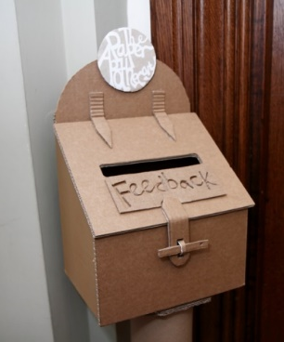
Embedded evaluation
Notes:
Mood Tree

Slide 10
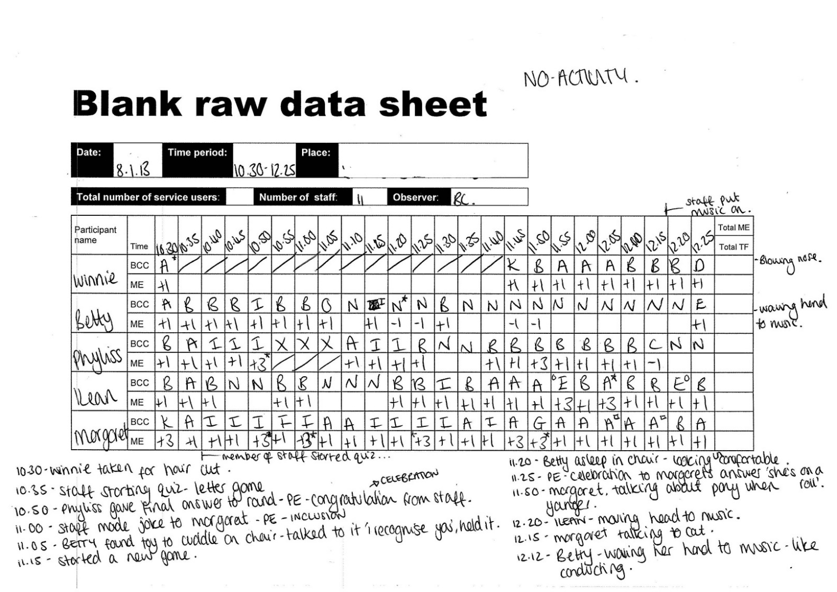
Observation at Suffolk Artlink
  Dementia Care Mapping measures levels of motivation and engagement

Slide 11
Even everyday care improved
 | Before |  | After
Everyday care: | 0% | +7% | 7%
Organised activity: | 18% | +16% | 34%

Slide 12
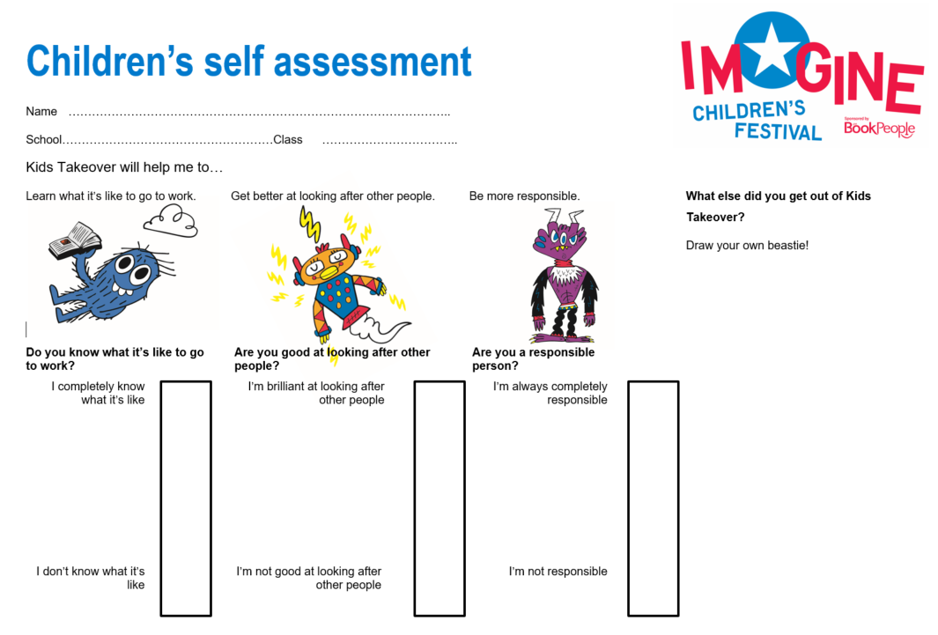


Slide 13

Key features
  Is about community and place as
  well as individuals
  Uses Asset Based Community Development (ABCD)
  Builds on action research, Five
  Ways to Wellbeing and ONS/
  national datasets
  Is about active citizenship,
  subjective wellbeing and feelings
  and functioning
Notes:
Surroundings, environment link
3 of 4 ONS questions on happiness, satisfaction and worthwhile – not anxious
ONS, Interested in new things/interaction = wemwbs, surroundings = understanding society, UKNEA
Three questions about short and long term feelings, and functioning (links to community as well)

Slide 14
Your own LIFE
All positive.
On the whole the ‘functioning’ outcomes saw
less change

Slide 15
Your own LIFE
Biggest change related to surroundings

Slide 16

655 young people worked with
From national figures, 210 to 130
likely to have mental health needs
– costs £4.5K
170 likely to be NEET – costs £3.2K
Break-even is 22 YP costing £7.7K saved,
Or 3% reduction across all YP
  Our rough estimates of value helped conceptualise the value
Notes:
CAMHS – PSSRU
NEET – ACEVO
Non SV evaluation is just not good enough
We think evaluators are afraid to have a go
But from a mgt perspective we think it all helps

Slide 17
For visitor services, the focus is on communities, at ‘population level’
A party in crisis: Can Labour connect with its heartlands. Observer 12Feb17
Notes:
Make Culture Work

Slide 18
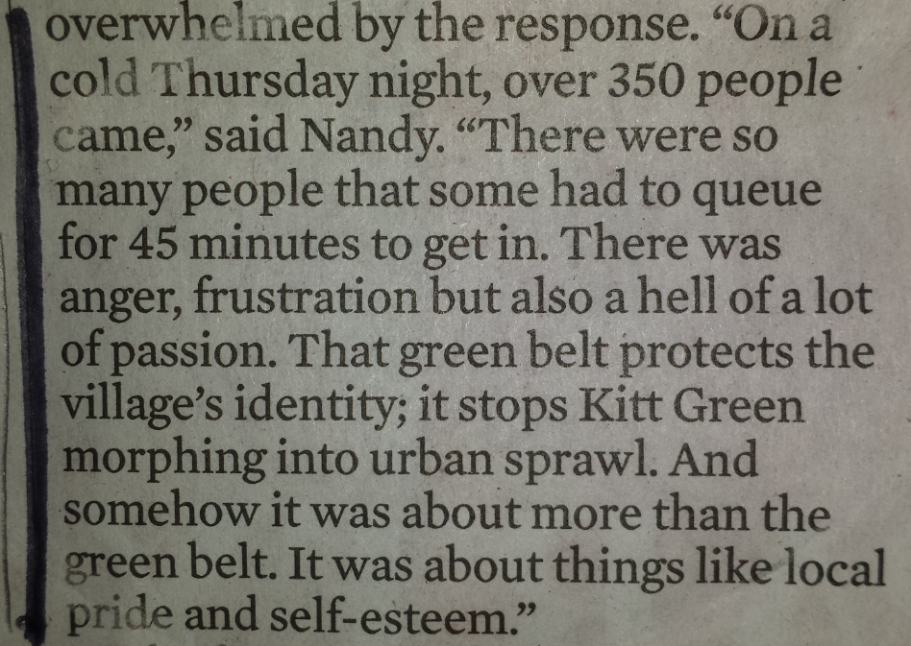
A Story of Change: Who, How, What, Why?
A party in crisis: Can Labour connect with its heartlands. Observer 12Feb17

Slide 19
Mandy@MBAssociates.org
MakeCultureWork.org.uk

