Slide 1
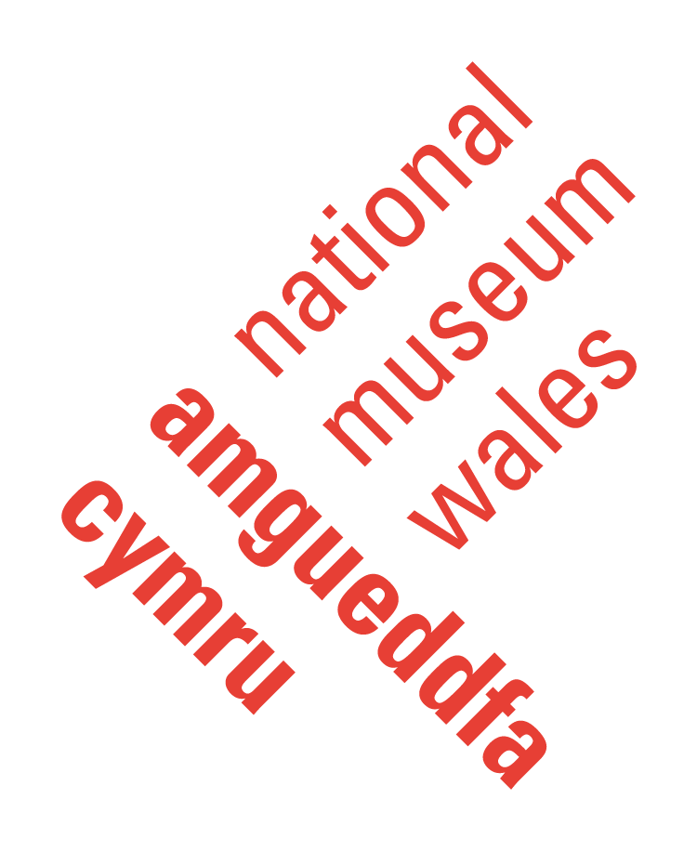
What is all this telling Us and are we doing it right?
Janice Lane
Cyfarwyddwr Datblygu Orielau a Phrofiad Ymwelwyr
/ Director of Gallery Development & Visitor Experience
Amgueddfa Cymru National Museum Wales
VSG March 2017
Notes:
.

Slide 2
The Sunday Question
The Public House The House for the Public

Slide 3
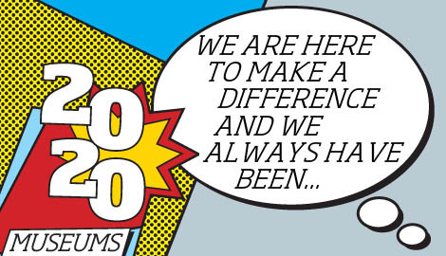


Slide 4
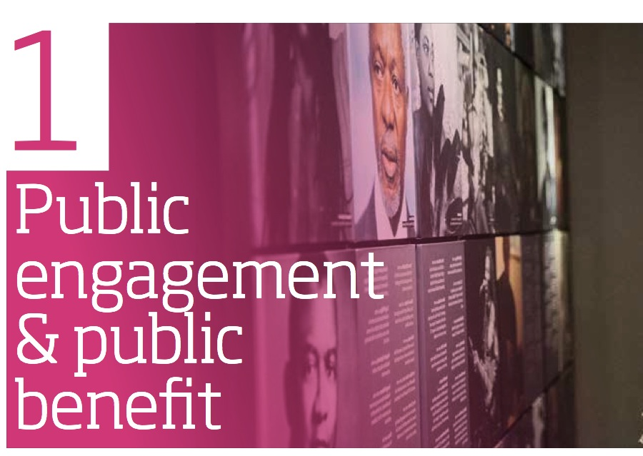
Museum Association Code of Ethics

Slide 5
Who is doing the measuring in our museums?
How many museums have dedicated visitor studies or participation research staff resources?

Slide 6
Amgueddfa Cymru : Challenges of evaluating work and measuring impact
No dedicated staff resource
Historically no evaluation strategy or consistency in approach or methodology
Limited budgets to extend our capacity and infrastructure
Lack of evaluation and research expertise and confidence in house
Significant growth in our participatory work
Diversifying funding base requires more robust evidence of impact
Notes:
.

Slide 7
What are we doing to improve how we measure impact?
Dedicated budget to do targeted evaluation on priority activities and audiences
Investing in building skills and capacity internally

Slide 8
What is all this telling us and are we doing it right?
1. Amgueddfa Cymru – National Museum Wales, our National policy context and political expectation
2. The challenges of developing impact evaluation for a national programme led by Welsh Government: Fusion: Creating Opportunities through culture
3. Our approach to developing an effective systematic evaluation framework for our museum programmes and services: the journey so far…

Slide 9
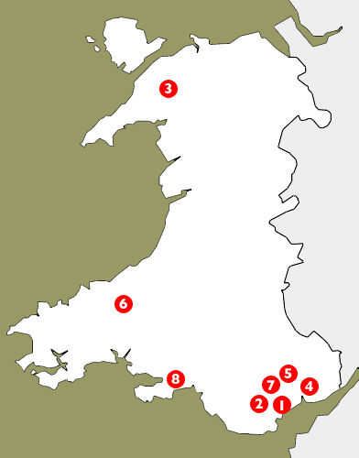
A remit across Wales
Amgueddfa Genedlaethol Caerdydd- National Museum Cardiff
Sain Ffagan – National Museum of History
Amgueddfa Lechi Cymru – National Slate Museum
Amgueddfa Lleng Rufeinig Cymru – National Roman Legion Museum
Pwll Mawr - Big Pit: National Coal Museum
Amgueddfa Wlân Cymru – National Wool Museum
National Collections Centre
Amgueddfa Genedlaethol y Glannau - National Waterfront Museum Swansea

Slide 10
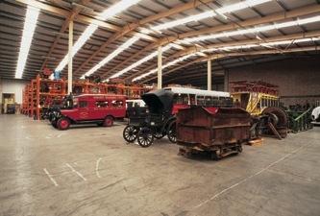
Amgueddfa Cymru-National Museum Wales
Amgueddfa Genedlaethol Caerdydd National Museum Cardiff
Big Pit Amgueddfa Lofaol Cymru
Big Pit National Coal Museum
Sain Ffagan Amgueddfa Werin Cymru
St Fagans National History Museum
Amgueddfa Wlân Cymru National Wool Museum
Amgueddfa Lleng Rufeinig Cymru National Roman Legion Museum
Amgueddfa Lechi Cymru National Slate Museum
Amgueddfa Genedlaethol y Glannau National Waterfront Museum
Canolfan Gasgliadau Genedlaethol
National Collection Centre

Slide 11
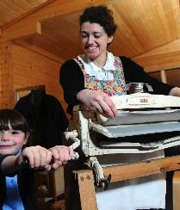
Amgueddfa Cymru National Museum Wales
1.69m visitors annually
Largest provider of bi-lingual learning outside the classroom in Wales
200,000 formal learners annually
250,000 informal learners annually
Over half a million of our visitors are families

Slide 12
Vision:
Amgueddfa Cymru: inspiring people, changing lives
Purpose:
Inspiring people though our museums and collections to find a sense of wellbeing and identity, to discover, enjoy and learn bi-lingually and to understand Wales’ place in the wider world
Notes:
.

Slide 13
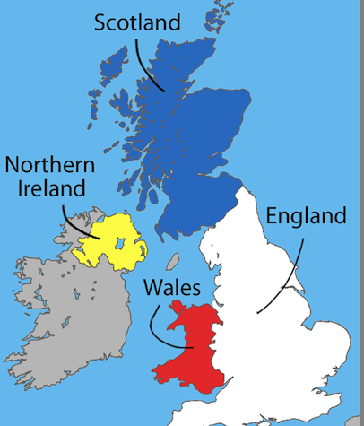
Wales is…
…Not England

Slide 14
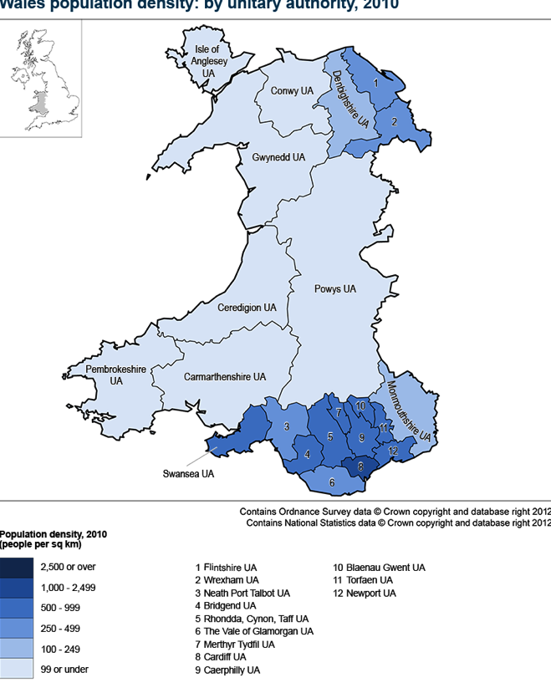
National Context
3 million population
Bi-lingual country
1 in 3 children living in poverty
Low educational attainment
Poor health and employability
Post industrial nation

Slide 15
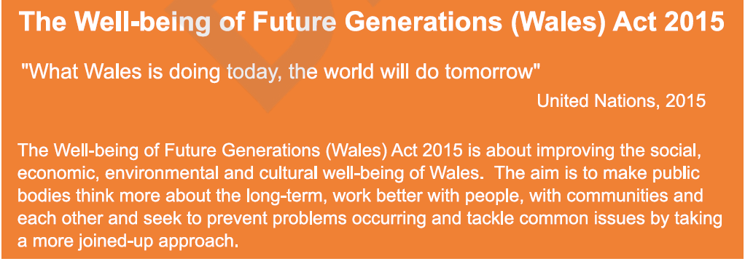
National Policy context

Slide 16
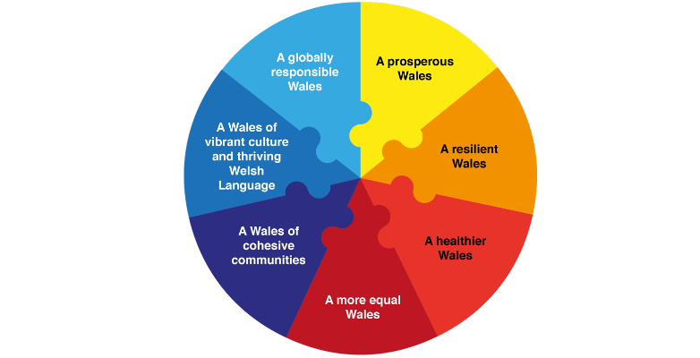
Well-Being Goals

Slide 17
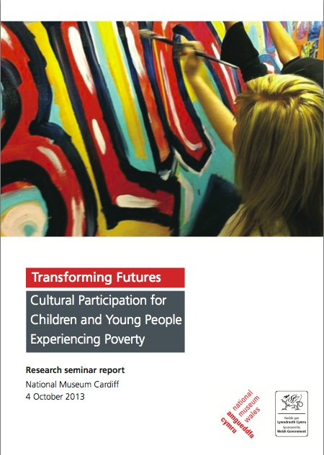
Transforming Futures
We took forward research into the value and role of cultural organisations in tackling the consequences of poverty and promoting inclusion and equality of access to cultural participation

Slide 18
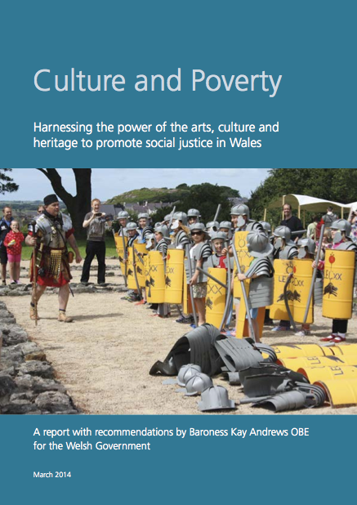
Museums Change Lives
The task was…” to explore with cultural and heritage bodies across Wales how they could contribute more effectively to reducing poverty and raising ambition. This was a conversation about the connection between access to culture and social justice.”

Slide 19
Fusion: Creating Opportunities through Culture – a national programme
Taking part in cultural activity can benefit many people through:
transforming their confidence and motivation
gaining the skills, experience and qualifications to help them find work
supporting learning for all ages
improving their physical and mental health and wellbeing.
Our Fusion programme is working to break down barriers and to encourage everyone to take part and enjoy these benefits.
The programme is contributing to many of the goals of the Well-being of Future Generations Act

Slide 20

Fusion – how it works
Wrexham Pioneer Area: Case Study from year 1
Local gallery delivered drawing courses for unemployed and socially isolated adults.
Participants formed their own group. They generate projects and coordinate and lead each session.
Cultural bodies support by offering trips and activities.
Outcome: an increase in self-confidence and motivation. Allowing group to apply and develop their skills beyond their usual familiar community surroundings.

Slide 21
The overarching aims and objectives of the evaluation framework
  The Process Evaluation:
  Analyse the effectiveness of the Pioneer Area programme’s processes, in terms of its design and delivery
  The Outcome Evaluation:
  To what extent has the programme increased participation by young people, adults and families living in Communities First areas in culture, arts and heritage activities, in ways that help them gain in learning, skills, confidence and wellbeing?

Slide 22
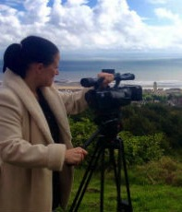
Year 1 findings and challenges
The Swansea Pioneer Area
is led by the local authority, in partnership with the National Waterfront Museum.
It brought together over 50 partner organisations from across the city including local authority and independent cultural providers.

Slide 23
Year 2 Evaluation objectives
1. Improve the monitoring and reporting information of Fusion Partnerships
2. Obtain the views of stakeholders participating in Fusion Partnerships, to assess the impact of the programme on their organisation
3. Obtain more detailed views from a small sample of cultural stakeholders

Slide 24
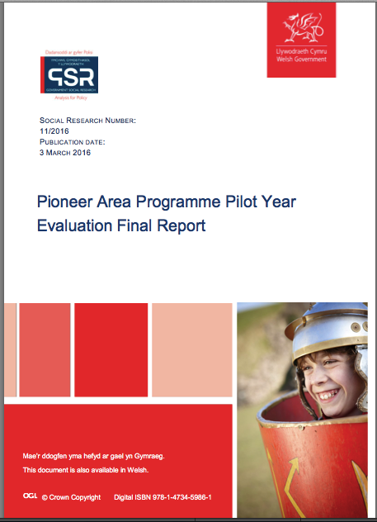
Evaluation report
http://gov.wales/statistics-and-research/evaluation-pioneer-areas-pilot-year/?lang=en

Slide 25
Ardal Ymchwil Research Areas
Ymchwil Ymwelwyr Visitor Research
Ymchwil Addysg a Learning & Participation
Chyfranogiad Research
Ymchwil Orielau Gallery Research

Slide 26
Gwerthuso neu Ymchwil
Evaluation v Research
The purpose of evaluation is to improve, not prove.
Stufflebeam
The distinction between research and evaluation is arbitrary. One can make the case that the two are the same and different. The purpose of making such distinctions, then, must guide the distinctions made.
Michael Quinn Patton

Slide 27
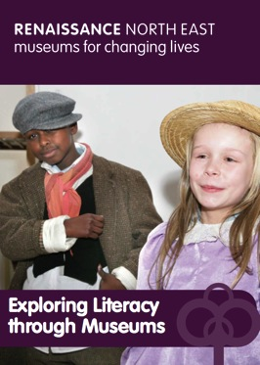
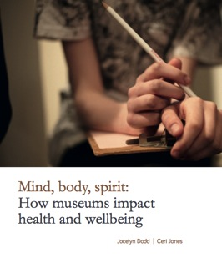
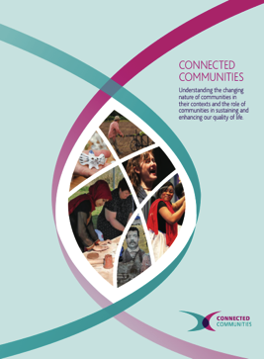
Cultural Learning
Health & Well being
Cultural Participation
Social/economic Impact
Sectoral Change

Slide 28
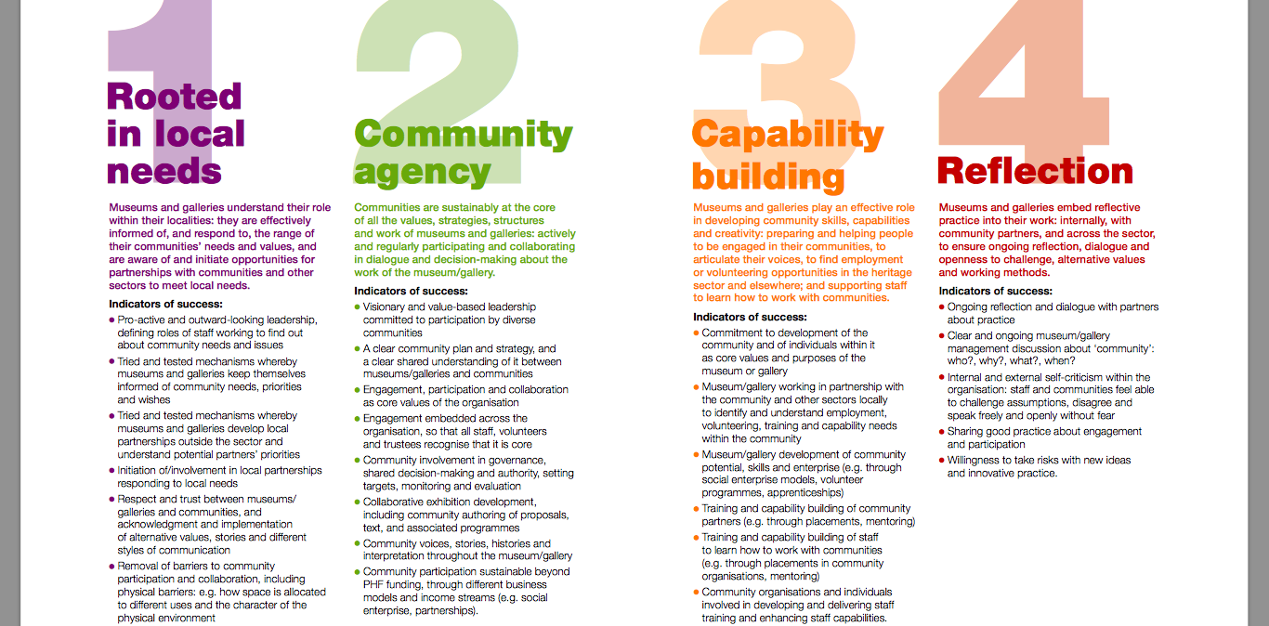
Our Museum Outcomes

Slide 29
Our Museum Evaluation Evidence
Type 1
Known and easily shared evidence
Written and statistical evidence
Type 2
Known but not shared or written
Evidence gathered through questionnaire and face-to-face sessions
Type 3
Emergent evidence
Observation and reflective
Type 4
Unknown discoveries
Captured through journals, blogs and social media

Slide 30
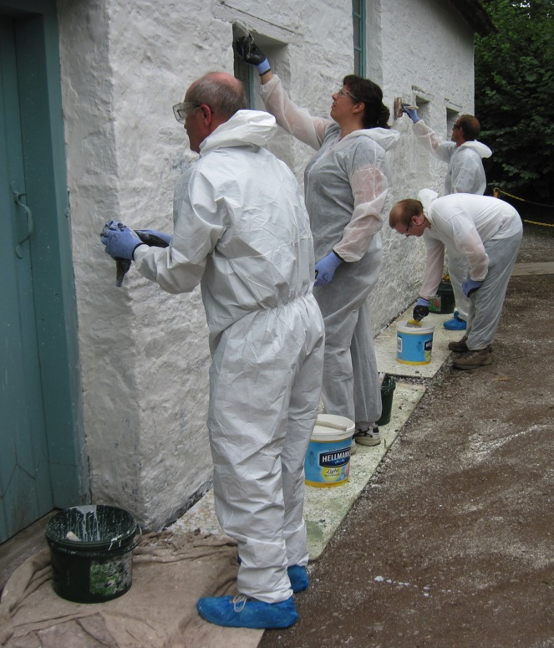
Adaptive Evaluation; Volunteers
Quantitative data gathered includes volunteer numbers, hours, monitoring information and activities.
Qualitative data gathered includes collating volunteers’ opinions through forums, yearly surveys and creative methods such as postcards, videos and drawings (some of our volunteers are unable to read and write).

Slide 31






Motivations for visiting
NMW’s Visit Occasion Segments (%)
TOPIC INTEREST - Visiting because they have a particular interest in the subject at the museum
Overall
Day trippers
‘Tourists’
CHILDREN - Visiting so that children can learn from or be entertained by the experience
Topic Interest
TICK BOX - Visiting because the museum is a must-visit venue
Children
Tick Box
SOCIAL - Visiting to unwind and relax, escape from the daily grind
Social
Special Focus
SPECIAL FOCUS - Visiting to see an exhibition or event
Broaden Horizons
BROADEN HORIZONS – To learn something new and/or to understand how people felt in the past
Source: Q5b
Base: 2012 data. All respondents n=1740; day trippers n=1109; tourists n=623

Slide 32
Why Evaluate Course
To build a better understanding of your visiting publics, (e.g. needs, interests, motivations, language).
To inform your plans and to predict which engagement or learning methods and content will be most effective.
To know whether you have achieved your objectives (and why or why not).
To re-design your approach to be even more effective in future.

Slide 34





“No museum...must come to a standstill.”
Iorwerth C Peate, 1948
Diolch
Thank you

