Slide 1
Accessibility: The Inclusive Museum
No one survives without community and no community thrives without the individual.

Slide 2
Access to culture, science and museums still remains the preserve of the society’s most advantaged groups.
Manchester Museum and the Whitworth Art Gallery are devoted to promoting equality and diversity, access and accessibility and making our collections work harder for us.
Social responsibility describes the way we are making a difference to the social and economic well-being of our communities through our teaching, research and public events and activities.

Slide 3
Things to consider….
Visitors
Community
The welcome
Roles & responsibilities within partnerships?
Training/raising awareness
Programming
Exhibitions
Communication/Marketing
The building
Volunteers

Slide 4
Visitor Diversity in the Inclusive Museum
Community of Users – who might these be?
Visitors of today are recognisably more diverse
Health & Culture programme has a strong focus on:
Hospital community – staff, patients & visitors
People with dementia and their carers
Stroke survivors
Mental health issues
Students and professionals from the health and social care sector

Slide 5
Culture Shots – a week long series of free events, bringing art and culture into the hospital environment.

Slide 6
Good health stems from much more than just a healthy body. Cultural experiences can enable individuals to express their individuality, connect with others and even develop emotional resilience

Slide 7
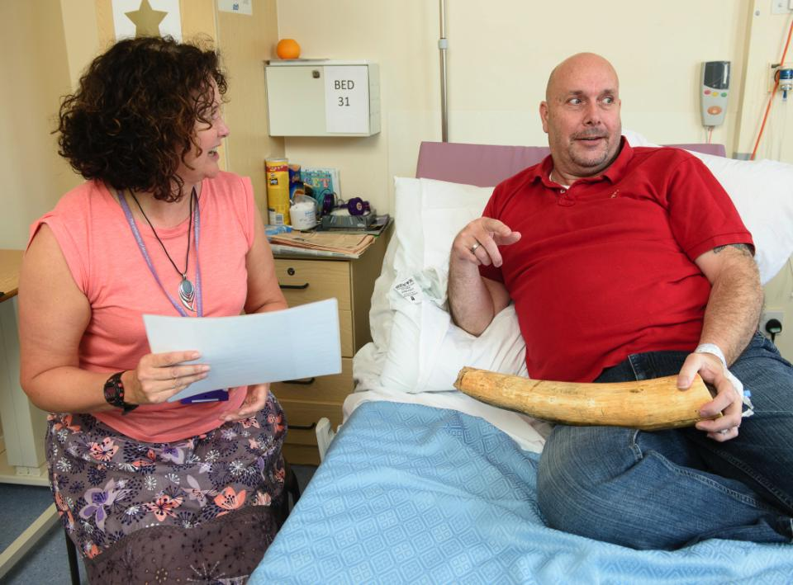
DESIGN YOUR MONTESSORI ACTIVITY

Slide 8
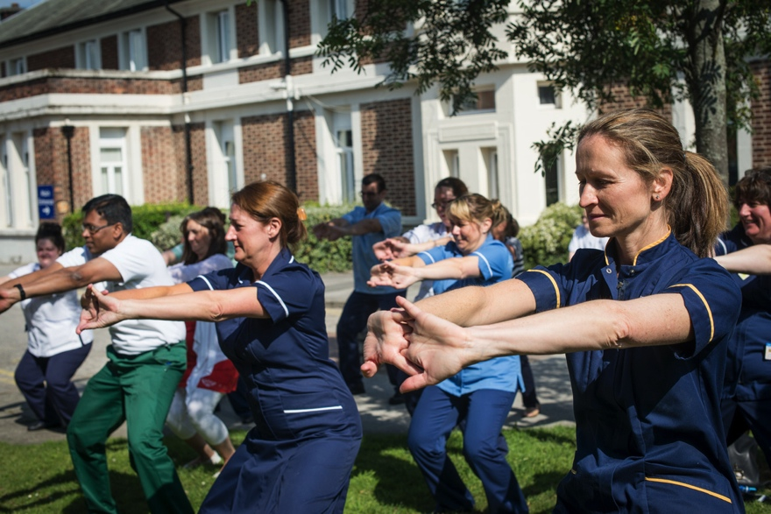
Things to consider….
Visitors
Community
The welcome
Roles & responsibilities within partnerships?
Training/raising awareness
Programming
Exhibitions
Communication/Marketing
The building
Volunteers

Slide 9
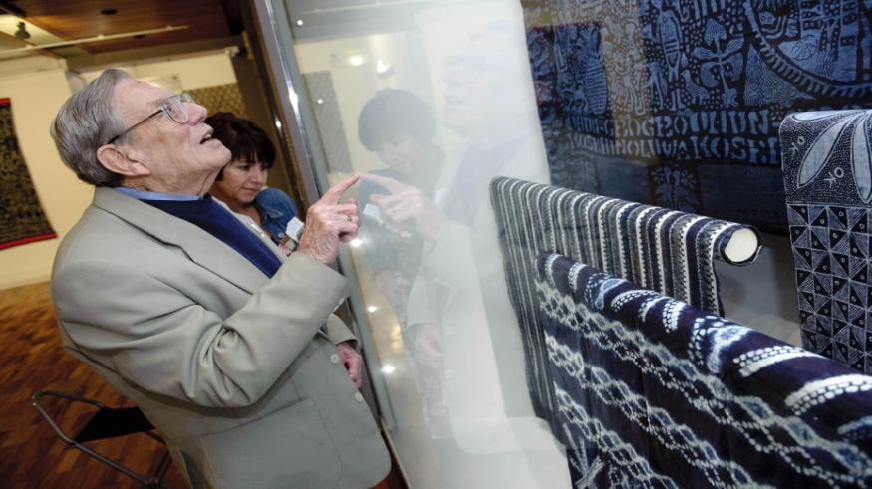
Coffee, Cake & Culture

Slide 10
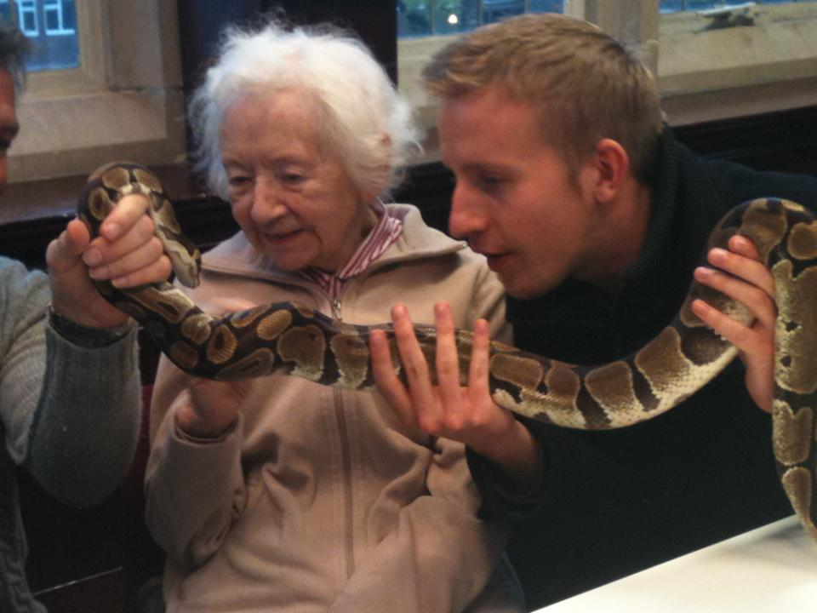
Things to consider….
Visitors
Community
The welcome
Roles & responsibilities within partnerships?
Training/raising awareness
Programming
Exhibitions
Communication/Marketing
The building
Volunteers

Slide 11
Art groups for stroke survivors and their carers

Slide 12
Who cares? If you only see the illness you miss the person

Slide 13
Things to consider….
Visitors
Community
The welcome
Roles & responsibilities within partnerships?
Training/raising awareness
Programming
Exhibitions
Communication/Marketing
The building
Volunteers

Slide 14
ArtMED – a programme of workshops and courses that engage with themes of interest for people working and/or studying in health and social care. Art MED uses different art forms to provide a non clinical approach toward medicine and healthcare.

